Slide 2
What is Shareholder Value?
“Is it any wonder we have seen the recent stock market bubble burst when it was originally inflated by management who believed that share price was driven by growing earnings per share?
How wrong could they be?
The real value is the economic value, which is the net present value of future cash flows discounted at the weighted average cost of capital”.
Ken Lever, Finance Director, Tomkins.

Slide 3
How do shareholders get returns?
Dividends
Share price growth
Notes:
__________________________________________________________________________________________________________________________________________________________________________________________________________________________________________________________________________________________________________________________________________________________________________________________________________________________________________________________________________________________________________________________________________________________________________________________________________________________________________________________________________________________________________________________________________________________________________________________________________________________________________________________________________________________________________________

Slide 4
The problem with profit as a measure of value performance
Historic focus rather than future focus
Tenuous link to cash flow
Accounting policy differences can distort underlying performance
Positive profits are achieved with no adequate risk hurdle

Slide 5
Total Shareholder Returns (TSR)
Total
Shareholder
Return %
Dividends + Change in Share Price
Initial Share Price
=
‘The ultimate measure of value performance for shareholders’
Notes:
__________________________________________________________________________________________________________________________________________________________________________________________________________________________________________________________________________________________________________________________________________________________________________________________________________________________________________________________________________________________________________________________________________________________________________________________________________________________________________________________________________________________________________________________________________________________________________________________________________________________________________________________________________________________________________________

Slide 6
Next plc TSR February 2005 – January 2006
44p
1592p
1733p
Value will only be have created if ‘relative’ improvement is achieved

Slide 7
Value v performance
In principle, we should measure value creation performance via the change in the value of a business over a period plus the value of dividends.
For example, a business is valued at £100m at the start of the year, pays a dividend of £5m, is valued at £120m at the end of the year and has a cost of capital of 10%. How much value has the business created in the year?
Notes:
__________________________________________________________________________________________________________________________________________________________________________________________________________________________________________________________________________________________________________________________________________________________________________________________________________________________________________________________________________________________________________________________________________________________________________________________________________________________________________________________________________________________________________________________________________________________________________________________________________________________________________________________________________________________________________________

Slide 8
Economic profit
150
50
100
150
40
50
100
60
0
Tax
Charge
Profit less
Capital
Economic
Operating
Operating
Profit
Profit
Net
Adjusted Tax
Notes:
__________________________________________________________________________________________________________________________________________________________________________________________________________________________________________________________________________________________________________________________________________________________________________________________________________________________________________________________________________________________________________________________________________________________________________________________________________________________________________________________________________________________________________________________________________________________________________________________________________________________________________________________________________________________________________________

Slide 9
Economic profit illustration: Royal Mail Holdings plc year ending March 2014
Source: Shareholder Executive Annual Report 2014/5
Notes:
__________________________________________________________________________________________________________________________________________________________________________________________________________________________________________________________________________________________________________________________________________________________________________________________________________________________________________________________________________________________________________________________________________________________________________________________________________________________________________________________________________________________________________________________________________________________________________________________________________________________________________________________________________________________________________________

Slide 10
Economic profit – the interpretation
Although successful from an accounting profit perspective, the cost of using investors’ funds is ignored by just focusing on operating profit
Once the full cost of investors’ funds is included (the capital charge) then we have a true indication of the underlying economic profit of an entity

Slide 11
Economic profit – the inputs
Operating profit – excluding gains and losses arising from non-operating assets
Capital charge, being:
Invested capital – being equity plus net debt, multiplied by…
Cost of capital – calculated using quoted comparables from relevant sectors

Slide 12
Economic profit insights – lessons from Diageo
Scotch Whisky
Revenues | £100m
Costs | £50m
Invested capital | £400m
Cost of capital | 10%
Vodka
Revenues | £90m
Costs | £60m
Invested capital | £100m
Cost of capital | 10%

Slide 13
Economic profit insights – lessons from Diageo
Scotch Whisky
Operating profit
Margin
Economic profit
Vodka
Operating profit
Margin
Economic profit
As a result of analysis like this, the business switched funds from lower value-added brands (whisky) to the higher ones (vodka) and diverted advertising expenditure accordingly

Slide 14



ECONOMIC PROFIT – THE “PROOF”?
.

Slide 15
Cascading the measures
The ultimate objective
The stock market measure used at corporate level
The internal short-term performance measure
Generic financial value drivers
Operational measures
Maximise shareholder value
Total Shareholder Returns (TSR)
Economic profit
Growth, margins, efficiency, cost of capital
Financial and non-financial kpi’s

Slide 16
Agenda
The changing role of finance – the need to ‘add value’
Measuring value performance
Adding value with forecasting
Adding value with ‘Beyond Budgeting’
Adding value with the Balanced Scorecard

Slide 17
Principles of Value-Based Forecasting
Proposition : a robust financial forecast should be based on the economic reality that the business operates within and should be driven from the fundamental value drivers
These fundamental value drivers are:
Return on Invested Capital (ROIC)
Weighted Average Cost of Capital (WACC)
Growth
Free Cash Flow (FCF)

Slide 18
Linking the value drivers
Bad growth destroys value
Growth in capital invested
Good growth creates value
ROIC – WACC spread
Missed opportunities sacrifice value
Divestment can create value

Slide 19
A general model of value creation
Strategy
Competition
Projected ROIC
Peak ROIC
WACC
Sustainability
Time

Slide 20
The key questions to consider when forecasting
Can the company charge a price premium for its products or services?
Does the company have lower unit costs than its competition?
Can the company sell more products or services per pound of capital invested?
How intense is the competition? (increases ROIC decay)
How likely is it that the strategy will continue to sustain competitive advantage? (decreases ROIC decay)

Slide 21
The analysis of historical performance
Reorganise the financial statements to reflect economic instead of accounting performance. Create new numbers such as Net Operating Profit Less Adjusted Tax (NOPLAT), Invested Capital and Free Cash Flow (FCF)
Measure and analyse the company’s ROIC to obtain a value-based understanding of margin management and capital efficiency
Break down revenue growth into its four components: organic, currency effects, acquisitions, accounting changes

Slide 22
Reorganising the financial statements - definitions
NOPLAT = the total after tax operating income available to all financial investors
Invested capital = the operating assets of the business minus the operating liabilities
ROIC and FCF both rely on NOPLAT and Invested Capital

Slide 23
Reorganising the financial statements – invested capital example
Accountants approach |  |  |  | Invested Capital
 | Prior Year | Current year |  |  | Current Year
Assets
Inventory | 200 | 225 |  | Inventory | 225
Net PP&E | 300 | 350 |  | Accounts payable | (150)
Equity investments | 15 | 25 |  | Operating working capital | 75
Total assets | 515 | 600
 |  |  |  | Net PP&E | 350
Liabilities and equity
Accounts payable | 125 | 150 |  | Invested capital | 425
Interest bearing debt | 225 | 200
Share capital | 50 | 50 |  | Non-operating assets | 25
Retained earnings | 115 | 200
Total liabilities and equity | 515 | 600 |  | Total funds invested | 450
 |  |  |  | Sources of funds invested
 |  |  |  | Interest bearing debt | 200
 |  |  |  | Share capital | 50
 |  |  |  | Retained earnings | 200
 |  |  |  |  | 450

Slide 24
Reorganising the financial statements – NOPLAT example
Accountants approach |  |  | NOPLAT
Revenues | 1,000 |  | Revenues | 1,000
Operating Costs | (850) |  | Operating costs | (850)
Depreciation | (50) |  | Depreciation | (50)
Operating profit | 100 |  | Operating profit | 100
Non-operating income | 12 |  | Operating taxes | (25)
Interest | (20)
Profit before tax | 92 |  | NOPLAT | 75
Taxes (25%) | (23) |  | After tax non-operating income | 9
Net income | 69 |  | Total income to investors | 84
 |  |  | Reconciliation to net income
 |  |  | Net income | 69
 |  |  | After-tax interest | 15
 |  |  |  | 84

Slide 25
ROIC analysis
Good profit performance
Efficient use of capital
Lower taxes
Poor profit performance
Inefficient use of capital
Higher taxes

Slide 26
Decomposing ROIC into its constituent parts
The equation above demonstrates that a company’s ROIC is driven by its ability to maximise profitability (operating margin), optimise capital efficiency (capital turn), or minimise taxes

Slide 27
Decomposing ROIC via Dupont analysis
ROIC
Pre-tax
ROIC
Cash tax
rate
Operating
margin
Asset turn
Gross margin
Operating working
capital / revenues
SG & A / revenues
Fixed assets / revenues
Depreciation / revenues

Slide 28
Analysing revenue growth
We have established that a value-based forecast focuses on ROIC, WACC and growth
Long-term revenue growth can be converted to long-term cash flow growth via an analysis of the decomposition of ROIC
A historical analysis of revenue growth will allow an assessment of the potential for growth going forward

Slide 29
Analysing revenue growth
Total revenue growth year-on-year | x
Adjust for : acquisition / divestment effects | (x)/x
Adjust for : currency effects | (x)/x
Adjust for : accounting changes | (x)/x
Organic revenue growth | X

Slide 30
The analysis of historical performance
Reorganise the financial statements to reflect economic instead of accounting performance. Create new numbers such as Net Operating Profit Less Adjusted Tax (NOPLAT), Invested Capital and Free Cash Flow (FCF)
Measure and analyse the company’s ROIC to obtain a value-based understanding of margin management and capital efficiency
Break down revenue growth into its four components: organic, currency effects, acquisitions, accounting changes
This analysis now provides the basis for a robust future forecast consistent with value perspectives

Slide 31
Budgeting

Slide 32
Business leaders and academics views on budgets and budgeting
‘Budgeting is the bane of corporate America’
Jack Welch, ex-CEO, General Electric
‘The process of management is not about administering fixed budgets, it is about the dynamic allocation of resources’
Lord Browne, ex-CEO, BP
‘Uncertainty…has become so great as to render futile, if not counterproductive, the kind of planning most companies still practice; forecasting based on probabilities’
Peter Drucker

Slide 33
Budgeting approaches – all defunct ?
Incremental
The budget for each period is determined with reference to what was spent last period plus an allowance for anticipated inflation
Zero-based
The budget requires each cost element to be specifically justified, as if the activity were being undertaken for the first time
Activity-based budgeting
The budget is determined by identifying a series of cost-drivers and budgeting cost lines with respect to these drivers

Slide 34
The Traditional model
Vision
Strategy
Plan & Budget
‘Keeping on track’
Control
Notes:
The budget as a management tool is a modern creation. Devised in the 1920s as a means of tracking costs and cash flows in large companies, it was co-opted in the 1960s and 1970s by the accountants who had moved into the top seats on both sides of the Atlantic as a rigid framework to which all parts of the company must comply.
As such the budget was - and is - the armature that holds the command-and-control organisation together. Its heyday was the mass-production era when companies could sell everything they made and the only issue was the marginal cost of making more. The apogee came with Harold Geneen's legendary ITT, a vast and diverse conglomerate run by a gruelling process of detailed budgeting and reporting against plan. Geneen boasted that when he'd finished with ITT, a monkey would be able to run it. Of course, he was wrong. When the world changed and increasing competition required flexibility and initiative rather than simple obedience, the rigidity of the budget turned into an instrument of self-destruction, preventing adaptation, disempowering subsidiaries and demoralising staff. The budgeting process, says Hope, is the reason why so many corporate change initiatives fail. The dead hand of command and control which chokes the life out of attempts to put into practice delegation, decentralisation and customer focus.
The real killer, he believes, came when the budget became a fixed performance contract - fixed annual goals to which managers committed, supported by strong incentives to meet them. As readers of this column will have no difficulty in recognising, budgeting in this sense is none other than our old friend the public-sector target in private-sector guise - and in the private sector the results are just as baleful as in hospitals, schools or the police.

Slide 35
The fixed performance contract
Fixed targets
‘Targets are fixed for the year ahead and specified in terms of financial numbers’
Fixed incentives
‘Incentives are fixed to the agreed target and cover a range of outcomes’
Agreed upon plans
‘A reasonably rigid plan, expressed in strategic and financial terms, is prepared’
A statement of resources
‘The master budget is prepared and resources allocated to functions and departments’
A commitment to cross-
company actions
‘The contract specifies the commitments that one business unit must make to another’
Notes:
Budget has become more than a way of keeping score – it is now a fixed performance contract influencing the way people do business
companies the ubiquitous consequence of traditional budgeting is frenzied internal politicking as managers scheme to keep their targets low while ensuring that they spend every penny of their allocation. 'The budget is a protector of cost,' Hope says. 'At least 30 per cent of corporate costs are just wasted, but a budget based on last year's figures doesn't invite questions about waste or value. The budget sets a floor on cost and a ceiling on improvement, because it's in no one's interests to beat it by too much.'
Budgeting also distorts priorities. Perversely, the budget-based fixed performance contract forces subordinates to face towards senior management and the numbers imposed on them rather than the customers who are the source of the company's livelihood. Yet it is customers, not managers, who supply all-important intelligence about marketplace change. Thus, paradoxically, the more budget minders try to enforce control through numbers and budgets, the more they make real control, in the sense of rapid adoption to a changing market, impossible.
In turn, senior management attention is focused equally perversely on the stock market. As Reed points out, however, while budgets are geared to please the market, they distract attention from the real objectives of the business. At the extreme, budget promises - 'those solemn but ultimately hollow promises to investors', as Hope and Fraser put it - backed up by vast incentives, are at the heart of Enron and WorldCom-style corruption, in which whole companies are systematically set up to satisfy the analyst rather than the customer.
If budgets are so dysfunctional - and few deny that they are - why are companies so fixated on them? 'Because we're still a voice in the wilderness,' says Hope, research director of the Beyond Budgeting Round Table, a forum set up to develop alternatives to traditional budgeting methods. As in many other areas of business, the herd mentality is lamentably strong.
Svenska Handelsbanken, the top-performing Scandinavian bank which ascribes its success to the jettisoning of traditional budgets 30 years ago, is the movement's star exhibit, but Hope also claims significant interest on the part of BBRT sponsors such as BT, Unilever, Deutsche Bank and Diageo. Beyond Budgeting also has strong adepts in the voluntary sector, where charities are constantly having to balance their commitments against variable income.
Abandoning the budget, says a senior finance executive at a large multinational, is like moving from from a central-planning, 'Stalinist' style of financial governance to a market model - which is why senior managers find it so hard to do and those under them, having experienced the alternative, never want to go back. This is not because the alternatives - using relative or improvement-based contracts based on measures that really drive the business, rolling forecasts and continuous feedback - are more easy-going; it's that intuitively and practically they permit the true potential of a radically decentralised organisation to be born.
Instead of budgets, Reed Executive uses a range of scenarios between which it can switch as circumstances change. 'We have monthly accounts, but we want to know about changes long before they show up in the figures,' Reed says. 'We want people, not numbers, to manage and control the business.'

Slide 36
Dysfunctional behaviour
‘Always negotiate the lowest targets and the highest rewards’
‘Always make the bonus, whatever it takes’
‘Never share knowledge or resources with other teams – they are the enemy!’
‘Always ask for more resources than you need, expecting to be cut back to what you actually need’
‘Always have the ability to explain adverse variances’
‘Never provide accurate forecasts’
‘Always meet the numbers, never beat them’
‘Never take risks’
Notes:
Dysfunctional behaviour encouraged by the fixed performance contract

Slide 37
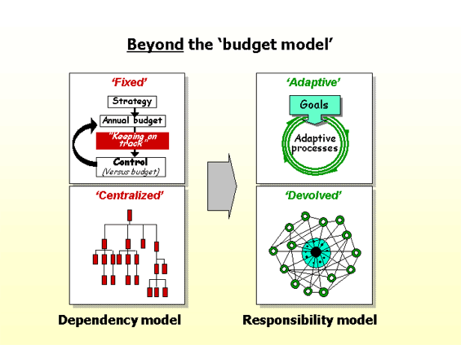
The new emerging model
Notes:
One company that has taken it is Volvo Cars. By abandoning the traditional budgeting and control round, managers now spend more time focused on those issues that make the business succeed in the intensely competitive automobile market; namely strategy, action planning and beating the competition. It doesn't mean that Volvo has abandoned financial planning. Instead, Volvo reviews strategy and forecasts during about four planning cycles every year. So facts are always up-to-date and managers are taking decisions based on what's happening in the real competitive environment - instead of on what planners thought might be happening when they drew up a budget months earlier. It's time for other companies to bin the budget, say the authors of a new "white paper" called Beyond Budgeting. Consultants Jeremy Hope and Robin Fraser have spent the past 18 months running the Beyond Budgeting Round Table which has more than 30 members, mostly big corporate names. They explored the experiences of successful companies that have abandoned budgeting such as IKEA, SKF, Schlumberger and Boots. Their conclusion is that abandoning the traditional top-down budget helps companies achieve the empowerment and culture change which lies at the heart of succeeding in fast-changing markets. The core of their argument is that old-style budgets are instruments of control - designed to lever managers into strait-jackets and stamp down on original thinking. If managers are to produce more imaginative strategies, they need to make faster decisions, be more responsive to customers, better prepared to anticipate threats and opportunities, and consistently improve quality. Not only do budgets not encourage any of these, they actually stand in the way - partly by using up time and energy, partly by limiting managers' freedom of action. Fraser and Hope's alternative is a more flexible planning regime in which managers consider a broader range of measures and react more quickly to fast-changing events. In their "emerging model" of a new budgeting process, targets, strategy, plans, forecasts and reporting are continuously reviewed in a process that involves rolling cycles and value focus within a culture in which the driving forces are enterprise and learning. They say: "Managing without budgets means a shift in management philosophy. Typical of such a shift would be accepting that 'people are assets, not resources', 'profits come from customers not products', 'quality is a religion, not a series of trade-offs' and 'managing value is more relevant than managing costs'." A sign that all this is happening is a change in the language. Out go words such as "procedures, budget, variance, compliance and control". In comes a new lexicon of "process, customer, value, knowledge and loyalty". Does it work? Fraser and Hope say that none of the 50 managers they interviewed who have made the switch want to move back to traditional budgeting. "They invariably wonder why they wasted so much time for so long, how they missed so many profit-making opportunities and how they consistently failed to respond quickly enough to customers. It's only with hindsight that the real barriers become visible." But for all their enthusiasm, Fraser and Hope's paper is thin on the specifics of making the switch. It may well be that there are real benefits to gain after scrapping the conventional budget, but deciding precisely what to put in its place is not easy. Few companies have made a decision like that. Then there is the inevitable opposition that any far-reaching change is likely to stimulate. There are going to be plenty of managers in any large company that will feel distinctly uncomfortable with the leap in the dark that binning the budget implies. Finally, there's the question of culture change. Making the new system a success depends on empowering managers - so what happens to all those legions of people clinging to the comfort blanket of the budget and control process? Fraser and Hope's work has started a useful debate. But most FDs will want more evidence than this paper provides before putting such a revolutionary idea to their boards.

Slide 38
Beyond Budgeting – Common Factors
The main organisational goals of businesses who have successfully introduced Beyond Budgeting
To satisfy shareholders by achieving sustained competitive success
To find and keep the best people
To be innovative
To operate with low costs
To satisfy customers profitably
To maintain effective governance and promote ethical reporting
Notes:
their book, Beyond Budgeting, Jeremy Hope and Robin Fraser highlight the inadequacy of traditional annual based budgeting and argue passionately for a new management model that can cope with the volatility of today's business environment. Their model embraces much more than just budgeting, it is more a philosophy of decentralization and a way of encouraging managers at all levels to become accountable for their performance without tying them to an annual budget straitjacket.Hope and Fraser analysed many companies of various types that have abandoned traditional annual budgeting in favour of their new model and found that management gained a new sense of empowerment and a "can do" attitude. In addition, they benefited from faster and more adaptive decision-making, reduced bureaucracy and lower costs. The companies became more competitive and customer satisfaction improved along with many of the company's KPI's (Key Performance Indicators).The new model replaces annual budgeting and centralized control systems with multilevel controls that include effective governance, fast financial actuals, trend analysis, rolling forecasts, key performance indicators, performance ranking, and management by exception.

Slide 39
Beyond Budgeting – Common Factors
The shared common principles of businesses who have successfully introduced Beyond Budgeting
Built a governance framework based on clear principles and boundaries
Created a high performance climate based on visibility of relative success at every level
Provided front line teams with the freedom to make decisions consistent with governance principles and strategic goals

Slide 40
Beyond Budgeting – Common Factors
The shared common principles of businesses who have successfully introduced Beyond Budgeting
Placed the responsibility for value creating decisions on teams
Focused teams on customer outcomes
Supported open and ethical information systems

Slide 41
Beyond Budgeting – The Twin Peaks
Hope & Fraser
Adaptive and
Devolved
Organisation
Adaptive
Organisation
Traditional
Organisation

Slide 42
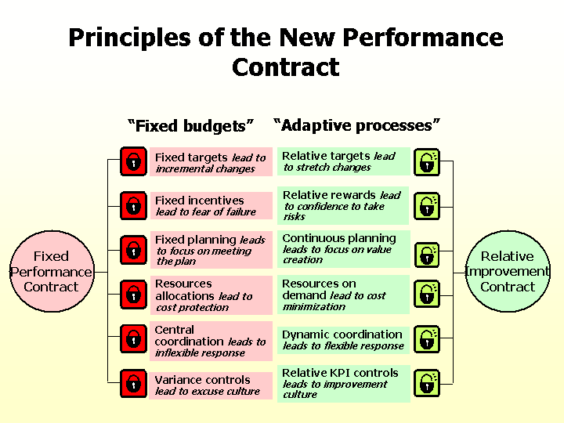

Slide 43
The new performance contract
 | Fixed Performance Contract | Relative Performance Contract
Targets | ‘Your (sales/profit) target is fixed at (£x million) | ‘We trust you to maximise your profit potential to continuously improve against the agreed benchmark KPIs’
Rewards | ‘Your rewards for reaching this target are x% of profits starting at 80% and capped at 120% of target’ | ‘You trust us to assess your rewards by a peer review panel based on your performance at the end of each year’
Plans | ‘Your agreed-upon action plans are attached to this contract’ | ‘We trust you to take whatever action is required to meet your goals within agreed-upon governance principles and strategic boundaries’
Resources | ‘The agreed resources to support the plan are set out in the attached budget statements’ | ‘You trust us to provide the resources you need when you need them. We trust you to keep within agreed KPI boundaries
Co-ordination | ‘Your activities will be co-ordinated with other budget holders according to the agreed plan’ | ‘We trust you to co-ordinate your activities with other teams according to periodic agreements and customer requirements’

Slide 44
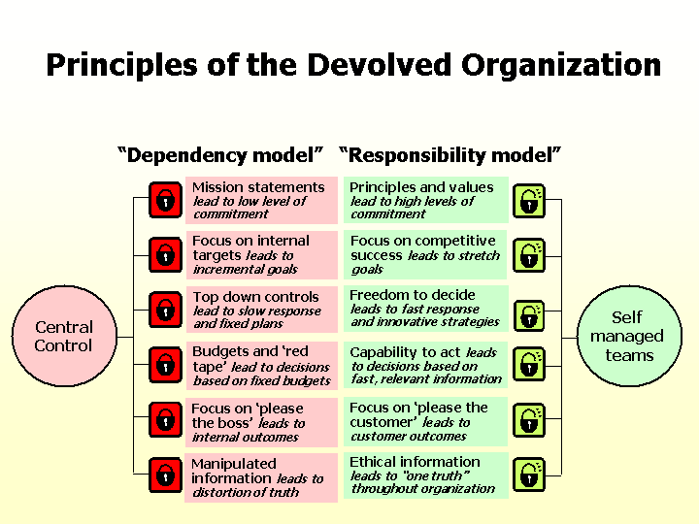

Slide 45
The balanced scorecard

Slide 46
The Balanced Scorecard
Developed by Kaplan & Norton, 1992
‘an integrated set of performance measures that are derived from the company’s strategy and that support this strategy through the organisation’

Slide 47
Evolution of the Balanced Scorecard
YEAR FOCUS BOOK TITLE
1992/ Measurement system Balanced Scorecard
1996
1996/ Performance The Strategy Focused
2002 measurement system Organisation
2002/ Strategy execution Strategy Maps,
2007 Alignment

Slide 48
The Balanced Scorecard concept
Exclusive reliance on financial measures (lagging indicators) promotes short-term behaviour not long-term value
The Balanced Scorecard supports the financial indicators with measures on the drivers (leading indicators) of future financial performance

Slide 49
The need for the Balanced Scorecard
PROBLEM Strategies – the ways by which organisations create value – were changing but the tools for measuring strategies were not.
How did businesses traditionally create value?
Tangible Book Value
as a % of Market Value
1980 62%
1990 38%
2000 15%

Slide 50
The need for the Balanced Scorecard
THEN NOW
ASSETS Tangible
CONTROL Central
CHANGE Incremental
MANAGEMENT Tactical
SYSTEM Budgets
Intangible
Decentralised
Rapid
Strategic
BALANCED
SCORECARD

Slide 51
Balanced Scorecard - Framework
Financial
Perspective
VISION &
STRATEGY
Learning &
Growth
Perspective
Customer
Perspective
Internal Business
Process Perspective

Slide 52
VISION & STRATEGY
VISION
Describes what you want your business to be in the future
STRATEGY
Describes the means by which you intend to take the business there
VALUES?
Notes:
I would have added the organisational values to the equation

Slide 53
Companies fail to execute their strategy
90% fail to execute on effectively formulated strategies
95% of the workforce does not understand the strategy
60% of companies do not link budgets to strategy
85% of executive teams spend less than one hour per month discussing strategy
70% of organisations do not link middle management incentives to strategy

Slide 54
BALANCED SCORECARD Going beyond the financial numbers
EXTERNAL v. INTERNAL MEASURES
LAGGING v. LEADING INDICATORS
OBJECTIVE v. SUBJECTIVE MEASURES

Slide 55
Lagging v. Leading Indicators
Lagging Indicators – Outcome Measures
Describe the results you would like to deliver
Leading Indicators – Performance Drivers
Describe your strategy – the means by which you will get to your end results

Slide 56
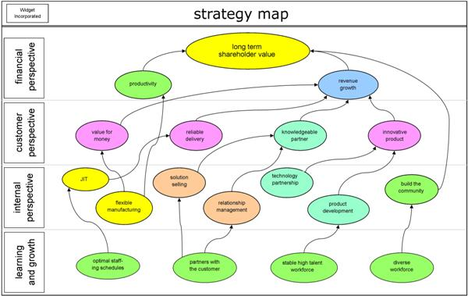
The strategy map – a ‘picture’ of the strategy’

Slide 57
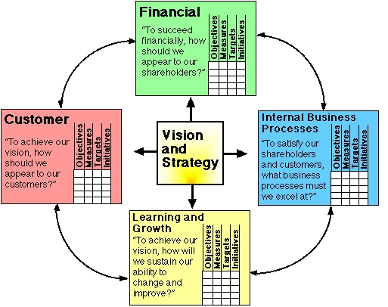
Managing the business using a BSC approach
‘Describe the strategy’
‘Measure the strategy

Slide 58
Designing the Scorecard - from Strategy to Performance Measurement
Performance measures
Financial
‘Has our financial
performance improved?’
What are our
financial goals?
Customer
‘Do customers recognise that
we are delivering more value?’
What customers do we
want and how are we
going to win and
retain them?
Vision and
strategy
Internal business process
‘Have we improved key business
processes so that we can deliver
more value to customers?’
What internal business
processes are critical to
provide value to
customers?
Learning and growth
‘Are we maintaining our ability
to change and improve?’

Slide 59
Financial
ROCE
Customer Loyalty
Customer
On Time Delivery
Internal
Processes
Process Quality
Cycle Times
Learning
& Growth
Employee Skills

Slide 60
Linking Objectives, Measures, Targets & Resources
Objective On Time Delivery What the Strategy is trying to achieve
Measure Percentage of How performance against Deliveries on objective is measured
Agreed Date
Target 95% Year 1 Required level of
99% Year 2 Performance
Resources Develop Delivery An action program to
Scheduling System achieve target

Slide 62
The BSC business management approach
Strategy-focused
organisations

Slide 63
The BSC business management approach
Translate strategy
into operational
terms
Strategy-focused
organisations

Slide 64
The BSC business management approach
Strategy-focused
organisations
Translate
Align the
Organisation to the strategy

Slide 65
The BSC business management approach
Strategy-focused
organisations
Translate
Align
Motivate by making strategy
everyone’s everyday job

Slide 66
The BSC business management approach
Strategy-focused
organisations
Translate
Adapt and
learn by making
strategy
continuous
Align
Motivate

Slide 67
The BSC business management approach
Mobilise change
through executive
leadership
Strategy-Focused
Organisations
Translate
Adapt
Align
Motivate

Slide 68
The BSC business management approach
Strategy-Focused
Organisations
Mobilise
Translate
Adapt
Align
Motivate
(Source: Kaplan and Norton, 2001)

Slide 69
A KPI wheel
Financial
Employee
Actual
Customer
Internal
Target

Slide 70
Montifiore Hospital’s Balanced Scorecard
CUSTOMER
Looking from
the outside in
INNOVATION
& GROWTH
Looking Ahead
FINANCIAL
Looking Back
OPERATIONS
Looking from
The inside out
Do we have momentum?
Are we in control?
Did we meet our targets?

Slide 71
Your Scorecard
What measures would you have under the four headings of:
Financial?
Customer?
Learning and Growth?
Internal?

Slide 72
Implementing the BSC approach – some issues
Premature linking of the scorecard to management processes (such as target setting and compensation)
Management practices inconsistent with the ‘balancing’ philosophy (such as rewarding executives on short-term profit performance)
No strategy to link
the scorecard to!
Confusion over terminology
Lack of education and training
No executive sponsorship
No new measures
No clearly understood objectives for the scorecard programme
Lack of cascading of the scorecard through the organisation
Timing issues – announcing the scorecard too early or too late

Slide 73
BSC – Top 10 Implementation issues
No executive sponsorship
Lack of education and training
No strategy
No objectives for programme
Timing
Inconsistent management practices
No new measures
Terminology
Lack of cascading
Premature links

Slide 74
Balanced Scorecard – The Benefits
Translating Strategy into Action
Improved Resource Allocation
Enhances Management Strategic Feedback & Learning
Clear communication of Strategy may highlight divergent views on strategy
Can result in a re-design / simplification of the Budget Process

