Slide 1
Malware

Slide 2
Detection
What malware are
How do they infect hosts
How do they hide
How do they propagate
Zoo visit !
How to detect them
Worms

Slide 3
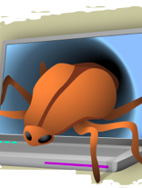
What is a malware ?
A Malware is a set of instructions that run on your computer and make your system do something that an attacker wants it to do.

Slide 4
What is its PURPOSE ?
Exfiltrate information
Delete files
Click fraud
Steal software serial numbers
Use your computer as relay

Slide 5
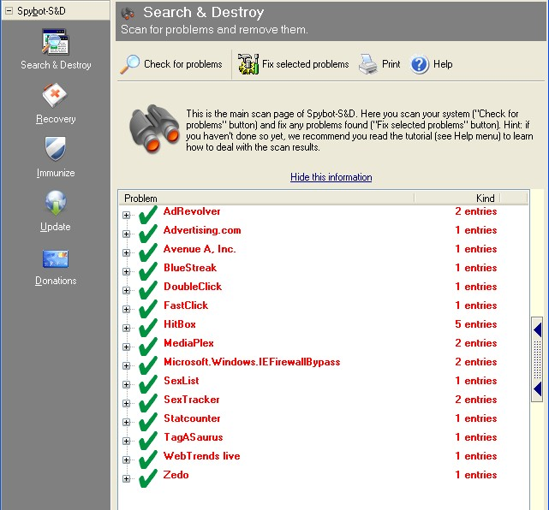
The Malware Zoo
Virus
Backdoor
Trojan horse
Rootkit
Scareware
Adware
Worm

Slide 6
What is a Virus ?
a program that can infect other programs by modifying them to include a, possibly evolved, version of itself
Fred Cohen 1983

Slide 7
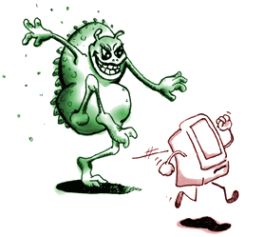
Some Virus Type
Polymorphic : uses a polymorphic engine to mutate while keeping the original algorithm intact (packer)
Methamorpic : Change after each infection

Slide 8
What is a trojan
A trojan describes the class of malware that appears to perform a desirable function but in fact performs undisclosed malicious functions that allow unauthorized access to the victim computer
Wikipedia

Slide 9
What is rootkit
A root kit is a component that uses stealth to maintain a persistent and undetectable presence on the machine
Symantec

Slide 10
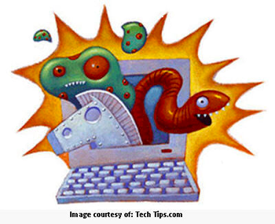
What is a worm
A computer worm is a self-replicating computer program. It uses a network to send copies of itself to other nodes and do so without any user intervention.

Slide 11
History
1981 First reported virus : Elk Cloner (Apple 2)
1983 Virus get defined
1986 First PC virus MS DOS
1988 First worm: Morris worm
1990 First polymorphic virus
1998 First Java virus
1998 Back orifice
1999 Melissa virus Zombie concept Knark rootkit
2000 love bug
2001 Code Red Worm Kernel Intrusion System Nimda worm
2003 SQL Slammer worm

Slide 12
Malware Repartition

Slide 13
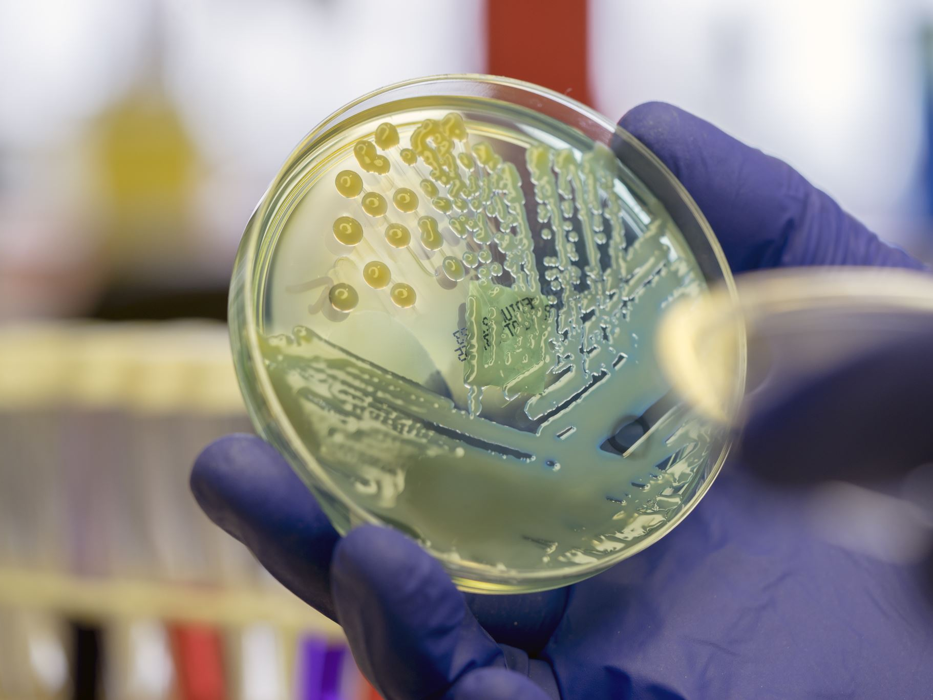
Infection methods

Slide 14
Outline
What malware are
How do they infect hosts
How do they propagate
Zoo visit !
How to detect them
Worms

Slide 15
What to Infect
Executable
Interpreted file
Kernel
Service
MBR
Hypervisor

Slide 16
Overwriting malware
Targeted
Executable
Malware
Malware

Slide 17
prepending malware
Malware
Targeted
Executable
Infected host
Executable
Malware

Slide 18
appending malware
Targeted
Executable
Infected
host
Executable
Malware
Malware

Slide 19
Cavity malware
Targeted
Executable
Infected host
Executable
Malware
Malware

Slide 20
Multi-Cavity malware
Targeted
Executable
Malware
Malware
Malware
Malware

Slide 21
Packers
Packer
Payload
Malware
Infected host
Executable

Slide 22
Packer functionalities
Compress
Encrypt
Randomize (polymorphism)
Anti-debug technique (int / fake jmp)
Add-junk
Anti-VM
Virtualization

Slide 23
Auto start
Folder auto-start : C:\Documents and Settings\[user_name]\Start Menu\Programs\Startup
Win.ini : run=[backdoor]" or "load=[backdoor]".
System.ini : shell=”myexplorer.exe”
Wininit
Config.sys
Notes:
more like
autoexec.bat
etc

Slide 24
Auto start cont.
Assign know extension (.doc) to the malware
Add a Registry key such as HKCU\SOFTWARE\Microsoft\Windows \CurrentVersion\Run
Add a task in the task scheduler
Run as service

Slide 25
Unix autostart
Init.d
/etc/rc.local
.login .xsession
crontab
crontab -e
/etc/crontab

Slide 26
Macro virus
Use the builtin script engine
Example of call back used (word)
AutoExec()
AutoClose()
AutoOpen()
AutoNew()

Slide 27
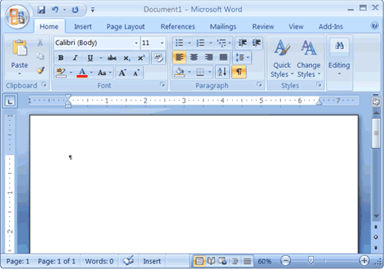
Document based malware
MS Office
Open Office
Acrobat

Slide 28
Userland root kit
Perform
login sshd passwd
Hide activity
Ps netstat ls find du

Slide 29
Subverting the Kernel
Kernel task
Process management
File access
Memory management
Network management
What to hide
Process
Files
Network traffic

Slide 30
Kernel rootkit
P1
P2
PS
P3
P3
KERNEL
rootkit
Hardware :
HD, keyboard, mouse, NIC, GPU

Slide 31
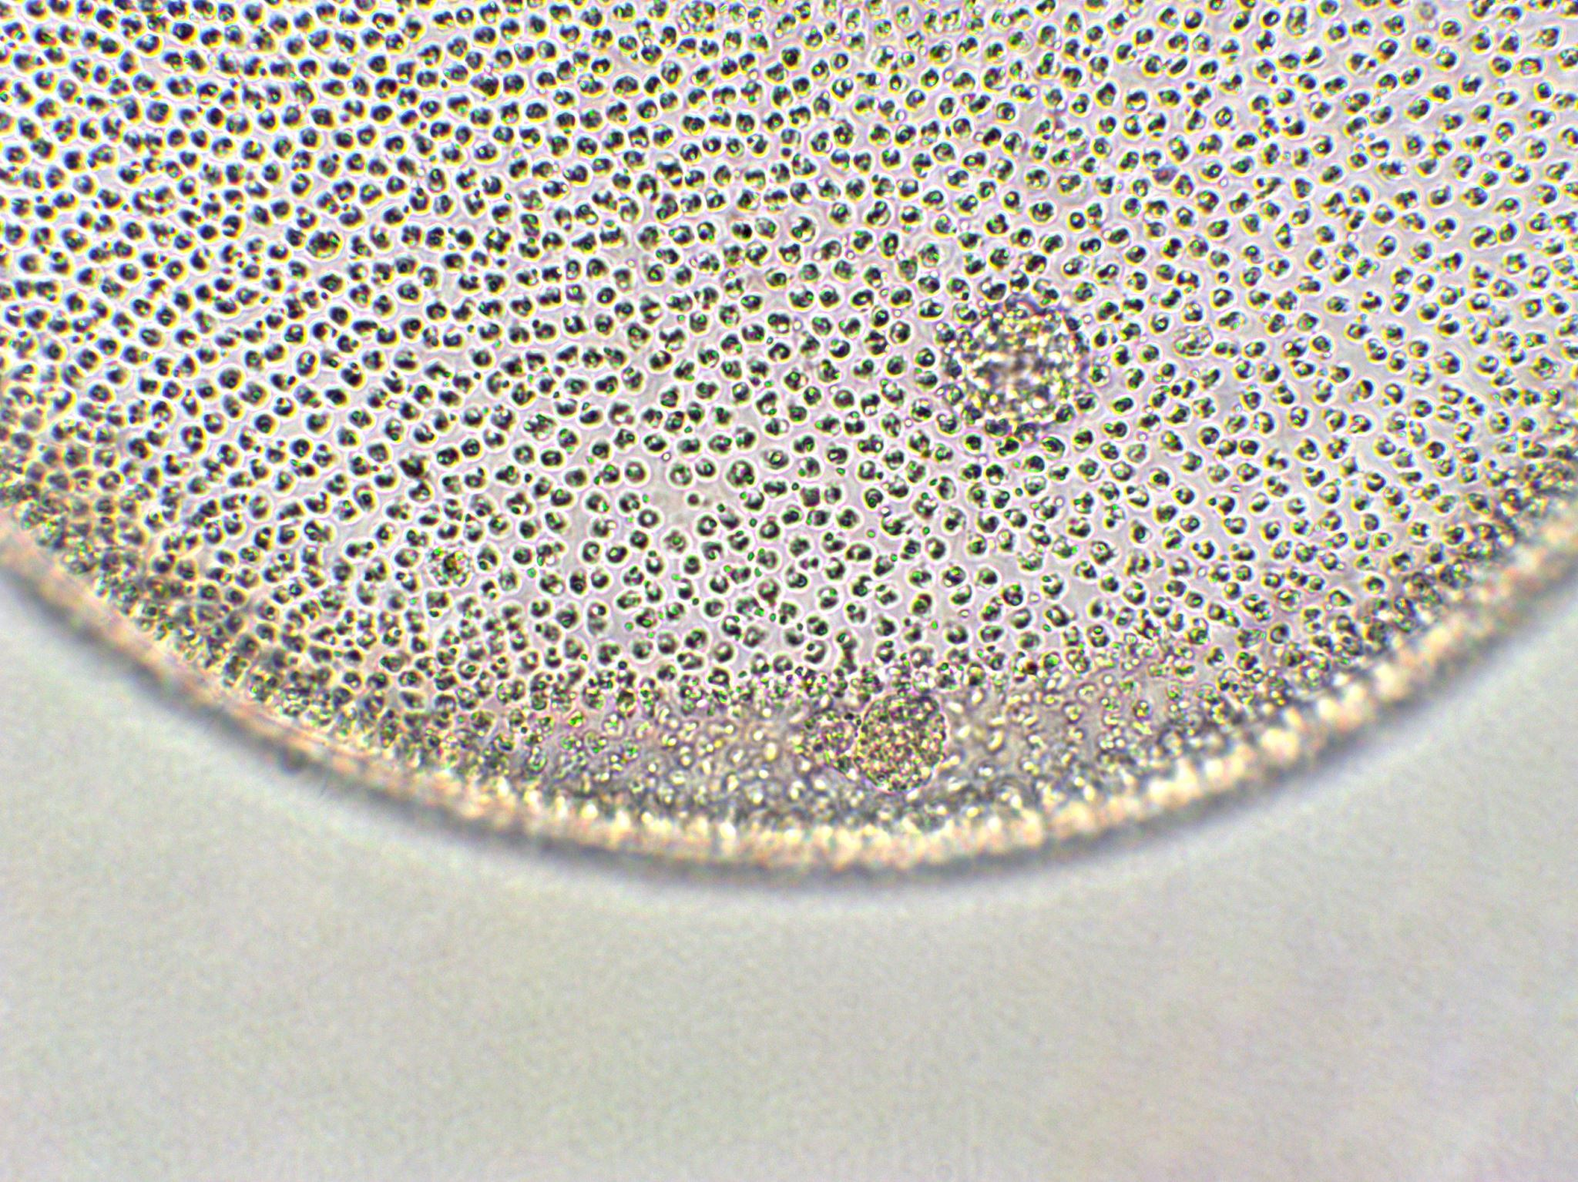
Subverting techniques
Kernel patch
Loadable Kernel Module
Kernel memory patching (/dev/kmem)

Slide 32
Windows Kernel
Csrss.exe
P1
P2
Pn
Win32 subsystem DLLs
User32.dll, Gdi32.dll and Kernel32.dll
Other Subsytems
(OS/2 Posix)
Ntdll.dll
ntoskrnl.exe
Executive
Underlying kernel
Hardware Abstraction Layer (HAL.dll)
Hardware
Notes:
Crss.exe Client/server run time sub system -> used to run a keep state of process => can be query in userland
Ntdll -> convert api call to kernel call
NTll do call gate jumps
Executive dispatch syscall to the underlying kernel
SSDT system service dispatch table
HAL.dll hardware abstraction
Transition using the int0x2E interrupt

Slide 33
Kernel Device driver
P2
Win32 subsystem DLLs
Ntdll.dll
C
ntoskrnl.exe
Interrupt Hook
System service dispatch table
System service dispatcher
New pointer
B
A
Driver Overwriting functions
Driver Replacing Functions
Notes:
A Overwrite
B Redirect by patching the service dispatch table
C Redirect the interrupt

Slide 34
MBR/Bootkit
Bootkits can be used to avoid all protections of an OS, because OS consider that the system was in trusted stated at the moment the OS boot loader took control.

Slide 35
BIOS
MBR
VBS
NT
Boot
Sector
WINLOAD.EXE
BOOTMGR.EXE
Windows kernel HAL.DLL
Notes:
VBS : volume boot sector
MBR: master boot record
white unknown
green - 16 bits
red 32 bits
blue 64 bits

Slide 36
Vboot
Work on historic Windows
3ko
Bypass checks by letting them run and then do inflight patching
Communicate via ping

Slide 37
Hypervisor rootkit
App
App
Target OS
Hardware
Notes:
Blue pill (Joanna)
SubVirt (Microsoft)

Slide 38
Hypervisor rootkit
App
App
Rogue app
Target OS
Host OS
Virtual machine monitor
Hardware
Notes:
Blue pill (Joanna)
injection method using raw disk access from user mode
patched need a signed driver

Slide 39
Propagation Vector

Slide 40
Outline
What malware are
How do they infect hosts
How do they propagate
Zoo visit !
How to detect them
Worms

Slide 41
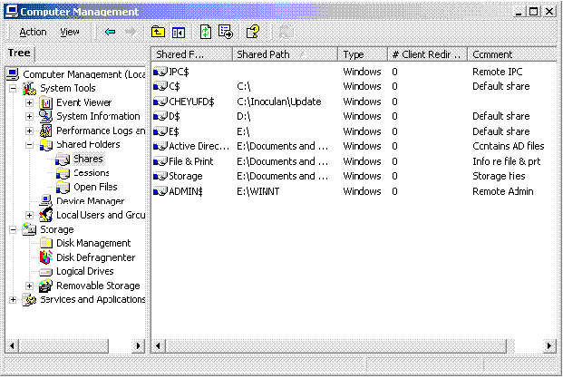
Shared folder

Slide 42
Phishing
Symantec 2009

Slide 43
Fake codec

Slide 44
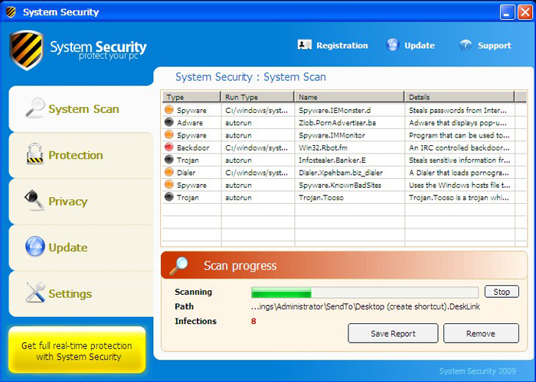
Fake antivirus
from pandalab blog

Slide 45
Hijack you browser
from pandalab blog

Slide 46
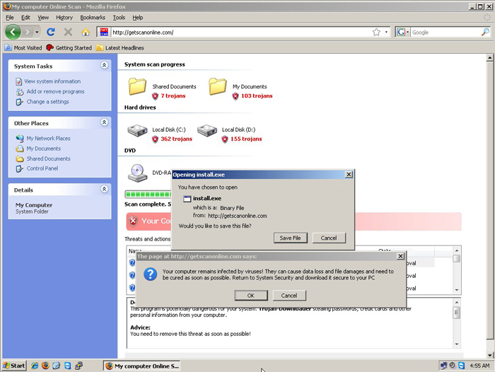
Fake page !
from pandalab blog

Slide 47
Backdoor

Slide 48
Basic
InfectedHost
Attacker
TCP

Slide 49
Reverse
InfectedHost
Attacker
TCP

Slide 50
covert
InfectedHost
Attacker
ICMP

Slide 51
Rendez vous backdoor
RDV
Point
InfectedHost
Attacker

Slide 52
Bestiary

Slide 53
Outline
What malware are
How do they infect hosts
How do they propagate
Zoo visit !
How to detect them
Worms

Slide 54
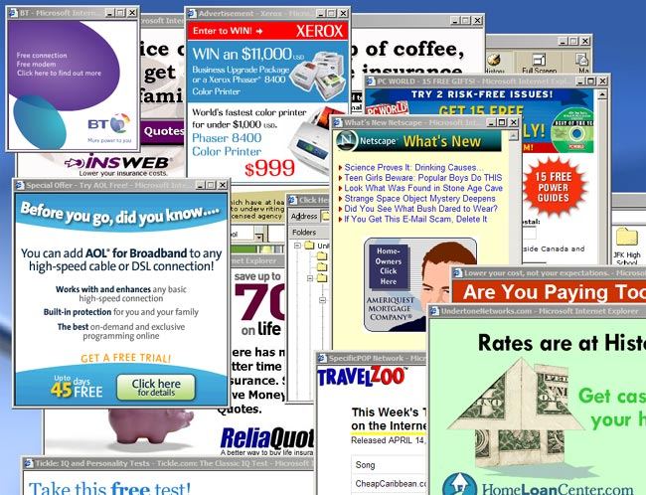
Adware

Slide 55
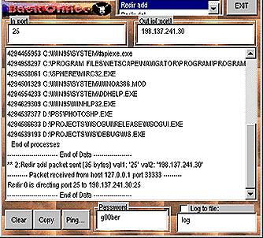
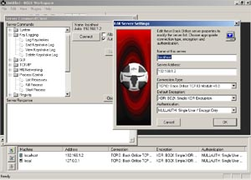
BackOrifice
Defcon 1998
new version in 2000
Notes:
Sir Dystic
Cult of the dead cow
demonstrate the vuln of 98

Slide 56
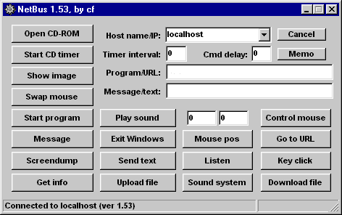
Netbus
1998
Used for “prank”
Notes:
used to plant child pornography on the work computer of Magnus Eriksson
law scholar at Lund University. The 3,500 images
n lost his research position
Fled the country
acquitted in 2004

Slide 57
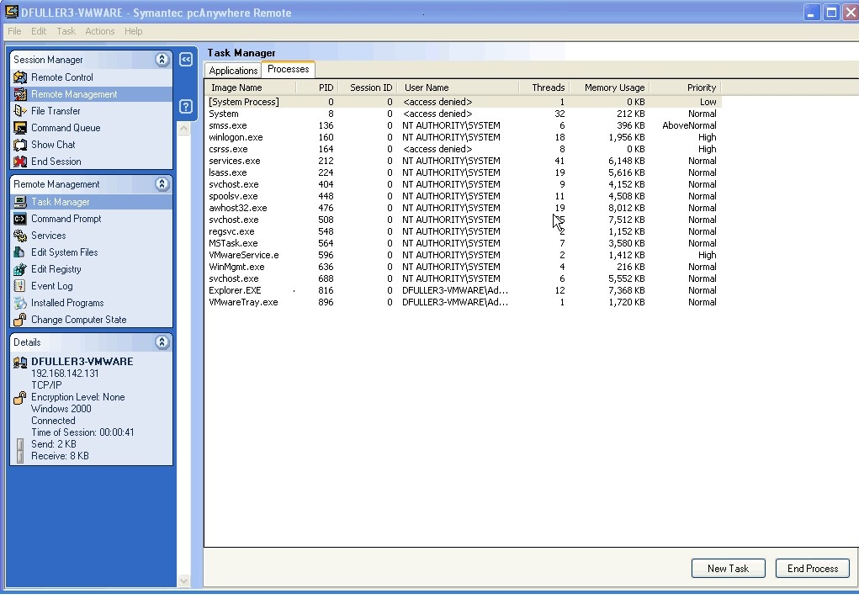
Symantec pcAnywhere

Slide 58
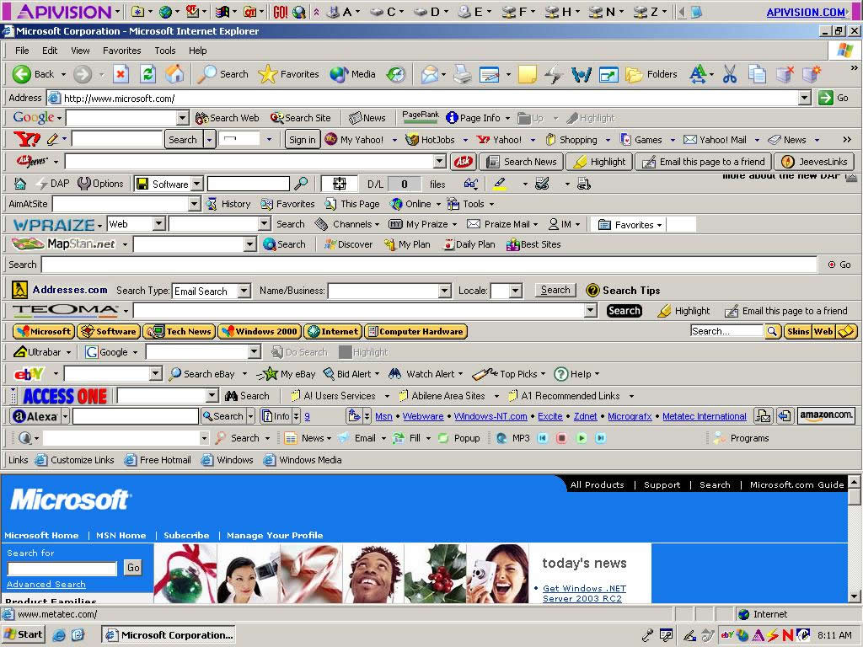
Browser Toolbar ...

Slide 59
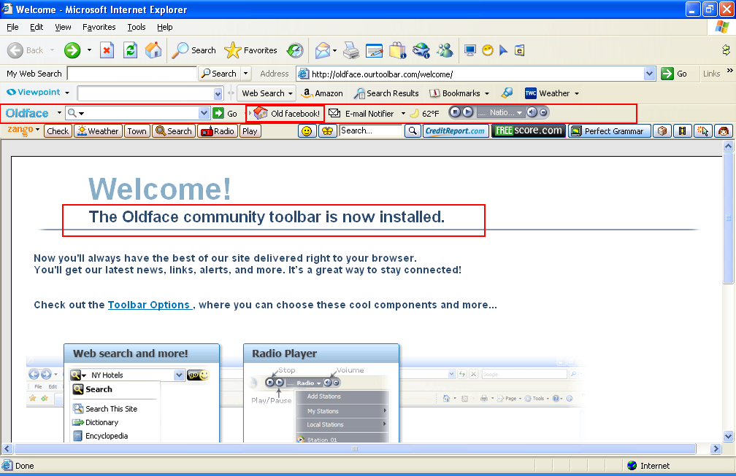
Toolbar again

Slide 60
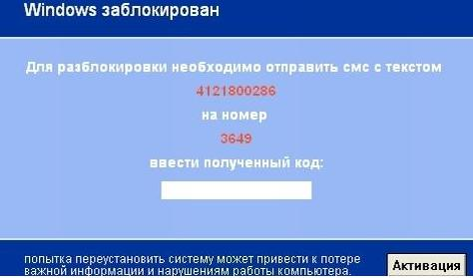
Ransomware
Trj/SMSlock.A
Russian ransomware
April 2009
To unlock you need to send an SMS with the text4121800286to the number3649Enter the resulting code:Any attempt to reinstall the system may lead to loss of important information and computer damage
from pandalab blog

Slide 61
Detection

Slide 62
Outline
What malware are
How do they infect hosts
How do they propagate
Zoo visit !
How to detect them
Worms

Slide 63
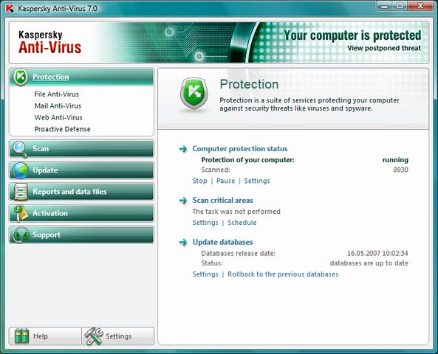
Anti-virus
Analyze system behavior
Analyze binary to decide if it a virus
Type :
Scanner
Real time monitor

Slide 64
Impossibility result
It is not possible to build a perfect virus/malware detector (Cohen)

Slide 65
Impossibility result
Diagonal argument
P is a perfect detection program
V is a virus
V can call P
if P(V) = true -> halt
if P(V) = false -> spread

Slide 66
Virus signature
Find a string that can identify the virus
Fingerprint like

Slide 67
Heuristics
Analyze program behavior
Network access
File open
Attempt to delete file
Attempt to modify the boot sector
Notes:
Speak of sending mail

Slide 68
Checksum
Compute a checksum for
Good binary
Configuration file
Detect change by comparing checksum
At some point there will more malware than “goodware” ...

Slide 69
Sandbox analysis
Running the executable in a VM
Observe it
File activity
Network
Memory

Slide 70
Dealing with Packer
Launch the exe
Wait until it is unpack
Dump the memory

Slide 71
Worms

Slide 72
Outline
What malware are
How do they infect hosts
How do they propagate
Zoo visit !
How to detect them
Worms

Slide 73
Worm
A worm is self-replicating software designed to spread through the network
Typically, exploit security flaws in widely used services
Can cause enormous damage
Launch DDOS attacks, install bot networks
Access sensitive information
Cause confusion by corrupting the sensitive information
Worm vs Virus vs Trojan horse
A virus is code embedded in a file or program
Viruses and Trojan horses rely on human intervention
Worms are self-contained and may spread autonomously
73

Slide 74
Some historical worms of note
Worm | Date | Distinction
Morris | 11/88 | Used multiple vulnerabilities, propagate to “nearby” sys
ADM | 5/98 | Random scanning of IP address space
Ramen | 1/01 | Exploited three vulnerabilities
Lion | 3/01 | Stealthy, rootkit worm
Cheese | 6/01 | Vigilante worm that secured vulnerable systems
Code Red | 7/01 | First sig Windows worm; Completely memory resident
Walk | 8/01 | Recompiled source code locally
Nimda | 9/01 | Windows worm: client-to-server, c-to-c, s-to-s, …
Scalper | 6/02 | 11 days after announcement of vulnerability; peer-to-peer network of compromised systems
Slammer | 1/03 | Used a single UDP packet for explosive growth
74

Slide 75
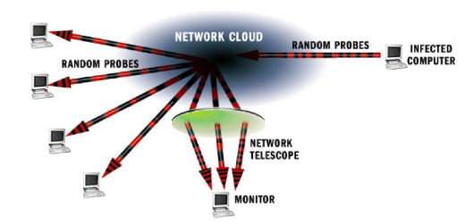
Measuring activity: network telescope
Monitor cross-section of Internet address space, measure traffic
“Backscatter” from DOS floods
Attackers probing blindly
Random scanning from worms
LBNL’s cross-section: 1/32,768 of Internet
UCSD, UWisc’s cross-section: 1/256.
75

Slide 76
Nimda
Released September 18, 2001.
Multi-mode spreading:
attack IIS servers via infected clients
email itself to address book as a virus
copy itself across open network shares
modifying Web pages on infected servers w/ client exploit
scanning for Code Red II backdoors (!)
worms form an ecosystem!
Leaped across firewalls.
76

Slide 77
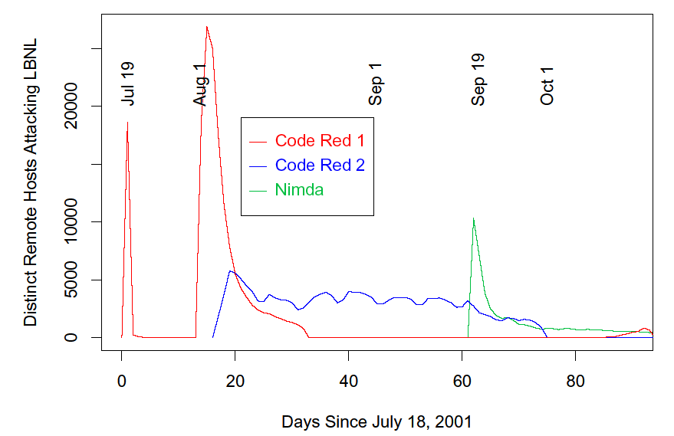
Code Red 2 kills off Code Red 1
Nimda enters the ecosystem
CR 1 returns thanks to bad clocks
Code Red 2 settles into weekly pattern
Code Red 2 dies off as programmed
77

Slide 78
How do worms propagate?
Scanning worms : Worm chooses “random” address
Coordinated scanning : Different worm instances scan different addresses
Flash worms
Assemble tree of vulnerable hosts in advance, propagate along tree
Not observed in the wild, yet
Potential for 106 hosts in < 2 sec ! [Staniford]
Meta-server worm :Ask server for hosts to infect (e.g., Google for “powered by phpbb”)
Topological worm: Use information from infected hosts (web server logs, email address books, config files, SSH “known hosts”)
Contagion worm : Propagate parasitically along with normally initiated communication
78

Slide 79
Worm Detection and Defense
Detect via honeyfarms: collections of “honeypots” fed by a network telescope.
Any outbound connection from honeyfarm = worm.
(at least, that’s the theory)
Distill signature from inbound/outbound traffic.
If telescope covers N addresses, expect detection when worm has infected 1/N of population.
Thwart via scan suppressors: network elements that block traffic from hosts that make failed connection attempts to too many other hosts
5 minutes to several weeks to write a signature
Several hours or more for testing
79

Slide 80
Signature inference
Challenge
need to automatically learn a content “signature” for each new worm – potentially in less than a second!
Some proposed solutions
Singh et al, Automated Worm Fingerprinting, OSDI ’04
Kim et al, Autograph: Toward Automated, Distributed Worm Signature Detection, USENIX Sec ‘04
80

Slide 81
Signature inference
Monitor network and look for strings common to traffic with worm-like behavior
Signatures can then be used for content filtering
81
Slide: S Savage

Slide 82
Content sifting
Assume there exists some (relatively) unique invariant bitstring W across all instances of a particular worm (true today, not tomorrow...)
Two consequences
Content Prevalence: W will be more common in traffic than other bitstrings of the same length
Address Dispersion: the set of packets containing W will address a disproportionate number of distinct sources and destinations
Content sifting: find W’s with high content prevalence and high address dispersion and drop that traffic
82
Slide: S Savage

Slide 83
Observation: High-prevalence strings are rare
Only 0.6% of the 40 byte substrings repeat more than 3 times in a minute
(Stefan Savage, UCSD *)
83

Slide 84
Challenges
Computation
To support a 1Gbps line rate we have 12us to process each packet, at 10Gbps 1.2us, at 40Gbps…
Dominated by memory references; state expensive
Content sifting requires looking at every byte in a packet
State
On a fully-loaded 1Gbps link a naïve implementation can easily consume 100MB/sec for table
Computation/memory duality: on high-speed (ASIC) implementation, latency requirements may limit state to on-chip SRAM
84

