Slide 1
API Security I

Slide 2

Disclaimer
Any API providing sensitive information to consumers should use Transport Layer Security (TLS) to encrypt the data.
Even if the API is only provided internally, privately, or at a partner level, using TLS, the protocol that encrypts HTTPS traffic, is mandatory.
Misconfigured or missing transit encryption can cause API users to pass sensitive API information in cleartext across networks, in which case an attacker could capture the responses and requests with a man-in-the-middle (MITM) attack and read them plainly.

Slide 3
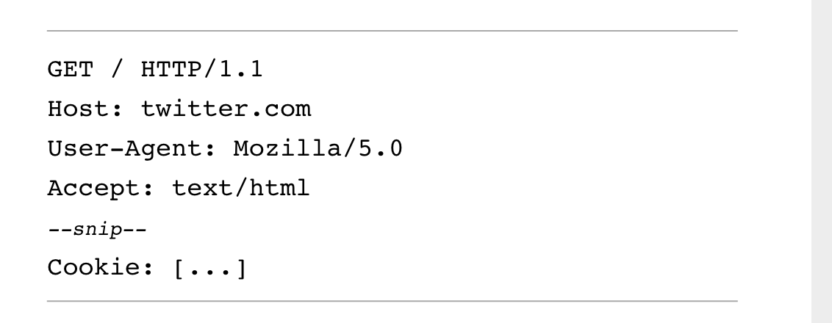
Interacting with REST APIs
The GET request: https://twitter.com

Slide 4
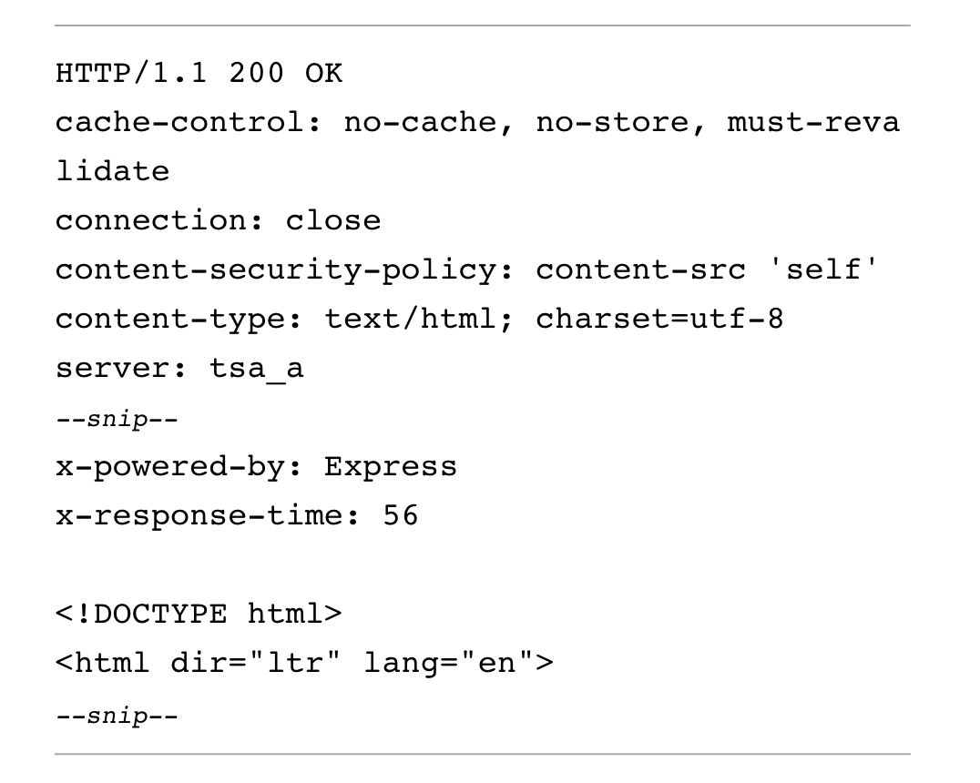
The response

Slide 5

Reading the headers
Server information section includes middleware information, and cookie-related information.
Client instructions section tells the browser how to handle the requested information, such as caching data, the content security policy, and the type of content that was sent.
The actual payload begins just below x-response-time; it provides the browser with the HTML needed to render the web page.

Slide 6
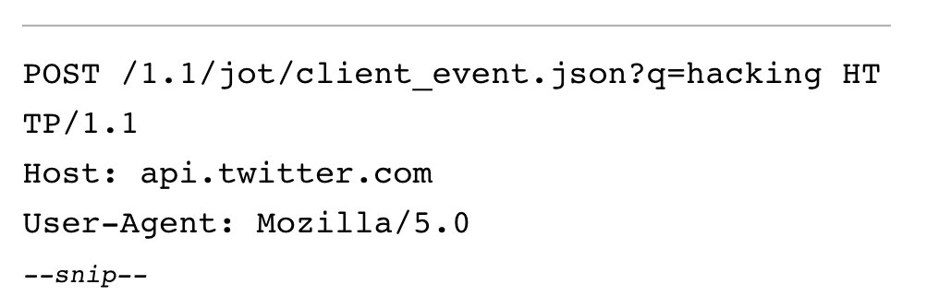
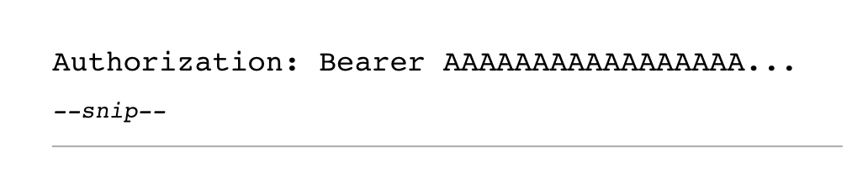
Invoking
This POST request is an example of the Twitter API querying the web service at api.twitter.com for the search term “hacking.”

Slide 7
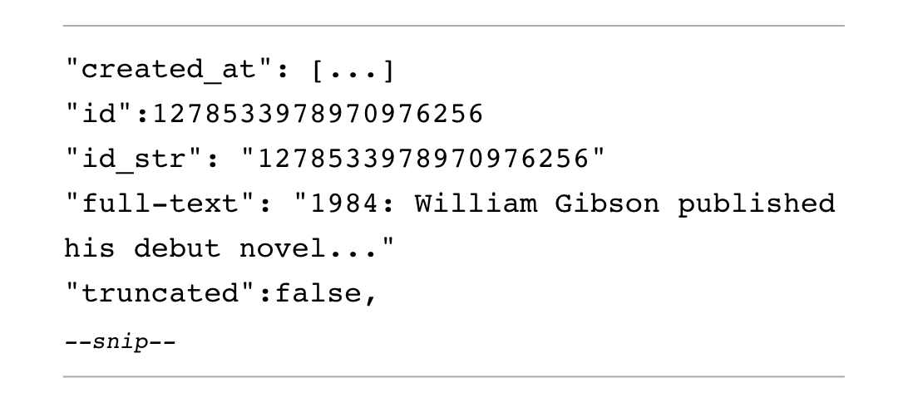
Response atttributes

Slide 8
Service or page?
Although the response body is formatted in a legible way, it’s meant to be processed by the browser to be displayed as a human-readable web page.
The browser renders the search results using the string from the API request.
The provider’s response then populates the page with search results, images, and social media–related information such as likes, retweets, comments
Can be a different wweb server optimized for delivering static content
User experience is seamless

Slide 9

API Authentication
APIs may allow public access to consumers without authentication, but when an API allows access to proprietary or sensitive data, it will use some form of authentication and authorization.
An API’s authentication process should validate that users are who they claim to be, and the authorization process should grant them the ability to access the data they are allowed to access.

Slide 10

The case for no auth
In web applications generally, there are plenty of instances where it is valid for an API to have no authentication at all. If an API does not handle sensitive data and only provides public information, the provider could make the case that no authentication is necessary.

Slide 11
HTTP basic authentication
The simplest form of API authentication is HTTP basic authentication, in which the consumer includes their username and password in a header or the body of a request.
The API could either pass the username and password to the provider in plaintext, like username:password, or it could encode the credentials using base64 to save space (for example, as dXNlcm5hbWU6cGFzc3dvcmQK).

Slide 12
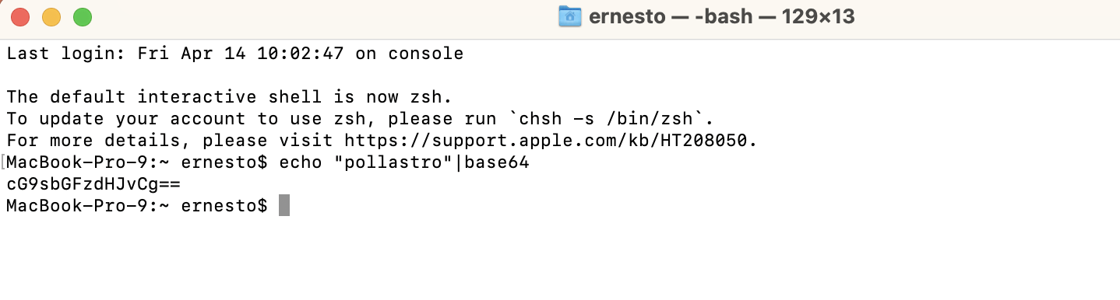
Example

Slide 13
Basic + keys
Stateless APIs would require to provide credentials in every request.
It is common for an API provider to instead use basic authentication once, for the first request, and then issue an API key or some other token for all other requests.

Slide 14

API Keys
API keys are unique strings that API providers generate and grant to authorize access for approved consumers.
Once an API consumer has a key, they can include it in requests whenever specified by the provider.
The provider will typically require that the consumer pass the key in query string parameters, request headers, body data, or as a cookie when they make a request.

Slide 15
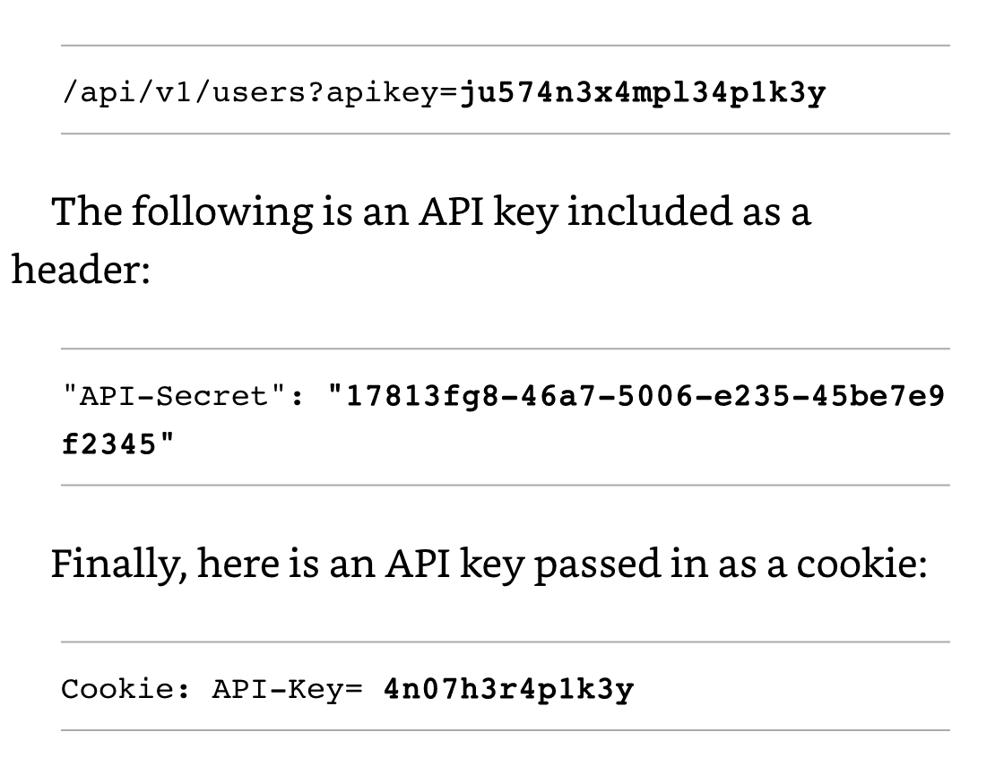
Examples

Slide 16
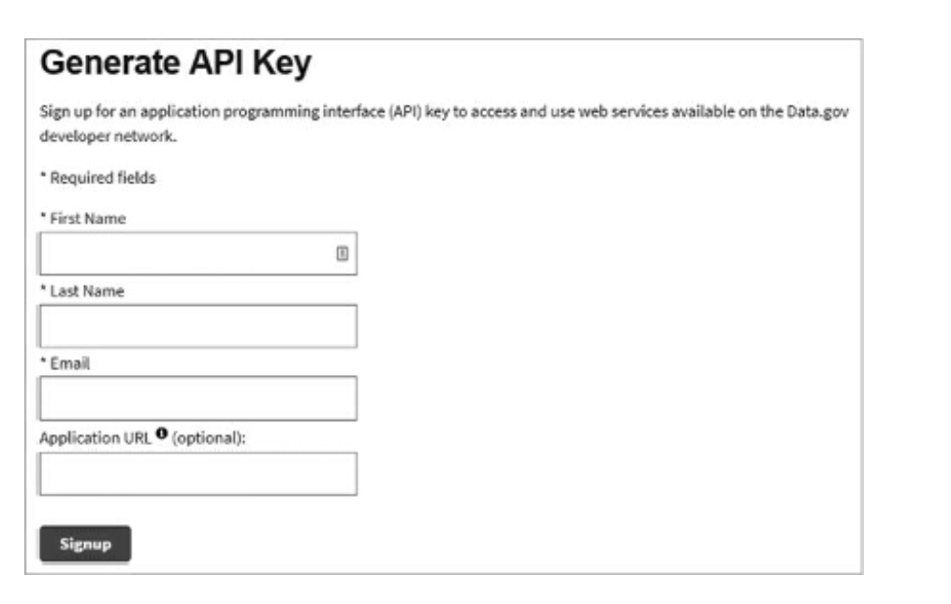
NASA Interface for key generation
The resulting key will look something like this: roS6SmRjLdxZzrNSAkxjCdb6WodSda2G9zc2Q7sK
Must be passed at invocation time api.nasa.gov/planetary/apod?api_key=roS6SmRjLdxZzrNSAkxjCdb6WodSda2G9zc2Q7sK

Slide 17

API keys are not secure
API keys can be found on the internet in online repositories, left in code comments, intercepted when transferred over unencrypted connections, or stolen through phishing.
Homework: find some API keys files in hacker resources

Slide 18
Jason Web tokens
A JSON Web Token (JWT) is a type of token commonly used in API token-based authentication.
It’s used like this: The API consumer authenticates to the API provider with a username and password.
The provider generates a JWT and sends it back to the consumer.
The consumer adds the provided JWT to the Authorization header in all API requests.

Slide 19
JWT structure
JWTs consist of three parts, all of which are base64-encoded and separated by periods: the header, the payload, and the signature.
The header includes information about the algorithm used to sign the payload.
The payload is the data included within the token, such as a username, timestamp, and issuer.
The signature is the encoded and encrypted message used to validate the token.

Slide 20
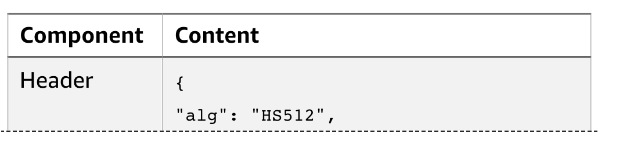
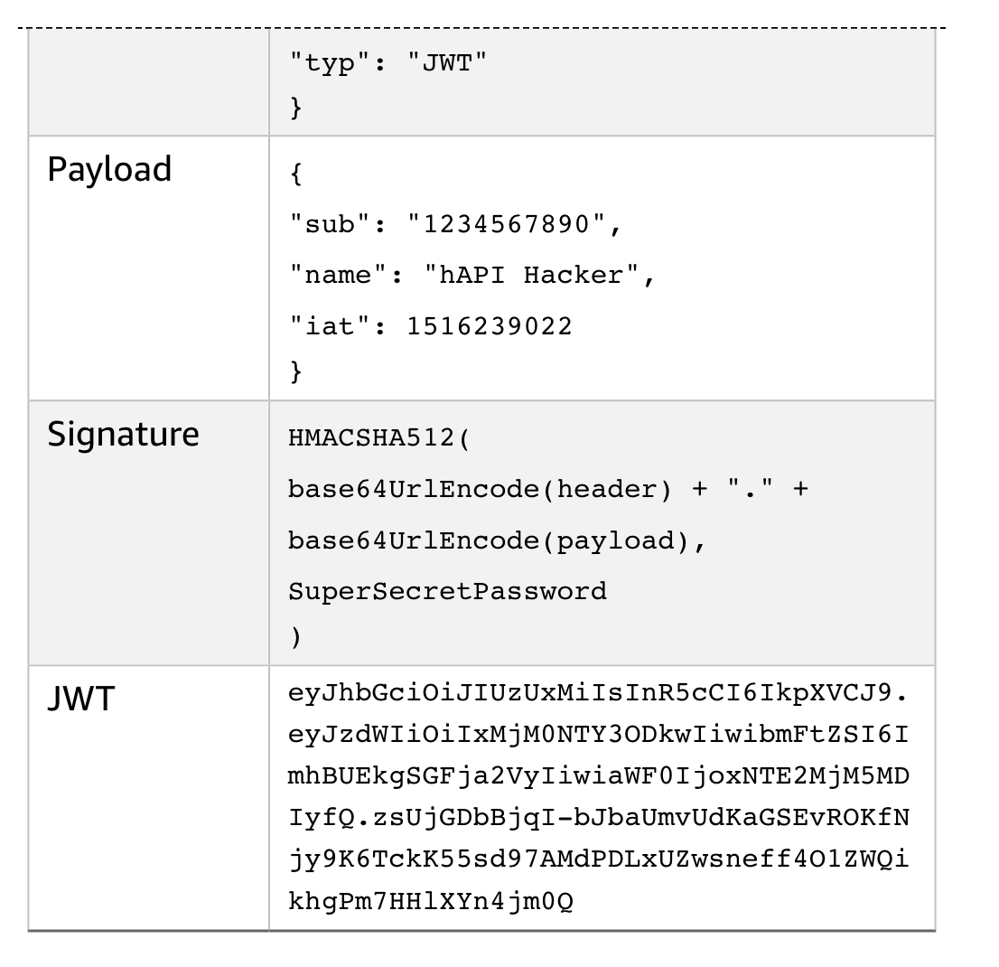

Slide 21
JWT security
JWTs are generally secure but can be implemented in ways that will compromise that security.
If the implementation does not use encryption, base64 decode is sufficient to see what is inside the token.
An API hacker could decode such a token, tamper with the contents, and send it back to the provider to gain access.
The JWT secret key may also be stolen or guessed by brute force.

Slide 22
HMAC
A hash-based message authentication code (HMAC) is the primary API authentication method used by Amazon Web Services (AWS). When using HMAC, the provider creates a secret key and shares it with consumer. When a consumer interacts with the API:
  an HMAC hash function is applied to the consumer’s API request data and secret key.
  The resulting hash (also called a message digest) is added to the request and sent to the provider.
  The provider calculates the HMAC, just as the consumer did, by running the message and key through the hash function, and then compares the output hash value to the value provided by the client.
  If the provider’s hash value matches the consumer’s hash value, the consumer is authorized to make the request.
  If the values do not match, either the client’s secret key is incorrect or the message has been tampered with.

Slide 23
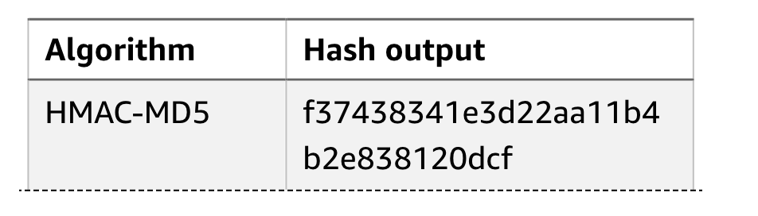
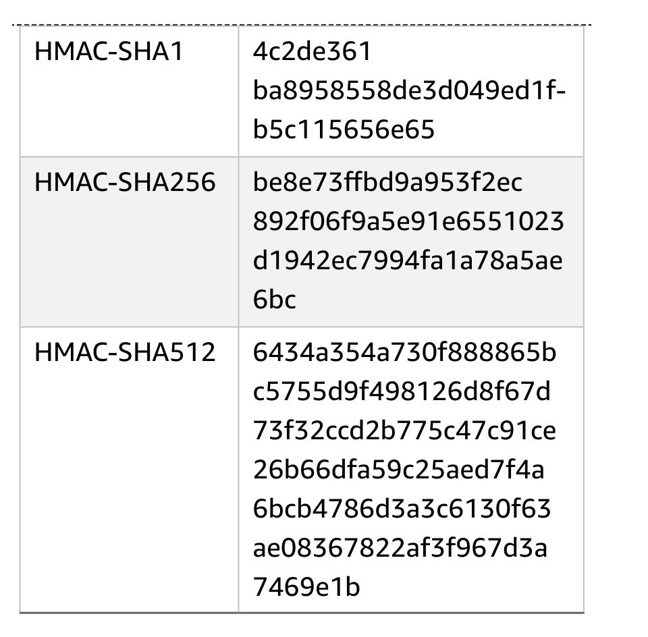
HMAC Security
there are currently no widespread vulnerabilities affecting HMAC-SHA1 and HMAC-MD5, but these functions are cryptographically weaker

Slide 24
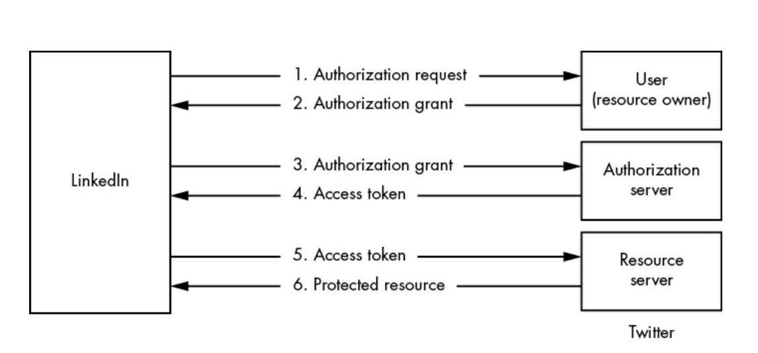
Oauth Recall

Slide 25
Remarks
When you authorize LinkedIn to access your Twitter posts, Twitter generates a limited, time-based access token for LinkedIn. LinkedIn then provides that token to Twitter to post on your behalf, and you don’t have to give LinkedIn your Twitter credentials.
In the LinkedIn–Twitter example, you are the resource owner, LinkedIn is the application/client, and Twitter is the authorization server and resource server.

Slide 26
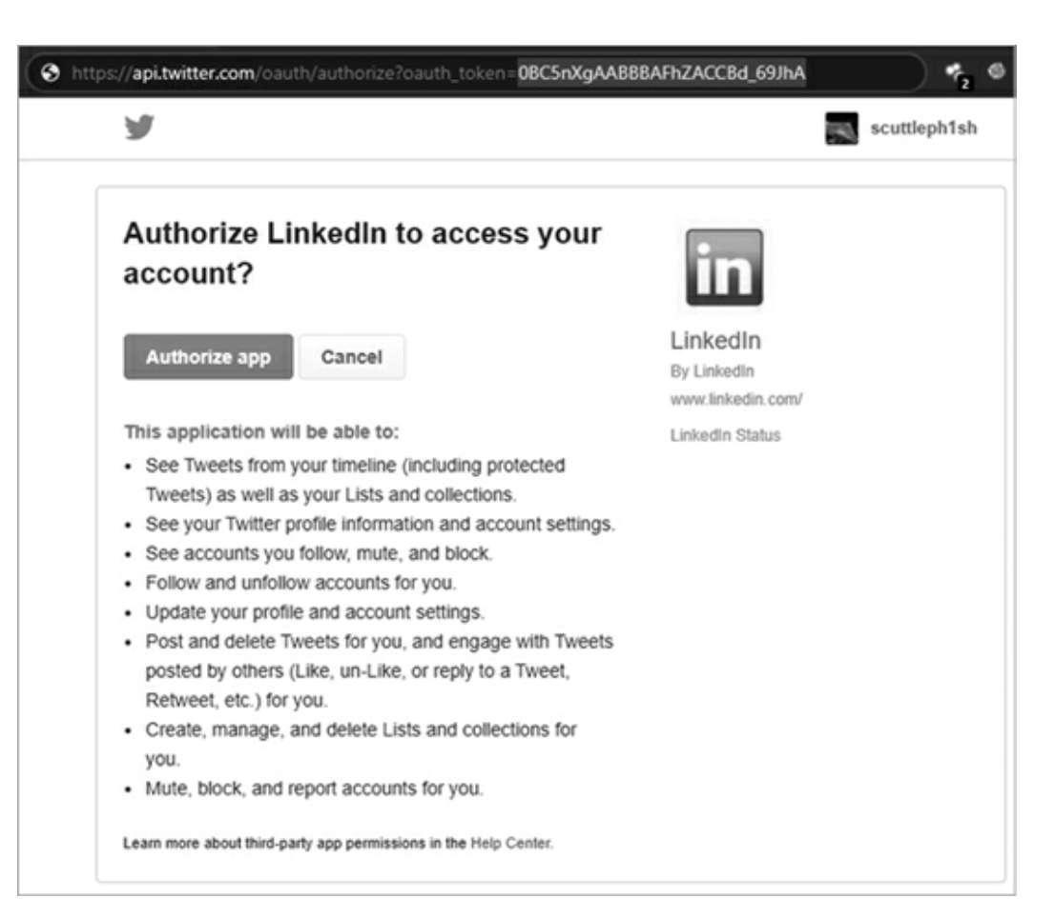
Authorization Request

Slide 27
Oauth Security
OAuth is one of the most trusted forms of API authorization. However, while it adds security to the authorization process, it also expands the potential attack surface
Flaws often have more to do with how the API provider implements OAuth than with OAuth itself.
API providers that poorly implement OAuth can expose themselves to a variety of attacks such as token injection, authorization code reuse, etc.

Slide 28

Common vulnerabilities
Understanding common vulnerabilities will help you identify weaknesses when you’re testing APIs.
the Open Web Application Security Project (OWASP) API Security Top 10 List

Slide 29
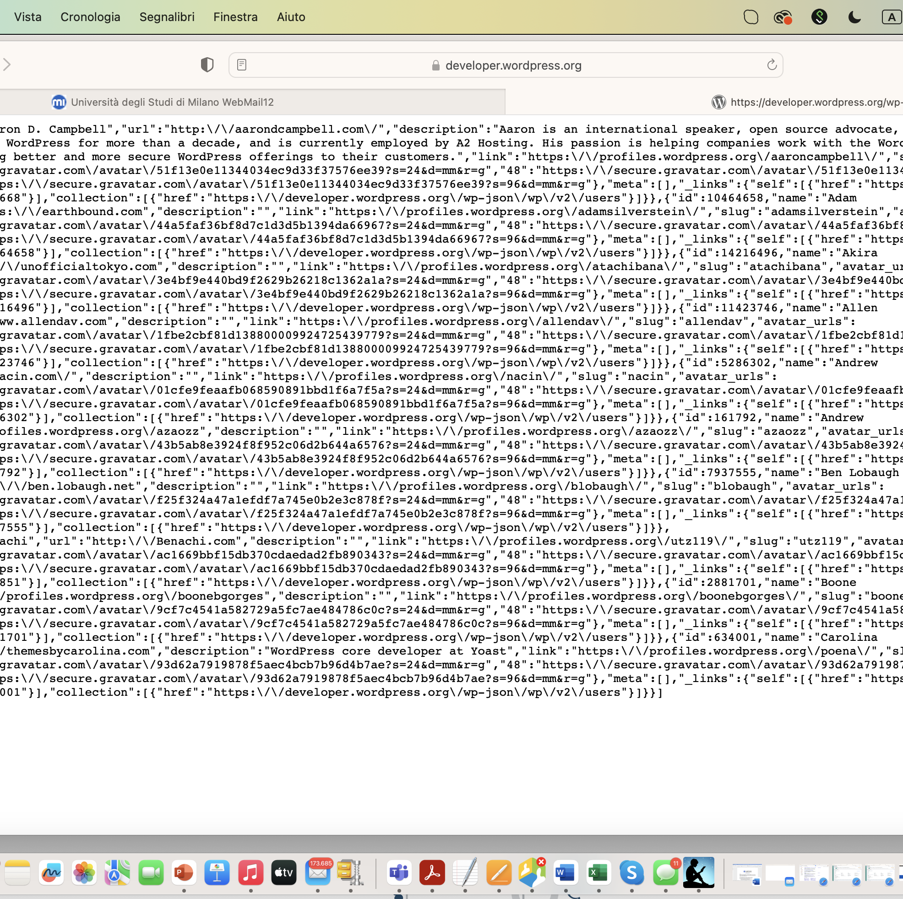
Disclosure vulnerability
When an API and its supporting software share sensitive information with unprivileged users, the API has a disclosure vulnerability (leak)
https://developer.wordpress.org/wp-json/wp/v2/users
These slugs can be used in an attempt to log in as the disclosed users with a brute-force, credential-stuffing, or password-spraying attack.

Slide 30

Broken object level authorization (BOLA).
BOLA vulnerabilities occur when an API provider allows an API consumer access to resources they are not authorized to access.
If an API endpoint does not have object-level access controls, it won’t perform checks to make sure users can only access their own resources. When these controls are missing, User A will be able to successfully request User B’s resources.

Slide 31
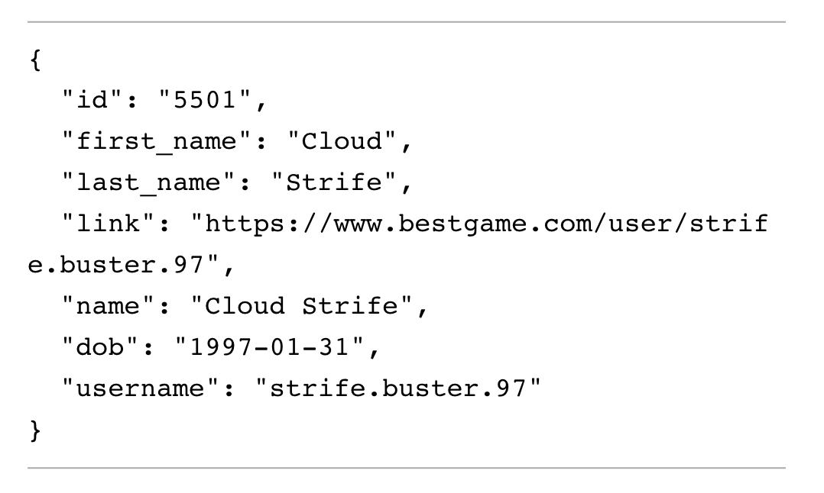
https://bestgame.com/api/v3/users?id=5501

Slide 32

BOLA at work
Try other id numbers (5502, 5503,…
Cry BOLA if you can display other users’ info
Note that predictable object IDs don’t necessarily indicate that you’ve found a BOLA.
For the application to be vulnerable, it must fail to verify that a given user is only able to access their own resources.
Homework test a site for BOLA

Slide 33
Broken User Authentication (BOA)
Broken user authentication refers to any weakness within the API authentication process.
These vulnerabilities typically occur when an API provider either doesn’t implement an authentication protection mechanism or implements a mechanism incorrectly.

Slide 34
Two remarks
Due to the stateless nature of REST APIs, a publicly exposed API key is the equivalent of discovering a username and password.
By using an exposed API key, the attacker assumes the role associated with that key.

Slide 35
Statelessness Risks
RESTful APIs are supposed to be stateless. In order to be stateless, the provider shouldn’t need to remember the consumer from one request to another.
For this constraint to work, APIs often require users to undergo a registration process in order to obtain a unique token. Users can then include the token within requests to demonstrate that they’re authorized to make such requests.
As a consequence, the registration process used to obtain an API token, the token handling, and the system that generates the token could all have their own sets of weaknesses.
To determine if the token generation process is weak, for example, we could collect a sampling of tokens and analyze them for similarities.

Slide 36
Token handling risks
Token handling could be the storage of tokens, the method of transmitting tokens across the network, the presence of hardcoded tokens, and so on.
Attackers might be able to detect hardcoded tokens in JavaScript source files or capture them analyzing a web application.
Once captured a token, the attacker can use it to gain access to previously hidden endpoints or to bypass detection.
If an API provider attributes an identity to a token, we would then take on the identity by hijacking the stolen token.

Slide 37
Registration systems risks
The other parts of the authentication processes that could have their own set of vulnerabilities include aspects of the registration system
Usual suspects are password reset and multi-factor authentication
For example, imagine a password reset feature requires you to provide an email address and a six-digit code to reset your password. Well, if the API allowed you to make as many requests as you wanted, you’d only have to make one million requests in order to guess the code and reset any user’s password.

Slide 38

Other risks
Also watch for the ability to access sensitive resources without being authenticated; API keys, tokens, and credentials used in URLs; a lack of rate-limit restrictions when authenticating; and verbose error messaging.

Slide 39
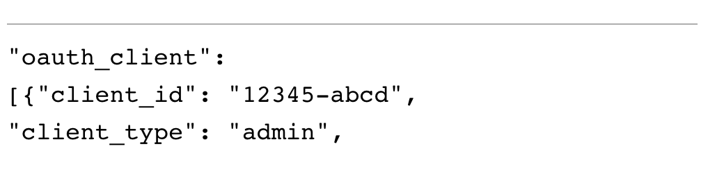
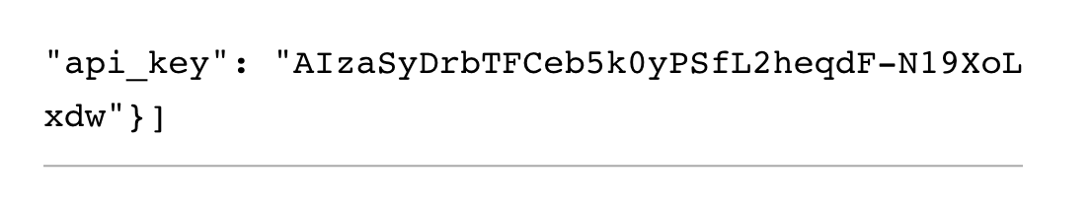
Example
Code committed to a GitHub repository could reveal a hardcoded admin API key:

Slide 40

Information OverExposure
IOE happens when a service responds with more information than is needed to fulfill a request.
This often occurs when the provider expects the API consumer to filter results
  when a consumer requests specific information, the provider might respond with all sorts of information, assuming the consumer will then remove any data they don’t need from the response.

Slide 41
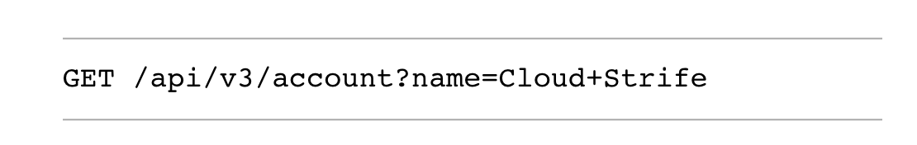
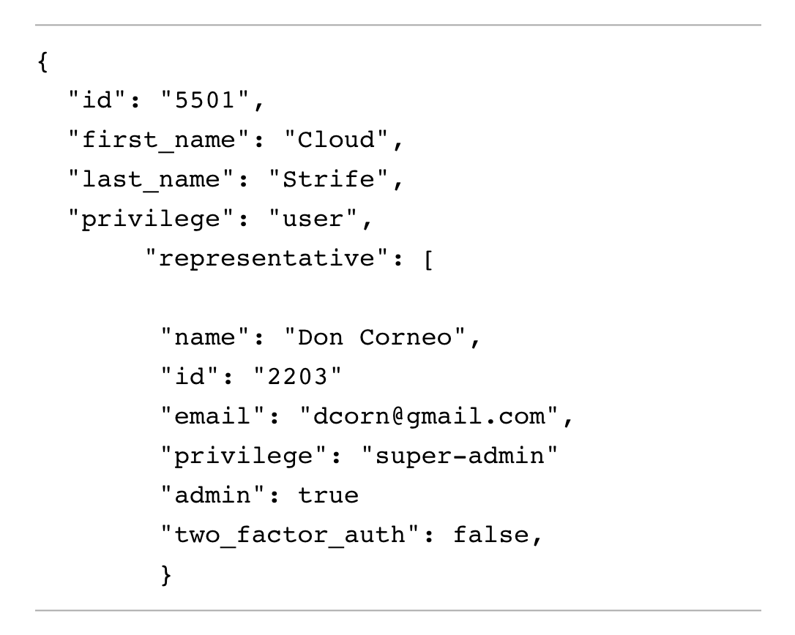
IOE at work

Slide 42
Remarks
Excessive data exposure is an awesome API vulnerability
It bypasses every security control in place to protect sensitive information and hands it all to an attacker on a silver platter
All you need to do to detect excessive data exposure is test your target API endpoints and review the information sent in response.

Slide 43

Denial of Service and Rate Limiting
Without limiting the number of requests consumers can make, an API provider’s infrastructure could be overwhelmed by the requests.
Too many requests without enough resources will lead to the provider’s systems crashing and becoming unavailable
denial of service (DoS) state.

Slide 44

Testing rate limiting
When testing an API that is supposed to have rate limiting, the first thing you should check is that rate limiting works, and you can do so by sending a barrage of requests to the API.
If rate limiting is functioning, you should receive some sort of response informing you that you’re no longer able to make additional requests, usually in the form of an HTTP 429 status code.
Homework: test an API of your choice and show the results

Slide 45

Broken function level authorization (BFLA)
Vulnerability where a user of one role or group is able to access the API functionality of another role or group.
API providers will often have different roles for different types of accounts, such as public users, merchants, partners, administrators, etc.
A BFLA is present if you are able to use the functionality of another privilege level or group.

Slide 46
BOLA and BFLA
FBFLA is BOLA on actions rather than on resources
For example, consider a vulnerable banking API.
When a BOLA vulnerability is present in the API, you might be able to access the information of other accounts, such as payment histories, usernames, email addresses, and account numbers.
If a BFLA vulnerability is present, you might be able to transfer money and actually update the account information.
BOLA is about unauthorized access, whereas BFLA is about unauthorized actions

Slide 47
No Access control via different URLs
If an API has different privilege levels or roles, it may use different endpoints to perform privileged actions.
For example, a bank may use the /{user}/account/balance endpoint for a user wishing to access their account information and the /admin/account/{user} endpoint for an administrator wishing to access user account information.
Vulnerabilities of authentication (e.g. keys) become vulberabilities of authorization

Slide 48

Verbs problem
APIs won’t always use administrative endpoints for administrative functionality.
Instead, the functionality could be based on HTTP request methods GET, POST, PUT, and DELETE.
If a provider doesn’t restrict the HTTP methods a consumer can use, simply making an unauthorized request with a different method could indicate a BFLA vulnerability.

Slide 49
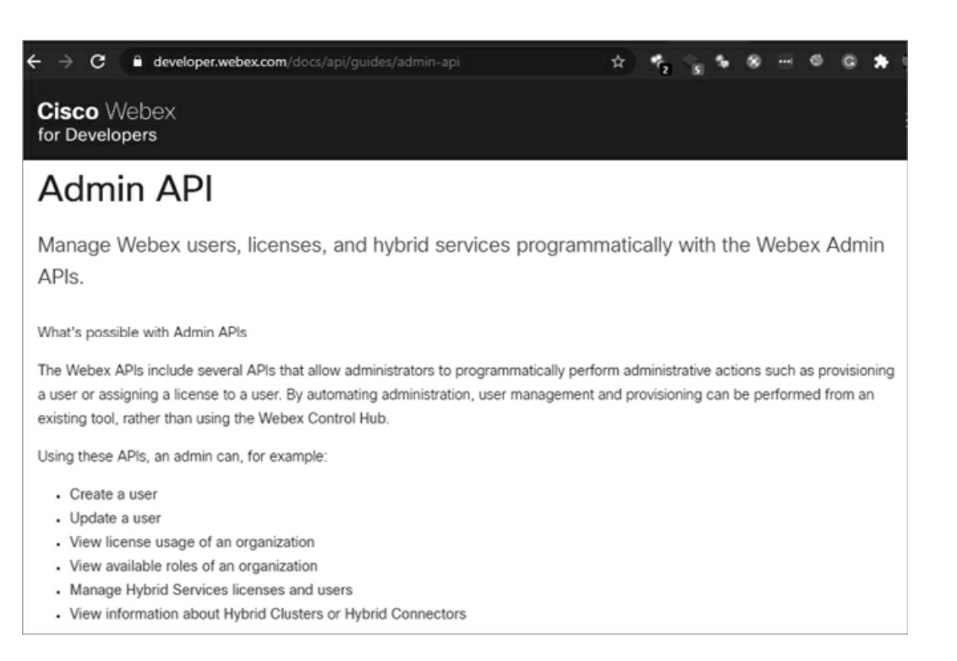
The easiest way in
The easiest way to discover BFLA is to find online administrative API documentation and send requests as an unprivileged user that test admin functions and capabilities.
The CISCO Webex Admin doc page
As an unprivileged user, make requests included in the admin section, such as attempting to create users, update user accounts, and so on.
If access controls are in place, you’ll likely receive an HTTP 401 Unauthorized or 403 Forbidden response.

Slide 50

Guessing
If API documentation for privileged actions is not available, you will need to guess, discover or reverse engineer the endpoints used to perform privileged actions before testing them
Once you’ve found administrative endpoints, you can begin making requests.

Slide 51

Mass assignment
Mass assignment occurs when an API consumer includes more parameters in their requests than the application intended and the application adds these parameters to code variables or internal objects. In this situation, a consumer may be able to edit object properties or escalate privileges.

Slide 52
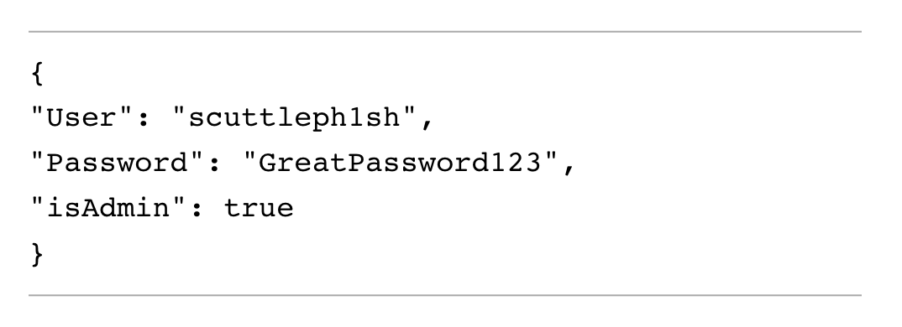
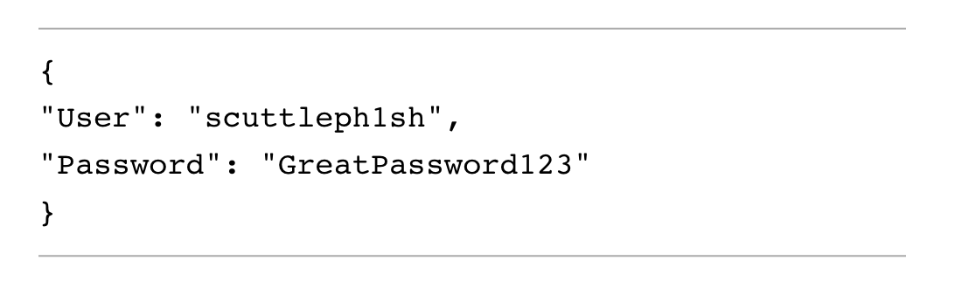
Example

