Slide 1
API security III

Slide 2

Linus Tech Hack
Linus Tech Tips one of the largest tech channels on YouTube got hacked with the hackers taking over the channel for an extended period of time. The hackers proceeded to rename the channel, delete a whole bunch of videos and started live streaming videos of Elon Musk for some reason.
Linus were eventually able to regain access but what is particularly scary is how the hackers were able to gain control in the first place.
You would think that they somehow got access to the YouTube credentials including passwords but the hackers did not have access to any of these.
What they had access to though was the session cookie belonging to the browser of one of the Linus Tech employees.

Slide 3

Reminder
What is a session cookie?
The session cookie is basically a piece of code that a website stores on your computer as a way to recognize your browser in future.
When you log into a website and then close the browser (you don't log out), if you were to open your browser and go to that same site again, you would be automatically logged back in.
This is because the website recognized your browser through the session cookie it stored on your computer the first time you logged in.

Slide 4
So what exactly happened?
The hackers first sent a phishing email to the targeted employee with the subject line pertaining to something about a sponsorship deal.
This sort of email is the type of email Linus tech get on a regular basis considering how big and popular the channel is. The email contained a PDF attachment with the supposed sponsorship details but was infact malware that when clicked on, was able to make an exact copy of the browser cache on the employee’s computer.
Homework: try to clone the browser cache on your machine

Slide 5
What’s in the story
The malware by essentially cloning the browser cache, was able to get access to the session cookies which now meant that the hackers were automatically logged into the YouTube account of the employee and just like that, the hackers now had access.
It might be hard to fault the employee for clicking on the attachment as the email did look to be legit and again it was the type of email they get regularly.
The employee should have raised the alarm when they clicked on the PDF attachment and nothing happened.
When you click on a file you expect it to open and if it doesn't then you should know something else is running in the background.
  If the employee had raised the alarm right then, maybe the hack could have been prevented or the damaged limited.

Slide 6

Readings for This Lecture
Wikipedia
  HTTP Cookie
  Same Origin Policy
  Cross Site Scripting
  Cross Site Request Forgery

Slide 7

Background
Many sensitive tasks are done through web
Online banking, online shopping
Database access
System administration
Web applications and web users are targets of many attacks
Cross site scripting
SQL injection
Cross site request forgery
Information leakage
Session hijacking

Slide 8

Cookies
Stored by the browser
Used by the web applications
  used for authenticating, tracking, and maintaining specific information about users
    e.g., site preferences, contents of shopping carts
  data may be sensitive
  may be used to gather information about specific users
Cookie ownership
  Once a cookie is saved on your computer, only the website that created the cookie can read it

Slide 9

Web Authentication via Cookies
HTTP is stateless
  How does the server recognize a user who has signed in?
Servers can use cookies to store state on client
  After client successfully authenticates, server computes an authenticator and gives it to browser in a cookie
    Client cannot forge authenticator on his own (session id)
  With each request, browser presents the cookie
  Server verifies the authenticator

Slide 10


A Typical Session with Cookies
client
server
POST /login.cgi
Verify that this
client is authorized
Set-Cookie:authenticator
GET /restricted.html
Cookie:authenticator
Check validity of
authenticator
Restricted content
  Authenticators must be unforgeable and tamper-proof
  (malicious clients shouldn’t be able to modify an existing authenticator)
  How to design it?
Notes:
What should the authenticator depends upon?
User name, current time

Slide 11

Same Origin Policy
The basic security model enforced in the browser
SoP isolates the scripts and resources downloaded from different origins
  E.g., evil.org scripts cannot access bank.com resources
Use origin as the security principal
Origin = domain name + protocol + port
  all three must be equal for origin to be considered the same

Slide 12

Security Principals
A security principal is an entity that can be authenticated by a computer system or network.
  Security principals, in addition to being able to be authenticated, are typically capable of being assigned rights and privileges over resources in the network.
Unit to which information security policies can apply.
Not to be confused with security principles.
Choosing the right security principal is important.
Homework: What are security principals in Linux/Unix?

Slide 13

Same Original Policy: What it Controls
Same-origin policy applies to the following accesses:
  manipulating browser windows
  URLs requested via the XmlHttpRequest
    XmlHttpRequest is an API that can be used by web browser scripting languages to transfer XML and other text data to and from a web server using HTTP, by establishing an independent and asynchronous communication channel.
      used by AJAX
  manipulating frames (including inline frames)
  manipulating documents (included using the object tag)
  manipulating cookies

Slide 14
Avoiding XSS bugs (PHP)
Main problem:
  Input checking is difficult --- many ways to inject scripts into HTML.
Preprocess input from user before echoing it
PHP: htmlspecialchars(string)
& → &amp; " → &quot; ' → &#039; < → &lt; > → &gt;
  htmlspecialchars(
  "<a href='test'>Test</a>", ENT_QUOTES);
  Outputs:
  &lt;a href=&#039;test&#039;&gt;Test&lt;/a&gt;

Slide 15
Avoiding XSS bugs (ASP.NET)
ASP.NET 1.1:
  Server.HtmlEncode(string)
    Similar to PHP htmlspecialchars
  validateRequest: (on by default)
    Crashes page if finds <script> in POST data.
    Looks for hardcoded list of patterns.
    Can be disabled:
    <%@ Page validateRequest=“false" %>

Slide 16
Cross site request forgery

Slide 17
Cross site request forgery (abbrev. CSRF or XSRF)
Also known as one click attack or session riding
Effect: Transmits unauthorized commands from a user who has logged in to a website to the website.
Recall that a browser attaches cookies set by domain X to a request sent to domain X; the request may be from another domain
  Site Y redirects you to facebook; if you already logged in, the cookie is attached by the browser

Slide 18
CSRF Explained
Example:
  User logs in to bank.com. Forgets to sign off.
  Session cookie remains in browser state
  Then user visits another site containing:
<form name=F action=http://bank.com/BillPay.php>
<input name=recipient value=badguy> …
<script> document.F.submit(); </script>
  Browser sends user auth cookie with request
    Transaction will be fulfilled
Problem:
  The browser is a confused deputy; it is serving both the websites and the user and gets confused who initiated a request

Slide 19
GMail Incidence: Jan 2007
Allows the attacker to steal a user’s contact
Google docs has a script that run a callback function, passing it your contact list as an object. The script presumably checks a cookie to ensure you are logged into a Google account before handing over the list.
Unfortunately, it doesn’t check what page is making the request. So, if you are logged in on window 1, window 2 (an evil site) can make the function call and get the contact list as an object. Since you are logged in somewhere, your cookie is valid and the request goes through.

Slide 20
Real World CSRF Vulnerabilities
Gmail
NY Times
ING Direct (4th largest saving bank in US)
YouTube
Various DSL Routers
Purdue WebMail
PEFCU
Purdue CS Portal
…

Slide 21
Prevention
Server side:
use cookie + hidden fields to authenticate a web form
hidden fields values need to be unpredictable and user-specific; thus someone forging the request need to guess the hidden field values
requires the body of the POST request to contain cookies
Since browser does not add the cookies automatically, malicious script needs to add the cookies, but they do not have access because of Same Origin Policy
User side:
logging off one site before using others
selective sending of authentication tokens with requests (may cause some disruption in using websites)

Slide 22
More issues…
More Web Security Issues
  SQL injection
  Side channel information leakage
  Cookie privacy issues

Slide 23
What is SQL Injection?
Code Injection Technique
Exploits Security Vulnerability
Targets User Input Handlers

Slide 24
Real World Examples
On August 17, 2009, the United States Justice Department charged an American citizen Albert Gonzalez and two unnamed Russians with the theft of 130 million credit card numbers using an SQL injection attack.
In 2008 a sweep of attacks began exploiting the SQL injection vulnerabilities of Microsoft's IIS web server and SQL database server. Over 500,000 sites were exploited.

Slide 25
Important Syntax
  COMMENTS: --
  Example: SELECT * FROM `table` --selects everything
  LOGIC: ‘a’=‘a’
  Example: SELECT * FROM `table` WHERE ‘a’=‘a’
  MULTI STATEMENTS: S1; S2
  Example: SELECT * FROM `table`; DROP TABLE `table`;

Slide 26
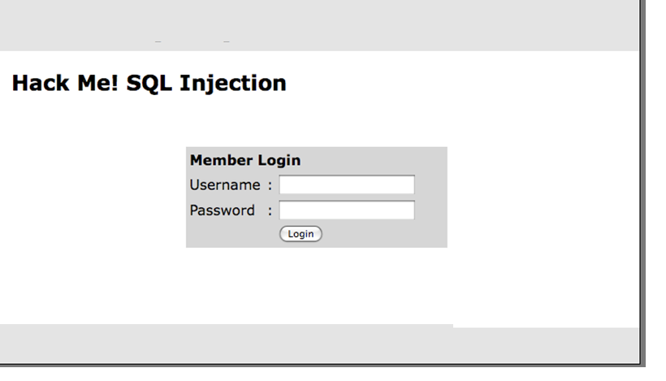
Example Website

Slide 27
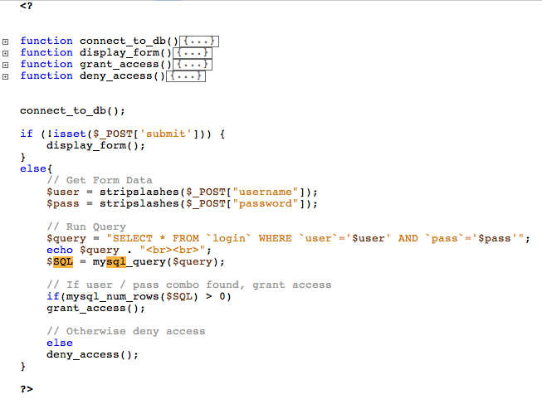

Slide 28
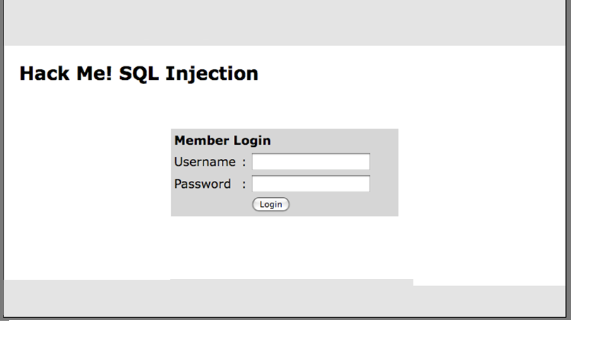
Example Website
cse7330
SELECT * FROM `login` WHERE `user`=‘timbo317’ AND `pass`=‘cse7330’

Slide 29
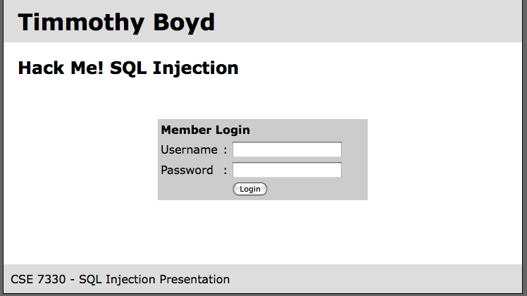
Example Hack
’ OR ‘a’=‘a
’ OR ‘a’=‘a
SELECT * FROM `login` WHERE `user`=‘’ OR ‘a’=‘a’ AND
`pass`=‘’ OR ‘a’=‘a’

Slide 30
It Gets Worse!
’; DROP TABLE `login`; --
SELECT * FROM `login` WHERE `user`=‘’; DROP TABLE `login`; --’ AND
`pass`=‘’

Slide 31
All Queries are Possible
SELECT * FROM `login` WHERE `user`=‘’; INSERT INTO `login` ('user','pass') VALUES ('haxor','whatever');--’ AND `pass`=‘’
SELECT * FROM `login` WHERE `user`=‘’; UPDATE `login` SET `pass`=‘pass123’ WHERE `user`=‘timbo317’;--’ AND `pass`=‘’

Slide 32
Prevention
Logic to allow only numbers / letters in username and password.
How should you enforce the constraint?
SERVER SIDE.
‘ESCAPE’ bad characters.
’ becomes \’
READ ONLY database access.
Remember this is NOT just for login areas!
NOT just for websites!!

Slide 33
Reading
(SQL Injection Walkthrough)(SQL Injection)(SQL Injection)
Friedl, S. (2009, 10 26). SQL Injection Attacks by Example. Retrieved from Steve Friedl's Unixwiz.net Tech Tips: http://unixwiz.net/techtips/sql-injection.html
IBM Informix Guide to SQL: Syntax. (n.d.). Retrieved 10 26, 2009, from IBM.COM: http://publib.boulder.ibm.com/infocenter/idshelp/v10/index.jsp?topic=/com.ibm.sqls.doc/sqls36.htm
SQL Injection. (n.d.). Retrieved 10 26, 2009, from SQL Server 2008 Books Online: http://msdn.microsoft.com/en-us/library/ms161953.aspx
SQL Injection. (n.d.). Retrieved 10 26, 2009, from php.net: http://php.net/manual/en/security.database.sql-injection.php
SQL Injection Walkthrough. (n.d.). Retrieved 10 26, 2009, from Securiteam: http://www.securiteam.com/securityreviews/5DP0N1P76E.html

Slide 34
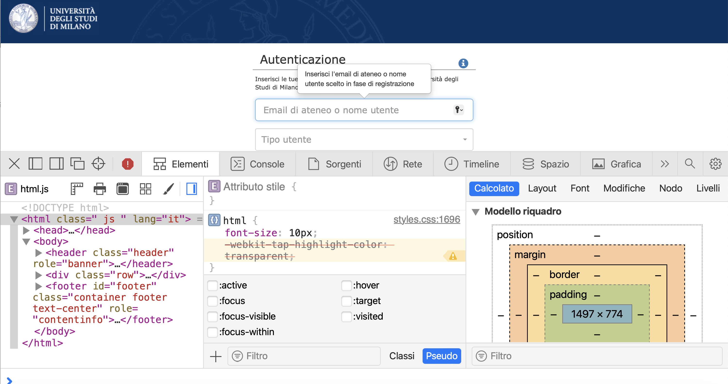
Analyzing Web Apps with DevTools
Use the Dev support of your browser
Chrome/Safari preferred

Slide 35
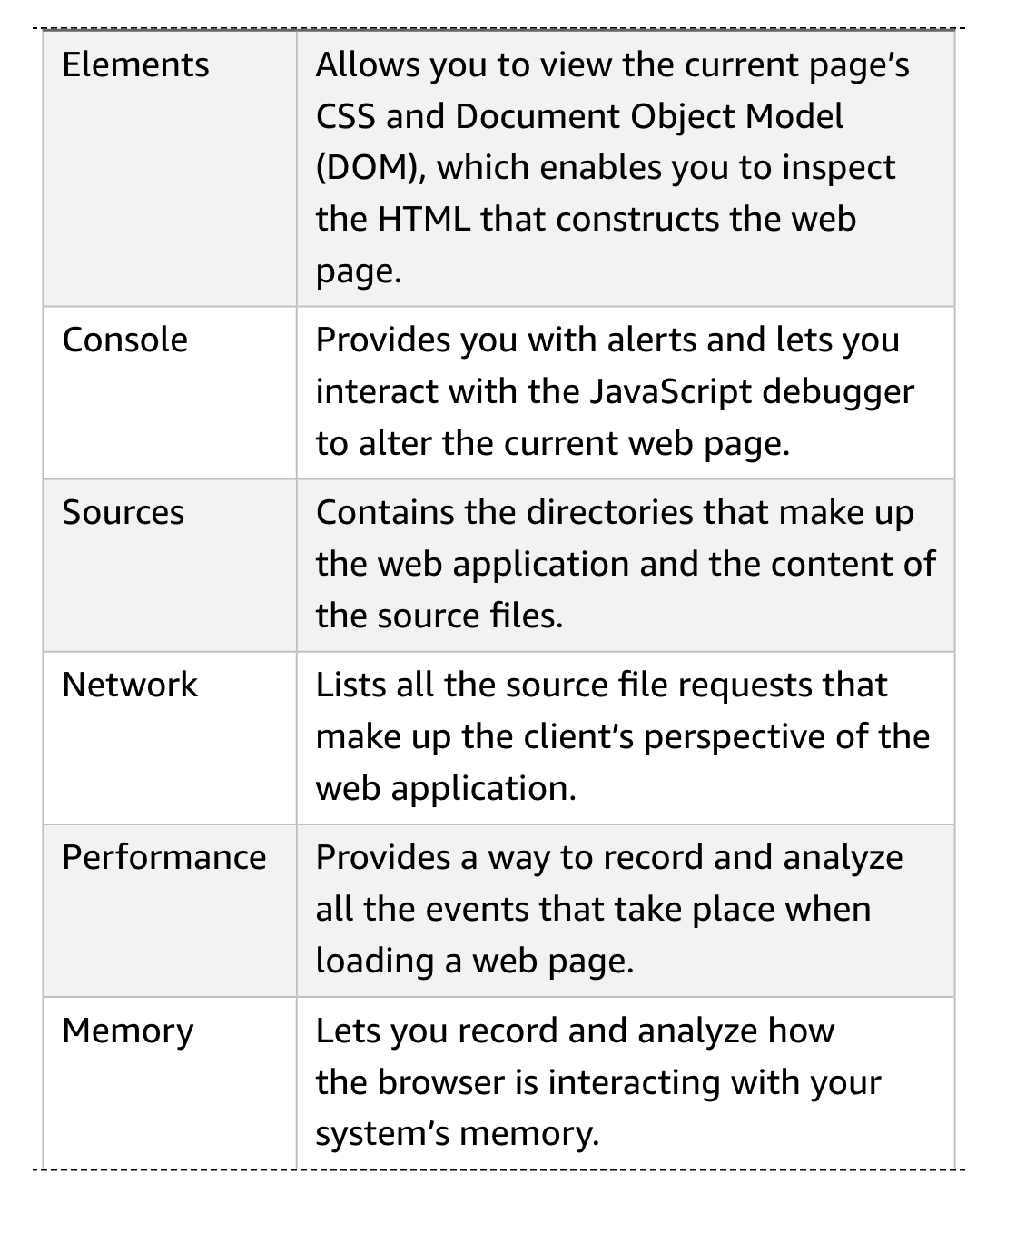
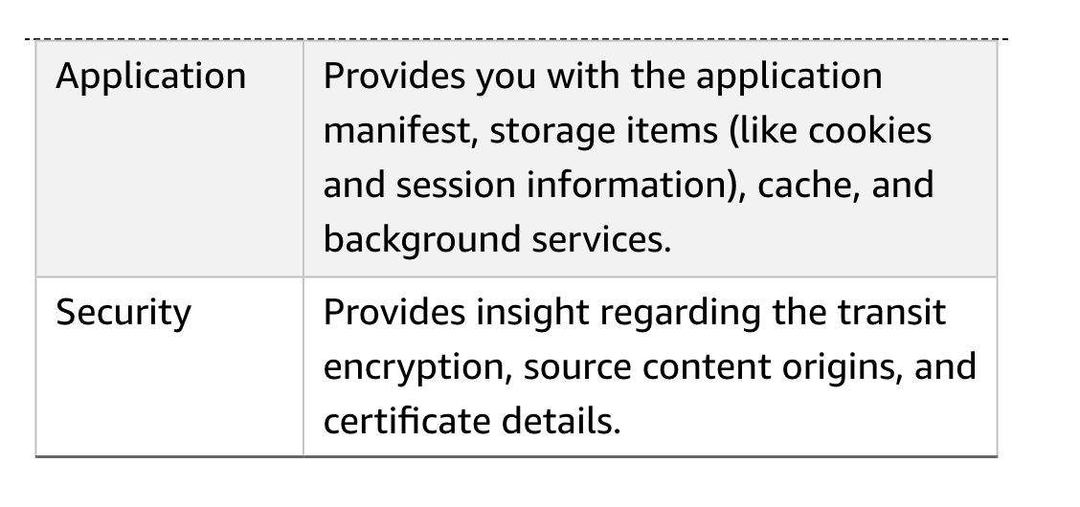
At a glance

Slide 36
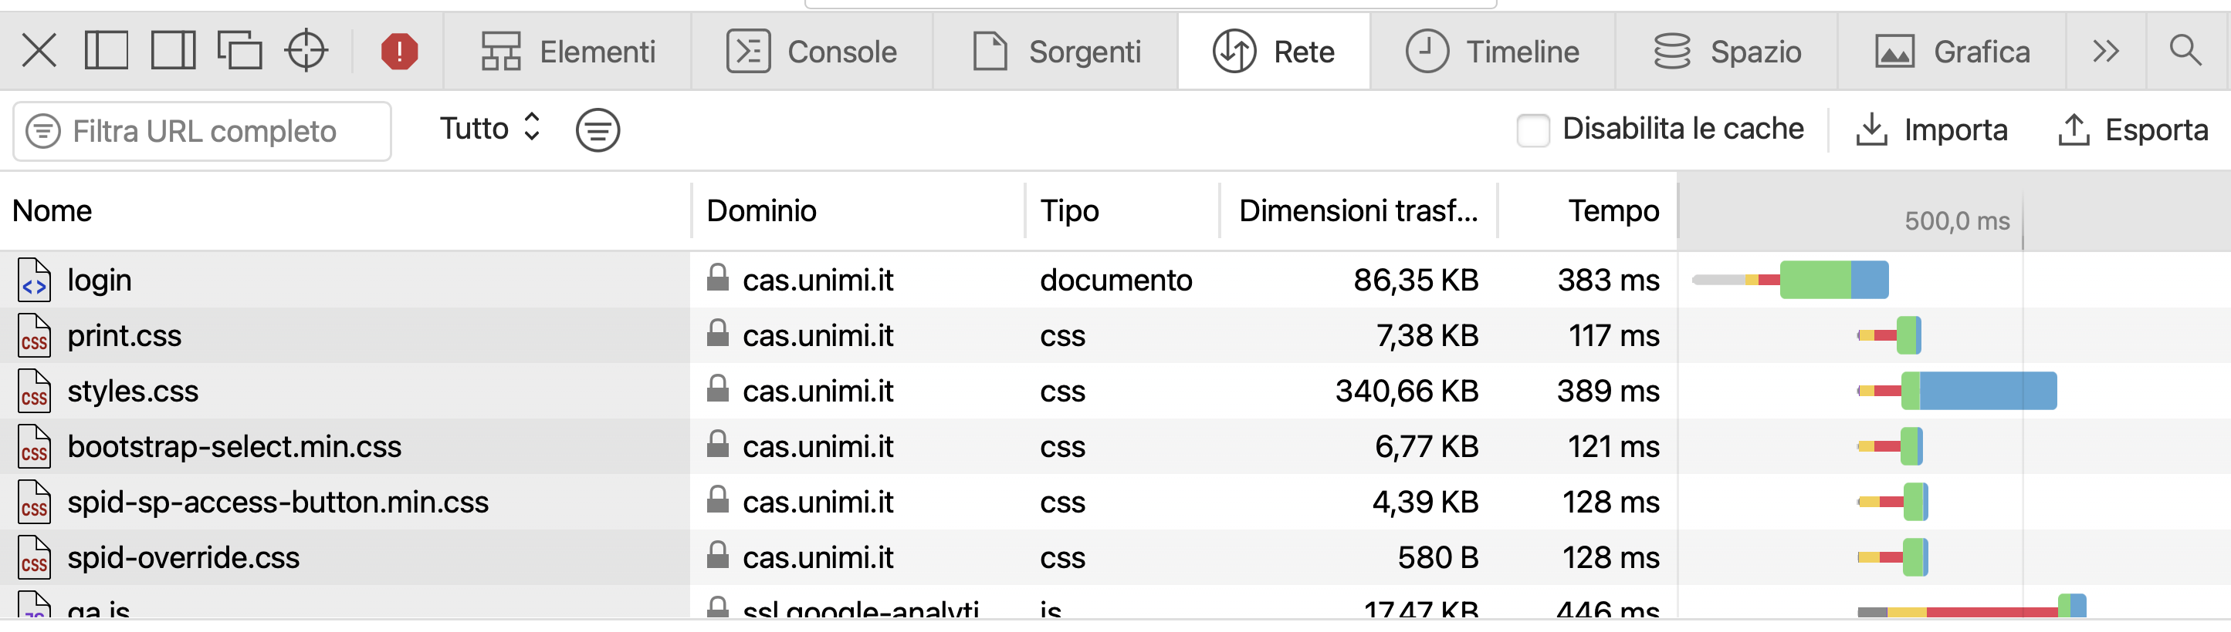
Network panel
Using the Network panel, you can drill down into each request to see the request method that was used, the response status code, the headers, and the response body. To do this, click the name of the URL of interest once under the Name column.

Slide 37
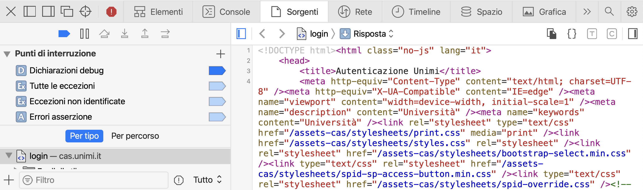
Sources panel
you can use the Sources panel to inspect the source files being used in the app. In capture-the-flag (CTF) events (and occasionally in reality) you may find API keys or other hardcoded secrets here.
The Sources panel comes equipped with strong search functionality that will help you easily discover the inner workings of the application.

Slide 38
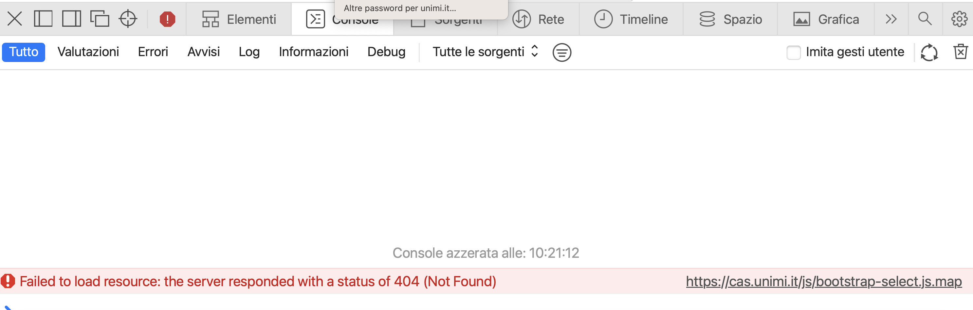
Console panel
The Console panel is useful for running and debugging the web page’s JavaScript. Y
You can use it to detect errors, view warnings, and execute commands.

Slide 39
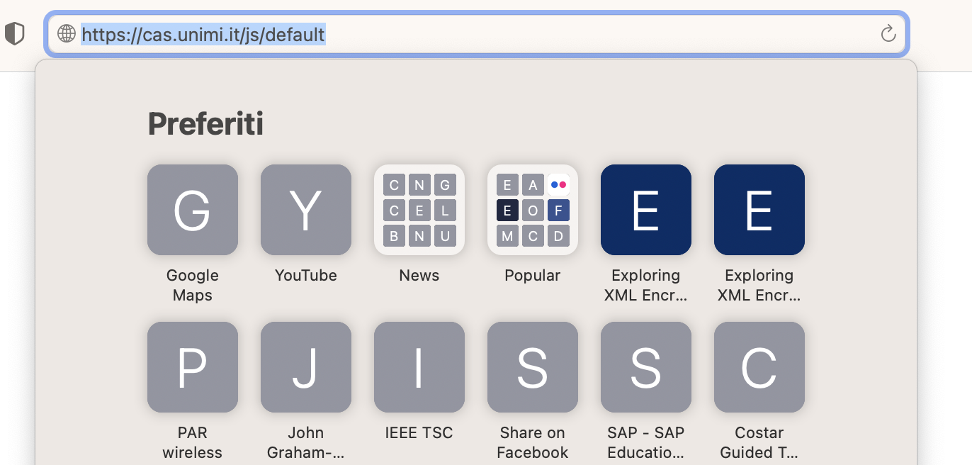
Try resource editing

Slide 40
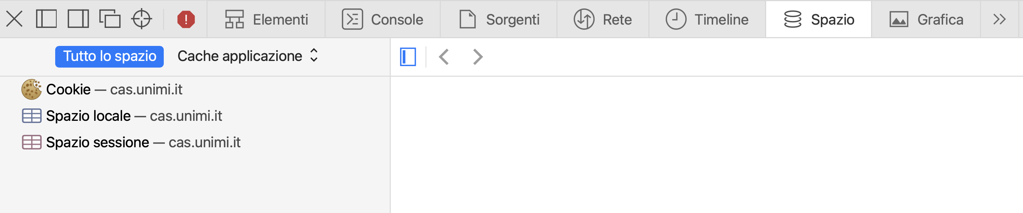
Space Console
Space shows the broswer cache for the current page/service

Slide 41
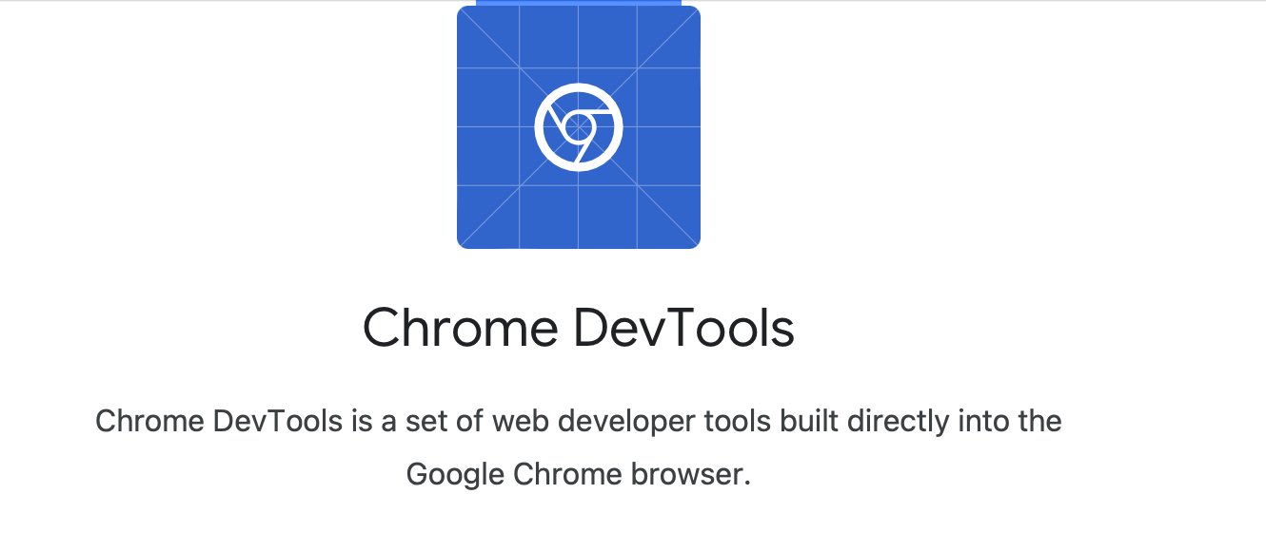
Self instruction
For more information about DevTools, check out the Google Developers documentation at https://developers.google.com/web/tools/chrome-devtools.

Slide 42
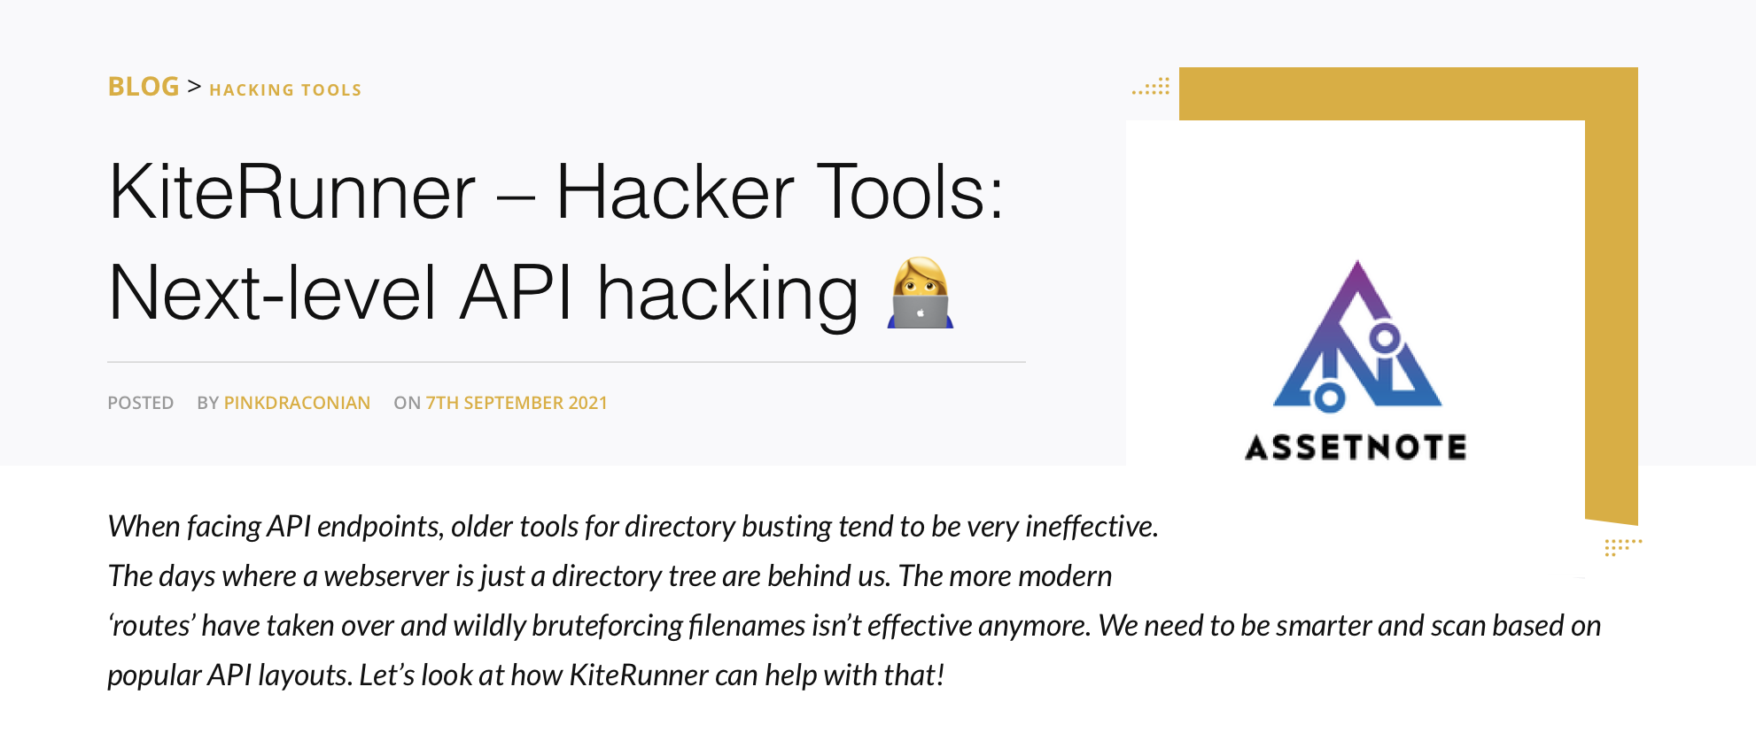
Try crawling
Spidering, or web crawling, is a method that bots use to automatically detect the URL paths and resources of a host.
  Typically, spidering was done by scanning the HTML of web pages for hyperlinks.
Spidering is a good way to get a basic idea of the contents of a web page, but it won’t be able to find hidden paths, or the ones that do not have links found within web pages.
To find hidden paths, we’ll need to use a tool like Kiterunner that effectively performs directory brute-force attacks. In such an attack, an application will request various possible URL paths and validate whether they actually exist based on the host’s responses.
Many modern frameworks (Flask, Rails, Express, Djangs) follow the paradigm of defining routes expecting certains headers.
With this specific knowledge and through internet-wide searches for route names, methods, parameters and headers, KiteRunner can bruteforce API endpoints smarter and faster.

Slide 43
Try fuzzing
As described by the OWASP community page on the topic, fuzzing is “the art of automatic bug finding.”
Using this attack technique, we’d send various types of input in HTTP requests. trying to find an input or payload that causes an application to respond in unexpected ways and reveal a vulnerability.
For example, if you were attacking an API and discovered you could post data to the API provider, you could then attempt to send it various SQL commands.
If the provider doesn’t sanitize this input, there is a chance you could receive a response that indicates that a SQL database is in use.

Slide 44
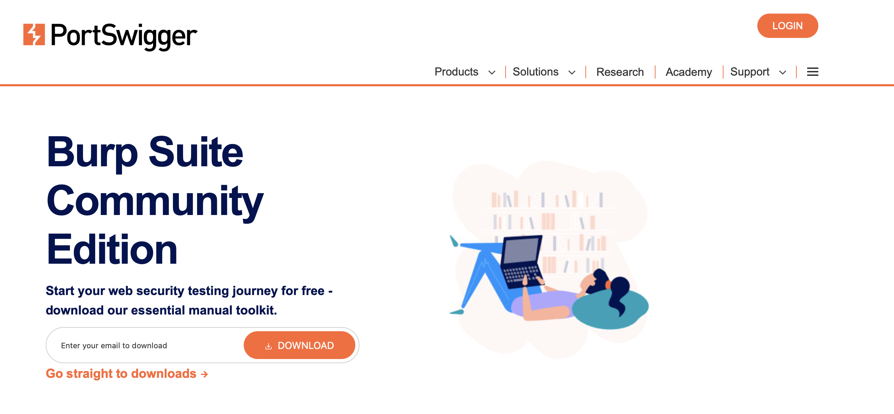
BurpSuite
Burp Suite’s key features is the ability to intercept HTTP requests.
Burp Suite receives requests before forwarding them to the server and then receives the server’s responses before sending them to the browser, allowing you to view and interact with those requests and responses.
For this feature to work, you’ll need to regularly send requests from the browser to Burp Suite.
  This is done with the use of a web proxy.
The proxy is a way for us to reroute web browser traffic to Burp before it is sent to the API provider.

Slide 45
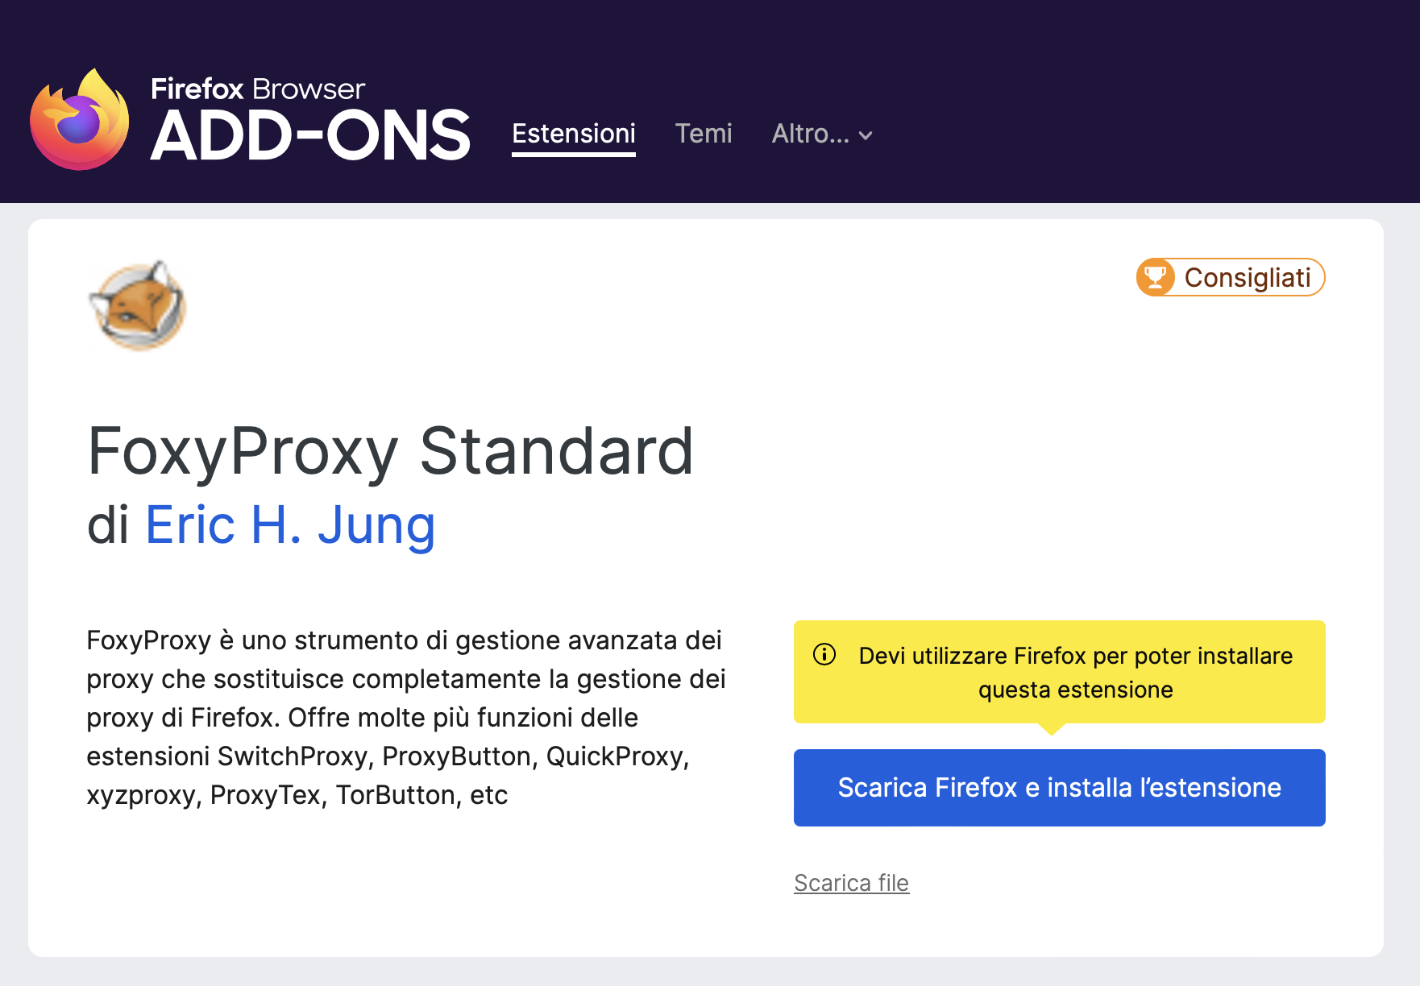
FoxyProxy
Web browsers have proxy functionality built in, but changing and updating these settings every time is unpractical.
A browser add-on called FoxyProxy lets you switch your proxy on and off with a simple click of a button.
FoxyProxy is available for both Chrome and Firefox.

Slide 46
Install FoxyProxy
Follow these steps to install FoxyProxy: Navigate to your browser’s add-on or plug-in store and search FoxyProxy.
1
Install FoxyProxy Standard and add it to your browser.
2
Click the fox icon at the top-right corner of your browser (next to your URL) and select Options. Select Proxies▶Add New Proxy▶Manual Proxy Configuration. Add 127.0.0.1 as the host IP address.
3
Update the port to 8080 (Burp Suite’s default proxy settings).
4

