Slide 1
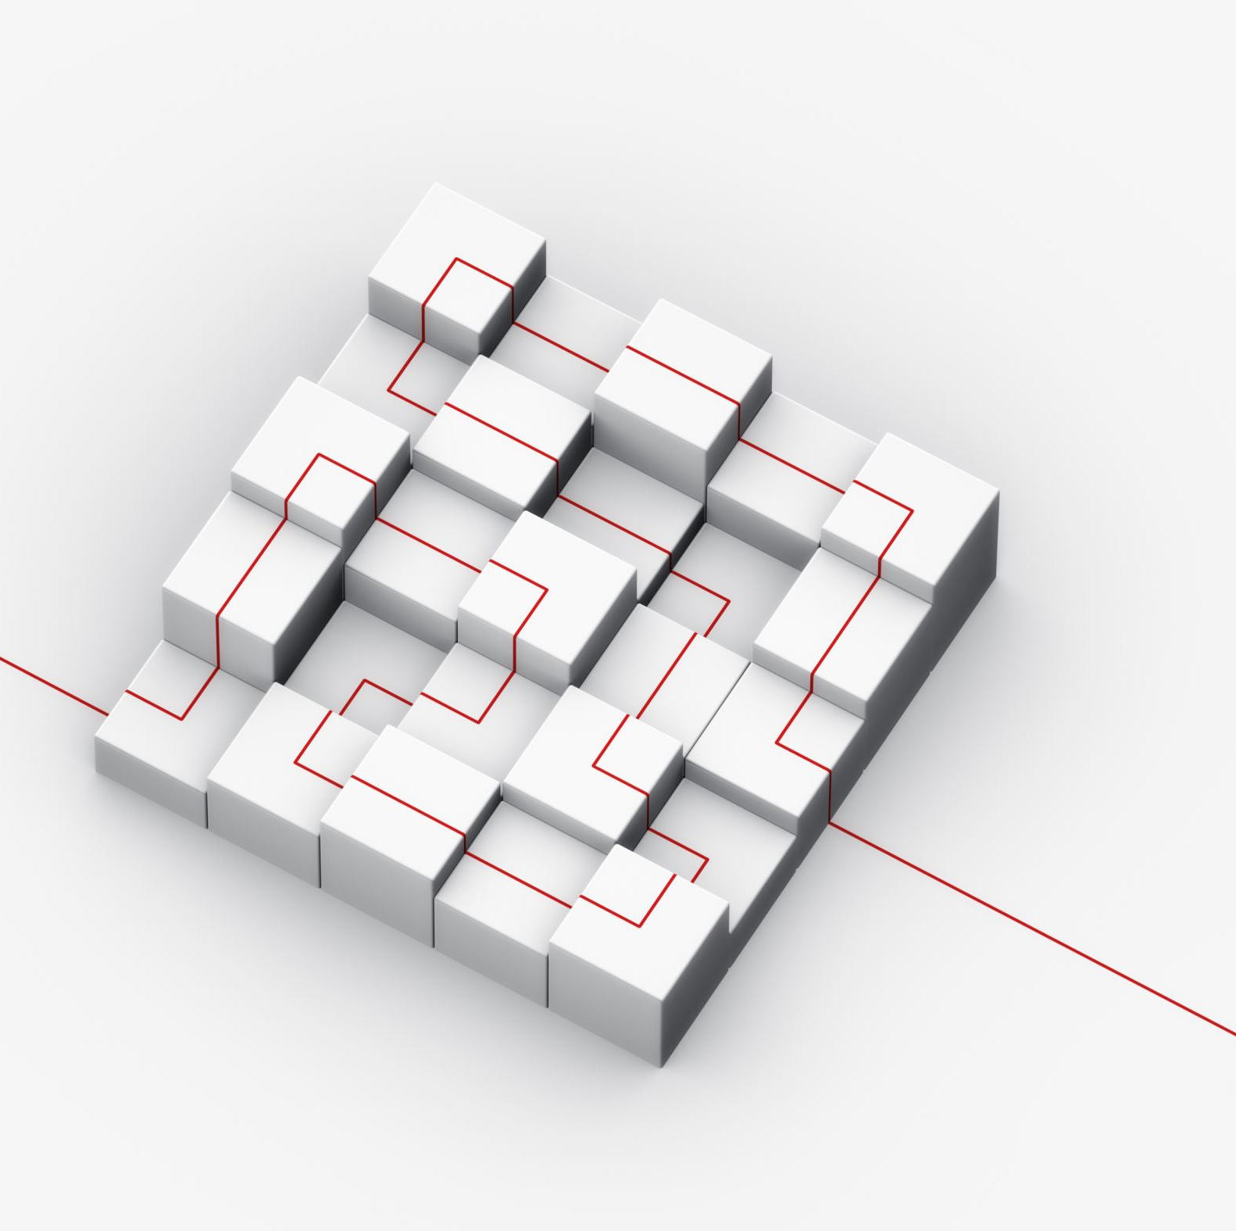
Outline
HIErarchical Network design
Redundant Network Design Topologies
Modular Network Design
Designing a Campus Network Design Topology
Designing the Enterprise Edge Topology
Secure Network Design Topologies

Slide 2
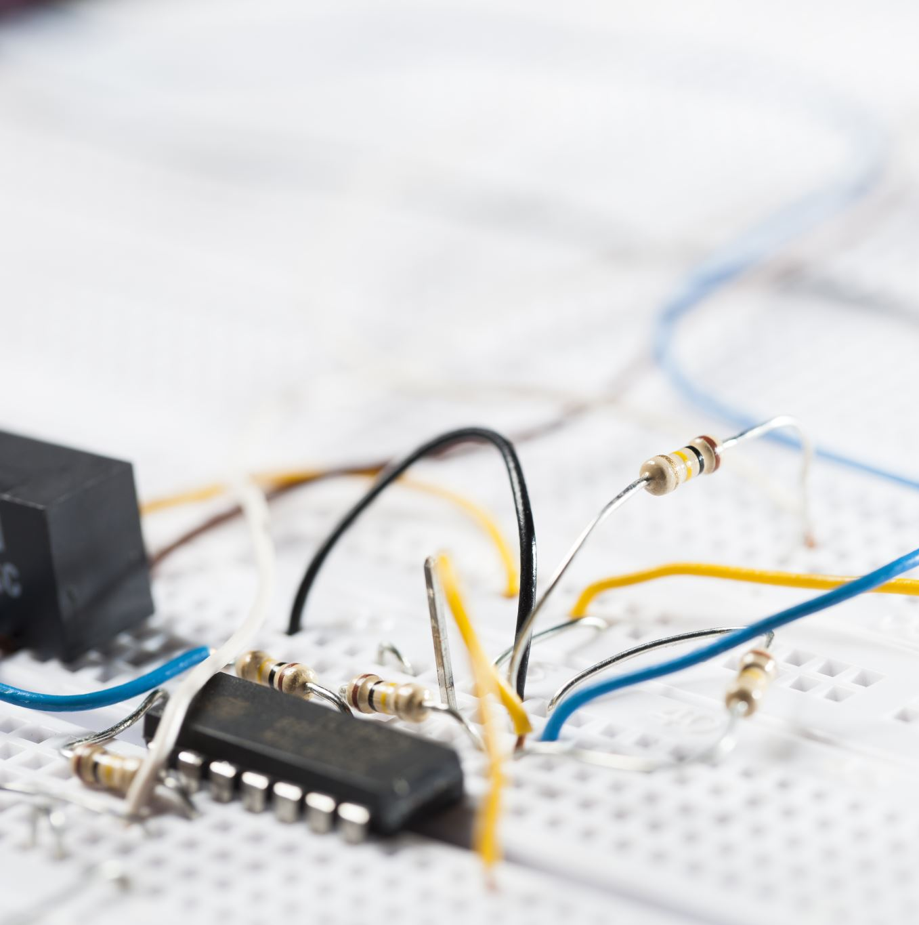
Virtual LANs (VLANs)
An emulation of a standard LAN that allows data transfer to take place without the traditional physical restraints placed on a network
A set of devices that belong to an administrative group
Designers use VLANs to constrain broadcast traffic

Slide 3
VLANs versus Real LANs
Switch A
Switch B
Station A1
Station A2
Station A3
Station B1
Station B2
Station B3
Network A
Network B
Notes:
To understand VLANs, it helps to think about real (non-virtual) LANs first. Imagine two switches that are not connected to each other in any way. Switch A connects stations in Network A and Switch B connects stations in Network B,
When Station A1 sends a broadcast, Station A2 and Station A3 receive the broadcast, but none of the stations in Network B receive the broadcast, because the two switches are not connected. This same configuration can be implemented through configuration options in a single switch, with the result looking like the next slide.

Slide 4
A Switch with VLANs
VLANs versus Real LANs
VLAN A
Station A1
Station A2
Station A3
Station B1
Station B2
Station B3
VLAN B
Notes:
Through the configuration of the switch there are now two virtual LANs implemented in a single switch, instead of two separate physical LANs. This is the beauty of VLANs. The broadcast, multicast, and unknown-destination traffic originating with any member of VLAN A is forwarded to all other members of VLAN A, and not to a member of VLAN B. VLAN A has the same properties as a physically separate LAN bounded by routers. The protocol behavior in this slide is exactly the same as the protocol behavior in the previous slide.

Slide 5
VLANs Span Switches
VLAN A
VLAN A
Station A1
Station A2
Station A3
Station A4
Station A5
Station A6
Switch A
Switch B
Station B1
Station B2
Station B3
Station B4
Station B5
Station B6
VLAN B
VLAN B
Notes:
VLANs can span multiple switches. In this slide, both switches contain stations that are members of VLAN A and VLAN B. This design introduces a new problem, the solution to which is specified in the IEEE 802.1Q standard and the Cisco proprietary Inter-Switch Link (ISL) protocol. The problem has to do with the forwarding of broadcast, multicast, or unknown-destination frames from a member of a VLAN on one switch to the members of the same VLAN on the other switch.
In this slide, all frames going from Switch A to Switch B take the same interconnection path. The 802.1Q standard and Cisco's ISL protocol define a method for Switch B to recognize whether an incoming frame belongs to VLAN A or to VLAN B. As a frame leaves Switch A, a special header is added to the frame, called the VLAN tag. The VLAN tag contains a VLAN identifier (ID) that specifies to which VLAN the frame belongs.
Because both switches have been configured to recognize VLAN A and VLAN B, they can exchange frames across the interconnection link, and the recipient switch can determine the VLAN into which those frames should be sent by examining the VLAN tag. The link between the two switches is sometimes called a trunk link or simply a trunk.
Trunk links allow the network designer to stitch together VLANs that span multiple switches. A major design consideration is determining the scope of each VLAN and how many switches it should span. Most designers try to keep the scope small. Each VLAN is a broadcast domain. In general, a single broadcast domain should be limited to a few hundred workstations (or other devices, such as IP phones).

Slide 6

WLANs and VLANs
A wireless LAN (WLAN) is often implemented as a VLAN
Facilitates roaming
Users remain in the same VLAN and IP subnet as they roam, so there’s no need to change addressing information
Also makes it easier to set up filters (access control lists) to protect the wired network from wireless users

Slide 7
Workstation-to-Router Communication
Proxy ARP (not a good idea)
Listen for route advertisements (not a great idea either)
ICMP router solicitations (not widely used)
Default gateway provided by DHCP (better idea but no redundancy)
Use Hot Standby Router Protocol (HSRP) for redundancy

Slide 8
HSRP
Active Router
Enterprise Internetwork
Virtual Router
Workstation
Standby Router

Slide 9
Multihoming the Internet Connection
ISP 1
ISP 1
Enterprise
Milan
Enterprise
NY
Option A
Option C
ISP 1
ISP 2
ISP 1
ISP 2
Enterprise
Milan
Enterprise
NY
Option B
Option D

Slide 10
Security Topologies
DMZ
Enterprise
Network
Internet
Web, File, DNS, Mail Servers

Slide 11
Security Topologies
Security Topologies
Internet
Firewall
DMZ
Enterprise Network
Web, File, DNS, Mail Servers

Slide 12
Summary
Use a systematic, top-down approach
Plan the logical design before the physical design
Topology design should feature hierarchy, redundancy, modularity, and security

Slide 13
DAFTAR PUSTAKA/SUMBER
Oppenheimer, Priscilla. (2013). Top Down Network Design. 3rd Edition. Cisco Press. Indianapolis. ISBN: 978-1-58705-152-4.
Hummel, S. L. (2015). Cisco Design Fundamentals: Multilayered Network Architecture and Design for Network Engineers.

Slide 14

Network Topology Design Themes
Hierarchy
Redundancy
Modularity
Well-defined entries and exits
Protected perimeters

Slide 15
Why Use a Hierarchical Model?
Reduces workload on network devices
  Avoids devices having to communicate with too many other devices (reduces “CPU adjacencies”)
Constrains broadcast domains
Enhances simplicity and understanding
Facilitates changes
Facilitates scaling to a larger size

Slide 16
Hierarchical Network Design
Enterprise WAN
Backbone
Core Layer
Campus A
Campus B
Distribution Layer
Campus C
Campus C Backbone
Access Layer
Building C-1
Building C-2

Slide 17
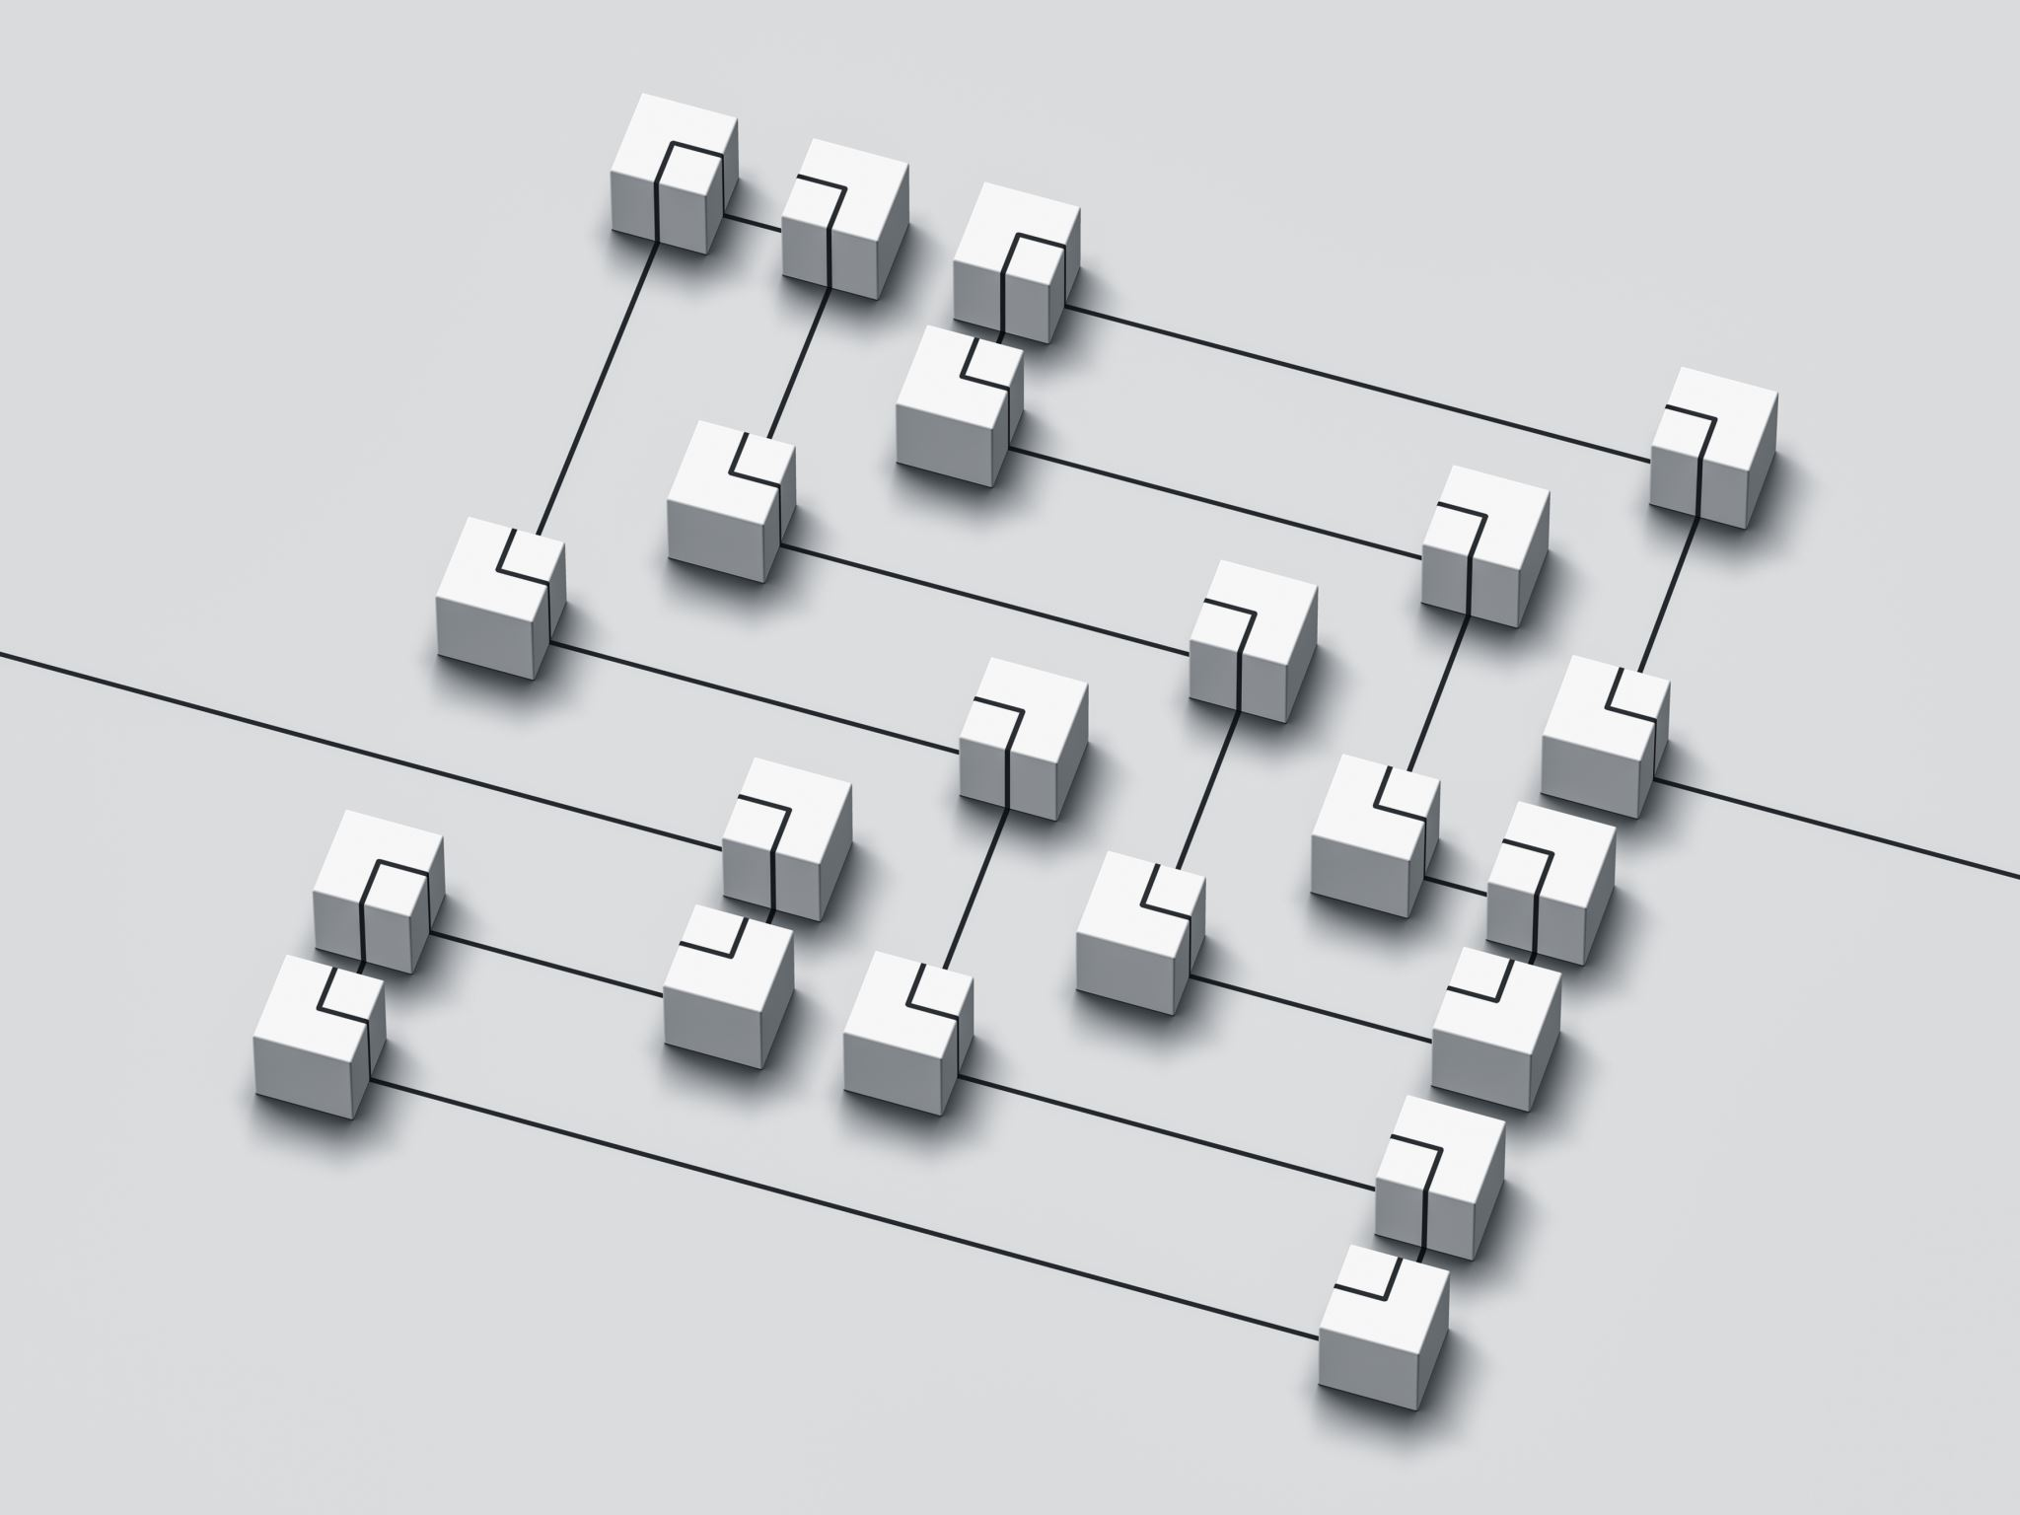
Cisco’s Hierarchical Design Model
A core layer of high-end routers and switches that are optimized for availability and speed
A distribution layer of routers and switches that implement policies and segment traffic
An access layer that connects users via hubs, switches, and other devices

Slide 18
Flat Versus Hierarchy
Headquarters in Milan
Headquarters in Milan
Como Branch Office
Pavia Branch Office
Cremona
Office
Como
Office
Pavia
Office
Cremona
Office
Flat Loop Topology
Hierarchical Redundant Topology

Slide 19
A Partial-Mesh Hierarchical Design
Headquarters (Core Layer)
Regional Offices (Distribution Layer)
Branch Offices (Access Layer)

Slide 20
Hub-and-Spoke Hierarchical Topology
Corporate Headquarters
Branch Office
Home Office
Branch Office

Slide 21
Avoid Chains and Backdoors
Core Layer
Distribution Layer
Access Layer
Backdoor
Chain

Slide 22

How Do You Know When You Have a Good Design?
When you already know how to add a new building, floor, WAN link, remote site, e-commerce service, and so on
When new additions cause only local change, to the directly-connected devices
When your network can double or triple in size without major design changes
When troubleshooting is easy because there are no complex protocol interactions to wrap your brain around
Notes:
Said by Dr. Peter Welcher, consultant and author of many networking articles in magazines, etc.

Slide 23
Cisco’s Enterprise Composite Network Model
Enterprise Campus
Enterprise Edge
Service Provider Edge
Building
Access
E-Commerce
ISP A
Network
Management
Building
Distribution
Campus Infrastructure
Edge
Distribution
Internet
Connectivity
ISP B
Campus
Backbone
PSTN
VPN/ Remote
Access
Frame
Relay,
ATM
WAN
Server Farm

Slide 24

Campus Topology Design
Use a hierarchical, modular approach
Minimize the size of bandwidth domains
Minimize the size of broadcast domains
Provide redundancy
  Mirrored servers
  Multiple ways for workstations to reach a router for off-net communications

Slide 25
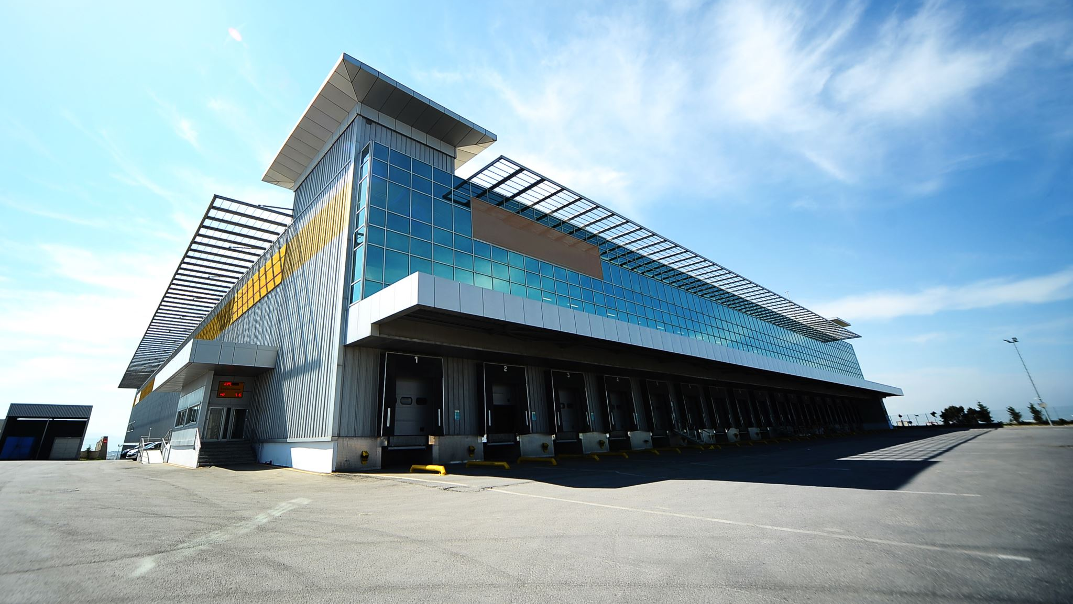
Enterprise Campus Modules
Server farm
Network management module
Edge distribution module for connectivity to the rest of the world
Campus infrastructure module:
  Building access submodule
  Building distribution submodule
  Campus backbone
Notes:
Building access submodule. Located within a campus building, this submodule contains end-user workstations and IP phones, connected to switches or wireless access points. Higher-end switches provide uplinks to the building distribution module. Services offered by this module include network access, broadcast control, protocol filtering, and the marking of packets for QoS features.
Building distribution submodule. The job of this submodule is to aggregate wiring closets within a building and provide connectivity to the campus backbone via routers (or switches with routing modules). This submodule provides routing, QoS, and access control methods for meeting security and performance requirements. Redundancy and load sharing are recommended for this submodule. For example, each building distribution submodule should have two equal-cost paths to the campus backbone.
Campus backbone. The campus backbone is the core layer of the campus infrastructure. The backbone interconnects the building access and distribution submodules with the server farm, network management, and edge distribution modules. The campus backbone provides redundant and fast-converging connectivity. It routes and switches traffic as fast quickly as possible from one module to another. This module usually uses high-speed routers (or switches with routing capability) and provides QoS and security features.

Slide 26
A Simple Campus Redundant Design
Host A
LAN X
Switch 1
Switch 2
LAN Y
Host B

Slide 27
Bridges and Switches use Spanning-Tree Protocol (STP) to Avoid Loops
Host A
LAN X
Switch 1
X
Switch 2
LAN Y
Host B

Slide 28
Bridges (Switches) Running STP
Participate with other bridges in the election of a single bridge as the Root Bridge.
Calculate the distance of the shortest path to the Root Bridge and choose a port (known as the Root Port) that provides the shortest path to the Root Bridge.
For each LAN segment, elect a Designated Bridge and a Designated Port on that bridge. The Designated Port is a port on the LAN segment that is closest to the Root Bridge. (All ports on the Root Bridge are Designated Ports.)
Select bridge ports to be included in the spanning tree. The ports selected are the Root Ports and Designated Ports. These ports forward traffic. Other ports block traffic.
Notes:
If all ports have equal distance to the Root Bridge, then the Designated Port is chosen by lowest sender Bridge ID. If the IDs are the same, then the port is chosen by lowest Port ID.
In general, STP checks for the best information by using these four criteria in the following order:
Lowest Root Bridge ID
Lowest path cost to the Root Bridge
Lowest sender Bridge ID
Lowest Port ID
See Top-Down Network Design for more details.

Slide 29
Elect a Root
Bridges (Switches) Running STP
Bridge A ID = 80.00.00.00.0C.AA.AA.AA
Lowest Bridge ID
Wins!
Root
Bridge A
Port 1
Port 2
LAN Segment 1
100-Mbps Ethernet
Cost = 19
LAN Segment 2
100-Mbps Ethernet
Cost = 19
Port 1
Port 1
Bridge B
Bridge C
Port 2
Port 2
Bridge B ID = 80.00.00.00.0C.BB.BB.BB
Bridge C ID = 80.00.00.00.0C.CC.CC.CC
LAN Segment 3
100-Mbps Ethernet
Cost = 19

Slide 30
Determine Root Ports
Bridges (Switches) Running STP
Bridge A ID = 80.00.00.00.0C.AA.AA.AA
Root
Bridge A
Lowest Cost
Wins!
Port 1
Port 2
LAN Segment 1
100-Mbps Ethernet
Cost = 19
LAN Segment 2
100-Mbps Ethernet
Cost = 19
Root Port
Root Port
Port 1
Port 1
Bridge B
Bridge C
Port 2
Port 2
Bridge B ID = 80.00.00.00.0C.BB.BB.BB
Bridge C ID = 80.00.00.00.0C.CC.CC.CC
LAN Segment 3
100-Mbps Ethernet
Cost = 19

Slide 31
Determine Designated Ports
Bridges (Switches) Running STP
Bridge A ID = 80.00.00.00.0C.AA.AA.AA
Root
Bridge A
Designated Port
Designated Port
Port 1
Port 2
LAN Segment 1
100-Mbps Ethernet
Cost = 19
LAN Segment 2
100-Mbps Ethernet
Cost = 19
Root Port
Root Port
Port 1
Port 1
Bridge B
Bridge C
Port 2
Port 2
Bridge B ID = 80.00.00.00.0C.BB.BB.BB
Bridge C ID = 80.00.00.00.0C.CC.CC.CC
Designated Port
LAN Segment 3
100-Mbps Ethernet
Cost = 19
Lowest Bridge ID
Wins!

Slide 32
Prune Topology into a Tree!
Bridges (Switches) Running STP
Bridge A ID = 80.00.00.00.0C.AA.AA.AA
Root
Bridge A
Designated Port
Designated Port
Port 1
Port 2
LAN Segment 1
100-Mbps Ethernet
Cost = 19
LAN Segment 2
100-Mbps Ethernet
Cost = 19
Root Port
Root Port
Port 1
Port 1
Bridge B
Bridge C
Port 2
Port 2
X
Bridge B ID = 80.00.00.00.0C.BB.BB.BB
Bridge C ID = 80.00.00.00.0C.CC.CC.CC
Designated Port
LAN Segment 3
100-Mbps Ethernet
Cost = 19
Blocked Port

Slide 33
React to Changes
Bridges (Switches) Running STP
Bridge A ID = 80.00.00.00.0C.AA.AA.AA
Root
Bridge A
Designated Port
Designated Port
Port 1
Port 2
LAN Segment 1
LAN Segment 2
Root Port
Root Port
Port 1
Port 1
Bridge B
Bridge C
Port 2
Port 2
Bridge B ID = 80.00.00.00.0C.BB.BB.BB
Bridge C ID = 80.00.00.00.0C.CC.CC.CC
Designated Port Becomes Disabled
LAN Segment 3
Blocked Port Transitions to Forwarding State

Slide 34

Scaling the Spanning Tree Protocol
Keep the switched network small
  It shouldn’t span more than seven switches
Use BPDU skew detection on Cisco switches
Use IEEE 802.1w
  Provides rapid reconfiguration of the spanning tree
  Also known as RSTP

