Slide 2
Outline
Virtualization
multi-cloud assurance, SLA and certification
A (meta-)model
Some research objectives
References

Slide 3
What is a virtualized infrastructure?

Slide 4
“Computer Utilities” Vision:
Implications of the Internet
1969 – Leonard Kleinrock, ARPANET project
  “As of now, computer networks are still in their infancy, but as they grow up and become sophisticated, we will probably see the spread of ‘computer utilities’, which, like present electric and telephone utilities, will service individual homes and offices across the country”
Computers Redefined
  1984 – John Gage, Sun Microsystems
    “The network is the computer”
  2008 – David Patterson, U. C. Berkeley
    “The data center is the computer. There are dramatic differences between of developing software for millions to use as a service versus distributing software for millions to run their PCs”
  2008 – “The Cloud is the computer” – Buyya!

Slide 5
Defining Clouds:
Over 20 definitions:
  http://cloudcomputing.sys-con.com/read/612375_p.htm
Buyya’s definition☺
  "A Cloud is a type of parallel and distributed system consisting of a collection of inter-connected and virtualised computers that are dynamically provisioned and presented as one or more unified computing resources based on service-level agreements established through negotiation between the service provider and consumers.”
Keywords: Virtualisation (VMs), Dynamic Provisioning (negotiation and SLAs), and Web 2.0 access interface

Slide 6
Cloud Services
Infrastructure as a Service (IaaS)
  CPU, Storage: Amazon.com, Nirvanix, GoGrid….
Platform as a Service (PaaS)
  Google App Engine, Microsoft Azure, Manjrasoft Aneka..
Software as a Service (SaaS)
  SalesForce.Com
Software as a Service
(SaaS)
Platform as a Service
(PaaS)
Infrastructure as a Service
(IaaS)

Slide 7
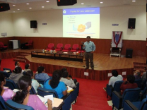

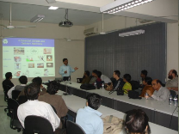
Clouds based on Ownership and Exposure
Public/Internet Clouds
Private/Enterprise Clouds
Hybrid/Mixed Clouds
3rd party,
multi-tenant Cloud
infrastructure
& services:
* available on
subscription basis
(pay as you go)
Cloud computing
model run
within a company’s
own Data Center /
infrastructure for
internal and/or
partners use.
Mixed usage of
private and public
Clouds:
Leasing public
cloud services
when private cloud
capacity is
insufficient

Slide 8
Benefits of (Public) Clouds
No upfront infrastructure investment
  No procuring hardware, setup, hosting, power, etc..
On demand access
  Lease what you need and when you need..
Efficient Resource Allocation
  Globally shared infrastructure, can always be kept busy by serving users from different time zones/regions...
Nice Pricing
  Based on Usage, QoS, Supply and Demand, Loyalty, …
Application Acceleration
  Parallelism for large-scale data analysis, what-if scenarios studies…
Highly Availability, Scalable, and Energy Efficient
Supports Creation of 3rd Party Services & Seamless offering
  Builds on infrastructure and follows similar Business model as Cloud

Slide 9
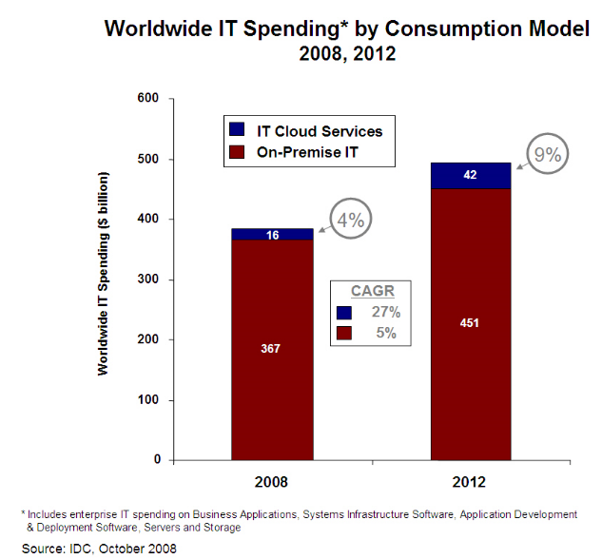
Cloud opportunity in short term

Slide 10
What Consumers and Providers Want?
Consumers – minimize expenses, meet QoS
  How do I express QoS requirements to meet my goals?
  How do I assign valuation to my applications?
  How do I discover services and map applications to meet QoS needs?
  How do I manage multiple providers and get my work done?
  How do I outperform other competing consumers?
  …
Providers – maximise Return On Investment (ROI)
  How do I decide service pricing models?
  How do I specify prices?
  How do I translate prices into resource allocations?
  How do I assign and enforce resource allocations?
  How do I advertise and attract consumers?
  How do I perform accounting and handle payments?
  …
Mechanisms, tools, and technologies
  value expression, translation, and enforcement

Slide 11
Market-oriented Cloud Architecture: QoS and SLA-based Resource Allocation

Slide 12




A (Layered) Cloud Architecture
Cloud applications
Social computing, Enterprise, ISV, Scientific, CDNs, ...
User level
Cloud programming: environments and tools
Web 2.0 Interfaces, Mashups, Concurrent and Distributed Programming, Workflows, Libraries, Scripting
User-Level
Middleware
Apps Hosting Platforms
QoS Negotiation, Admission Control, Pricing, SLA Management, Monitoring, Execution Management, Metering, Accounting, Billing
Autonomic / Cloud Economy
Adaptive Management
Core
Middleware
Virtual Machine (VM), VM Management and Deployment
Cloud resources
System level

Slide 13
Some Commercial-Oriented Cloud platforms/technologies
System Property | Amazon EC2 & S3 | Google App Engine | Microsoft Azure | Manjrasoft Aneka
Focus | IaaS | IaaS/PaaS | IaaS/PaaS | PaaS
Service Type | Compute (EC2), Storage (S3) | Web apps | Web and non-web apps | Compute/Data
Virtualisation | OS Level: Xen | Apps container | OS level/Hyper-V | Resource Manager and Scheduler
Dynamic Negotiation of QoS | None | None | None | SLA-oriented/ Resource Reservation
User Access Interface | EC2 Command-line Tools | Web-based Administration Console | Windows Azure portal | Workbench, Tools
Web APIs | Yes | Yes | Yes | Yes
Value-added Service Providers | Yes | No | Yes | No
Programming Framework | Amazon Machine Image (AMI) | Python | .NET framework | Multiple App models in.NET languages

Slide 14
Virtualized infrastructure (1)
A virtualized infrastructure creates a dynamic mapping between (virtual) IT resources and IT requirements
Ingredients:
  A physical IT supply infrastructure with an access network
  Three suppliers
    COMPUTE
    NETWORK
    STORAGE
  Many users
    Requiring IT at different granularities: applications (SaaS), clients/servers (PaaS), networks/data centers (IaaS)

Slide 15
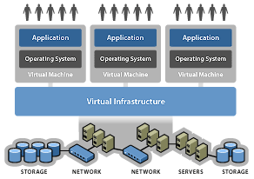
Virtual infrastructure
De-couple software environment from hardware infrastructure
Use virtual networking to aggregate virtual servers and storage in resource groups
Allocate resource groups to application/processes/functions
No need to trunk

Slide 16
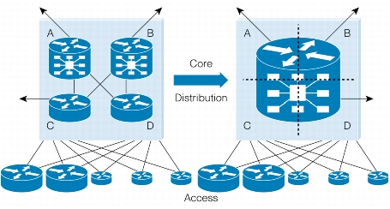
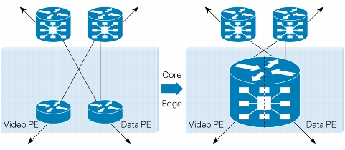
Network Virtualization
Objectives
  “Vertical” consolidation
    do all at layer 2
  “Horizontal” consolidation
    do all (data, voice, video) on the same network.
Tools
  (Complex and sophisticated) virtual appliances over (simple) commodity hardware

Slide 17
Where it is used
Network virtualization is applied to provision, rapidly evolving, resource-intensive environments
  Handle complexity both from a control plane and data plane perspective.
Example: POPs and core network environments
  Requirement: Aggregation point of all customers in a particular geographical region
    Many routing adjacencies
    full Internet routes to be exchanged among routing peers
    High bandwidth demands (greater than 10 Gbps).
  Answer: Use a simple physical infrastructure "on premises”, with rack space and power, and create the environment on top of it

Slide 18
Evolution of Tools
Hardware-Isolated Virtual Routers (HVR) have hardware-based resource isolation between routing entities
Software-Isolated Virtual Routers (SVR) rely on software-based resource isolation between routing entities.
  Problem: contention of resources.
  Solution: overprovision resources on all SVRs so that no individual SVR is likely to affect the others.

Slide 19
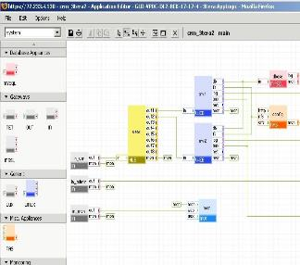



Cooking up a Virtual Environment
Central notions:
RECIPE
Configuration information (e.g. in XML) defining an entire stack (OS/storage/application) to be launched on top of a virtualization infrastructure
COOKBOOK
A set of ready-to-cook recipes
KITCHEN
The environment where you do your cooking
Includes:
Stove
Where recipes are defined/created/tested
Storeroom
Where recipes and ingredientsare kept/shared

Slide 20



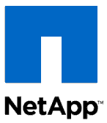
From Virtualization to Multi-tenancy
Traditional
Data Centers
Secure Multi-tenancy
Architecture
HR Apps
BU Apps
Core Apps
VMware
VMware
VMware
HR
BU
APP
HR
BU
APP

Slide 21

Sample Architecture
Compute
VMware vShield Manager
VMware vCenter
NetApp SnapManager
NetApp SANscreen
Compute
VMware vShield
VMware vSphere
Cisco Unified
Computing System
Network
Cisco Nexus 1000V
Cisco Nexus 5000
Cisco Nexus 7000
Cisco MDS
Storage
NetApp FAS
NetApp Multistore
Management
VMware vShield Manager
VMware vCenter
Cisco UCS Manager
Cisco DC Network Manager
NetApp Operations Manager
NetApp Provisioning Manager
NetApp SANscreen & SnapManager
VMware vShield
Cisco Nexus 1000V
VMware vSphere
VMware vSphere
VMware vSphere
Cisco UCS 5100
Blade Server
Cisco UCS Manager
Cisco UCS 6100
Fabric Interconnect
Network
Cisco Nexus 5000
Cisco Data Center Network Manager
Cisco Nexus 7000
SAN
Cisco MDS
Storage
NetApp MultiStore
NetApp FilerView
NetApp Provisioning Manager
NetApp Protection Manager
NetApp Operations Manager
NetApp FAS

Slide 22

A closer look
Compute
vCenter Heartbeat
VMware HA
vMotion/Storage vMotion
UCS Fabric Redundancy
Network
vPC
EtherChannel
N1KV Active/Standby VSM
Link/Device Redundancy
Storage
RAID-DP
NetApp HA
Snapshot
SnapMirror/SnapVault
Core/
Aggregation
Cisco
Nexus 7000
Access
vPC
Cisco
Nexus 5000
Compute
vPC
vPC
Cisco
UCS 6100
Fabric
Interconnect
Nexus 1000V
VMware vCenter
4x10GE
4x10GE
UCS 5100
Blade Server
VMware vSphere
4x10GE
4x10GE
SAN/Storage
Cisco MDS
Ether
Channel
FC
FC
Ether
Channel
FC
FC
NetApp FAS
10GE
10GE

Slide 23
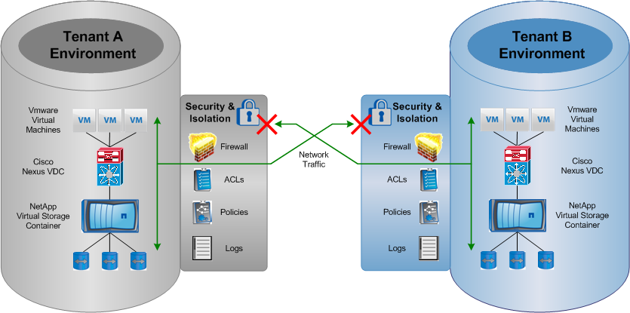
Separating tenants
Compute
  UCS & vSphere RBAC
  VM Security with
  vShield and Nexus 1000V
  UCS Resource Pool
  Separation
Network
  Access Control List
  VLAN Segmentation
  QoS - Classification
Storage
  vFiler units
  IP Spaces
  VLAN Segmentation

Slide 24





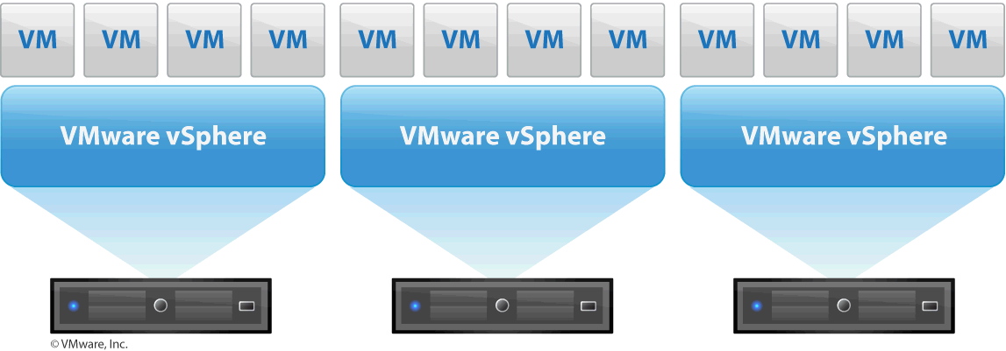

Access control
Cloud Administrator
Define Roles
  Cloud Administrator
  Tenant Administrator
  Tenant User
NetApp MultiStore
vFiler
vFiler
vFiler
vFiler
Tenant A
Tenant B
Tenant C
Tenant D
Role Based Access Control
  UCS Manager
    Server Admin
    Network Admin
    Storage Admin
    Customized Admin
  vCenter
    Privilege Assignment
    User Group Association
    Permission Assignment
Tenant B

Slide 25







Separating tenants (2)
vSphere Resource Pool Design Best Practice
  Dedicated resource pools for infrastructure and tenants
  Separate sub-resource pool for individual tenants
  Combined with RBAC to securely isolate access between tenants
Tenant B Resource Pool
Storage Pool
Interconnect Pool
Tenant A Resource Pool
Tenant B Resource Pool
Tenant B Resource Pool
Tenant Resource Pool
Infrastructure Resource Pool

Slide 26



Separating tenants (3)
Secure multi-tenancy MultiStore
  Secure partition of storage and networking
  Proven technology: 16,000 licenses
  Third-party valid security testing
Customer A
Customer B
Customer C
Data
Data
Data
Data
Data
Data
Data
Data
Data
Virtual Storage Partition
Virtual Storage Partition
Virtual Storage Partition

Slide 27
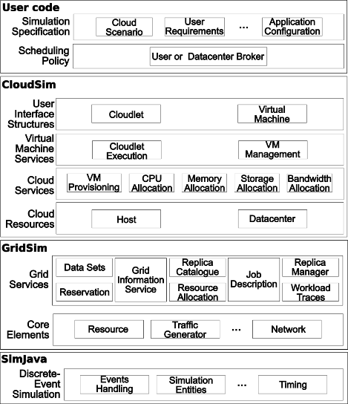
The CloudSim Toolkit http://www.cloudbus.org/cloudsim/

Slide 28
What is Virtualized Infrastructure’s Assurance?

Slide 29
First of all, SLA….

Slide 30
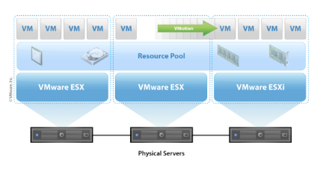




Managing SLA
Compute
Expandable Reservation
Dynamic Resource Scheduler
UCS QoS System Classes for Resource Reservation and Limit
Network
QoS - Classification
QoS - Queuing
QoS - Bandwidth control
QoS - Rate Limiting
Storage
FlexShare
Storage Reservations
Thin Provisioning
2 GE
4 GE
Gold
CoS
Platinum
CoS
Med Priority
High Priority

Slide 31
Network Service SLA
Traffic Types
Service-Class
CoS & UCS Class
QoS – Classification
  Classification Capability
  Identify Traffic Types
  Classify at Source of
  Origin
QoS – Queuing
  Packet Delivery Schedule
QoS - Bandwidth Control
QoS – Rate Limiting
Control &
Management
NFS Data Store/N1KV
CoS 5 Platinum
Network Management
CoS 6 Gold
vMotion
CoS 4, Silver
Front End Traffic
Transactional
CoS 5, Platinum
Bulk Data
CoS 6, Gold
CoS 4, Silver
Back End Traffic
Application
Storage IO
CoS 2, Bronze
CoS 5, Platinum
App to App
(multi-tier)
CoS 6, Gold
CoS 4, Silver
Best Effort
Best Effort
Scavenger
CoS 0 & 1, Best Effort

Slide 32
Computing Service SLA
Built-in vCenter Resource Pool settings
Resource guarantee for infrastructure and tenant services
Resource pool settings to be set based on tenant SLA
For example, VMware DRS provides automated load distribution across all blades in the ESX Cluster
Resource Pool Settings | Platinum Tenant | Gold Tenant | Silver Tenant
Reservation | Reserved | Reserved | No reservation
Limits | Unlimited | Limited | Limited
Shares | High | Medium | Low
Expandable Reservation | Enabled | Disabled | Disabled

Slide 33




Storage SLA
Clients
Set high priority for database (or Platinum) SLA
Multiple levels of prioritization available
Isolates tenant performance
.
Switch
Database Server
Platinum SLA
Gold SLA
High
Priority
Medium
Priority
FAS Storage System Running Data ONTAP® with FlexShare™

Slide 34
Case studies

Slide 35
Aneka: .NET-based Cloud Computing
SDK containing APIs for
multiple programming
models and tools
Runtime Environment for managing application
execution management
Suitable for
  Development of Enterprise
  Cloud Applications
  Cloud enabling legacy applications
Portability for Customer Apps:
  Enterprise ↔ Public Clouds
  .NET/Win ↔ Mono/Linux

Slide 36
QoS Negotiation in Aneka
Meta Negotiation Registry
…
3. Matching
DB
DB
Registries
DB
2. Publishing, Querying
1. Publishing
Gridbus Broker
MN Middelware
MN Middelware
Aneka
4. Session Establishment
Amadeus
Workflow
Meta-Negotiation
Meta-Negotiation
Handshaking
Handshaking
Alternate Offers
Negotiation
Strategy
Alternate Offers
Negotiation
Strategy
Local SLA Template
WSDL
Local SLA Template
5. Negotiation
Party 1
API
Party 2
Service Consumer
Service Provider
6. Service Invocation

Slide 37




Aneka: components
public DumbTask: ITask
{
…
public void Execute()
{
……
}
}
Aneka enterprise Cloud
for(int i=0; i<n; i++)
{
…
DumbTask task = new DumbTask();
app.SubmitExecution(task);
}
work units
Executor
Executor
Client
Agent
internet
Executor
work units
Scheduler
Aneka Worker
Service
Aneka Manager
internet
Executor
Client
Agent
Programming / Deployment Model
Aneka User Agent

Slide 38
Aneka & Virtual Resource Pools Integration
XenServer Pool
  Allows resource provisioning over private Cloud infrastructure managed by Xen Server
VMWare Pool
  Allows resource provisioning over private Cloud infrastructure managed by VMWare
Amazon EC2 Pool
  Allows resource provisioning over public Cloud provider : Amazon EC2

Slide 39












Aneka Cloud
Request (5 resources, $0)
Xen Server
- Capacity : 10 VMs
Request (5 resources, $0)
Completed
Aneka
Provision Service
VMWare
- Capacity : 5 VMs
Process (5)
Process (5)
Amazon Clouds
Enterprise Desktops/Servers Cloud
Notes:
39

Slide 40

Aneka+Xen
Start VM (10)
Suspend VM (10)
Request (5 resources, $0)
Xen Server
- Capacity : 10 VMs
Request (20 resources, $0)
Completed
Aneka
Provision (14)
Suspend VM (4)
Join Network(14)
Start VM (4)
Provision Service
Process (14)
VMWare
- Capacity : 5 VMs
Process (5)
Process (6)
Release (14)
Amazon Clouds
Enterprise Desktops/Servers Cloud
Notes:
40

Slide 41
Aneka+Xen+EC2
Start VM (10)
Suspend VM (10)
Request (5 resources, $0)
Xen Server
- Capacity : 10 VMs
Request (30 resources, $5)
Completed ($3.2)
Aneka
Provision (24)
Suspend VM (5)
Join Network(24)
Start VM (5)
Provision Service
Process (24)
VMWare
- Capacity : 5 VMs
Process (5)
Process (6)
Release (24)
Release VM (9)
Start VM (9)
Amazon Clouds
- Cost : 20 cents per instance
Enterprise Desktops/Servers Cloud
Notes:
41

Slide 42
Risk analysis

Slide 43
Related work
Security risks assessment
  QUIRC: Quantitative impact and risk assessment framework
  R_{O} = 1/n Σ_{e=1,…,n}P_{e} ✕ I_{e} (Risk = Likelihood ✕ Impact)
  Security risk assessment (without an explicit cloud focus) :
  CRAC++ [19], COBRA [20], CORAS [21]
Governance, Risk management and Compliance Stack (GRC stack; by Cloud Security Alliance):
  Cloud Controls Matrix: principles and guidelines to assess the overall security of a cloud provider [14]
  Consensus Assessments Initiative Questionnaire (CAIQ [15]): questions designed to help cloud customers and auditors to identify gaps in CCM controls in specific cloud providers
  CloudAudit: common interface and namespace to enable the audit and assessment of the security of cloud services [12]
  Cloud Trust Protocol: protocol for obtaining evidence for cloud operations
  IT audit practices and standards: industry driven (Service Organisation Controls (SOC), ISO27001); labour intensive and static

Slide 44
Certification
Software certification is not new (e.g., Common Criteria model) BUT
  Covers monolithic systems
  Targets humans → certificates not amenable to automated processing, e.g.,
      cannot be used for automated (and possibly on-fly) system component selection/replacement, verification etc)
  Cannot cope with changes to system structures and the operational environment
Recent work on SOA certification (Assert4SOA project [22]) covers (i)-(iii) in some circumstances
  Schema for specifying machine processable service certificates
  Ontologies for annotating certificates
  Certificates aware software service discovery and SaaS level composition [23]

Slide 45
The idea
Development of an integrated framework of models, processes, and tools supporting the dynamic certification of assurance related to security/privacy/dependability properties.
Suitable for infrastructure (IaaS), platform (PaaS) and software application services (SaaS) in clouds.
The framework will use multiple types of assurance evidence including
testing (evidence),
monitoring (evidence) and
trusted computing proofs,
and models for
hybrid,
incremental and
multi-layer security certification.

Slide 46
Objectives
Objective 1: Development of advanced service certification models based on service testing data, service monitoring data, and trusted computing platforms proofs and supporting hybrid, incremental and multi-layer certification.
Objective 2: Development of an interoperable certification infrastructure for generating, maintaining and using certificates according to the different types of certification models.
Objective 3: Delivery of an interoperable certification solution and contribution to standards.

Slide 47
Objective 1
Objective 1: Development of advanced service certification models based on service testing data, service monitoring data, and trusted computing platforms proofs and supporting hybrid, incremental and multi-layer certification for clouds.
Objective 2: Development of an interoperable certification infrastructure for generating, maintaining and using certificates according to the different types of certification models.
Objective 3: Delivery of an interoperable certification solution and contribution to standards.

Slide 48
OBJ 1: hybrid certification
What?
  Certification of assurance based on a combination of different types of evidence
  testing data
  monitoring data
  trusted computing proofs for the hardware elements of cloud infrastructures
Why?
  Some properties might be certifiable using a combination of evidence types

Slide 49
OBJ 1: hybrid certification – examples
  The availability of a service S may be certified by a certificate that is based on test data for the service as well as a TC proof for the configuration of the hosting cloud infrastructure (to ensure that the infrastructure where the service is deployed is the same as that for which test data were obtained)
  Hybrid certificate for software service availability based on test data and continuous monitoring in real operating conditions
Cert
Test Data
TC Proof
Cert
Test Data
Monitor Data

Slide 50
OBJ 1: multi-layer certification
What?
  Certification based on a combination of certificates of inter-dependent services (as opposed to simply “evidence”) at different layers of the cloud stack
Why?
  “Recipes” security properties are affected by such dependencies
  Inability to obtain the direct evidence required for property assessment) require making assessments on the basis of certificates rather than direct evidence

Slide 51
OBJ 1: multi-layer certification – examples
  The integrity of data-at-rest of a software service S₁ using a cloud storage service S₂ could under certain circumstances be certified on the basis of a certificate regarding the correct implementation of a “proof-of-storage” protocol by S₂
  The availability of a messaging service in a cloud federation may be certified on the basis of certificates regarding DoS-resilience of the hosting node(s) in the federation
  A data-in-process integrity certificate of a SaaS layer service requires TCP based certificate for hypervisor as the latter can ensure correct monitoring of security conditions of infrastructure services that are necessary for data-in-process integrity, and avoidance of data leaks of relevant monitoring data
SaaS
PaaS
PaaS
IaaS
SaaS
IaaS

Slide 52
OBJ 1: incremental certification
What?
  Ability to cover changes that may affect certified properties of cloud services without having to re-certify properties from scratch
Why?
  Operational conditions within a cloud infrastructure may change
  Cloud services and data may migrate to different cloud infrastructures within a cloud federation
  Constituent services of composite services may be substituted (whether co-tenant or not)

Slide 53
OBJ 1: incremental certification – examples
Re-validation of certificate due to changing operational conditions, e.g.:
  the certificate C for data integrity of a software service requires a certificate C’ for the data isolation scheme operated by the cloud storage service;
  the software service migrates to a different node in a cloud federation →
  C needs to be revalidated by considering whether the new hosting cloud has a certificate equivalent to (or appropriate substitute for) C’
Use continuous monitoring to create new certificates or “strengthen” existing certificates with increased operational evidence, e.g.,
  The certificate of data-isolation for software service in a given infrastructure requires isolation of co-tenant services in the infrastructure; the certificate is continually validated through continuous monitoring of the infrastructure

Slide 54
OBJ 1: Certification models
Purpose:
    To determine the evidence (type and extent) that needs to be considered to be able to certify a security property and how it will be used to assess the property
Address questions of the form
  When two distinct pieces of evidence can be considered equivalent for a given security property?
  If conflicting evidence arises what happens to the certificate?
  Should a certificate be revalidated/revoked when:
    The composition of a service changes
    The deployment configuration of a service changes (e.g., code or data migration to another node in a federation)
    The configuration of an infrastructure changes
  How certificate re-validation should be carried out? for example:
    Could equivalent security properties be considered sufficient?
    Could alternative equivalent pieces of evidence be used?

Slide 55
Some modeling…

Slide 56

Cloud Certification Meta-Model
  Meta-classes: specify shared concepts, elements, and relationships
    Security properties and commitments
    Target of certification (service-unit, resource-groups, resources in CSA document)
    Actors
    Models of certification
    Evidence

Slide 57
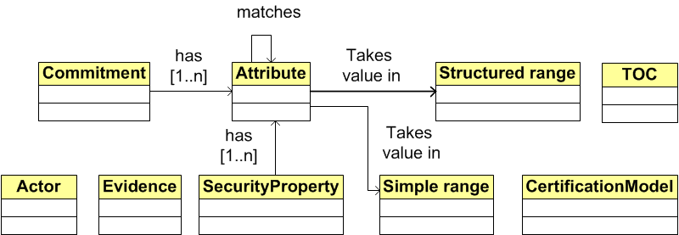
CUMULUS Meta-Model

Slide 58
Security Property: Model
  Security properties (security attributes fully qualified type in the Cloud Security Alliance terminology)
    Express abstract security properties
      E.g., confidentiality, integrity, authenticity
    May have a set of attributes that refine the abstract property (attribute parameter template and measurement parameter in CSA document)
      Refer to security functionalities (e.g., encr-algo=DES)
      Refer to threats (e.g., attack=MIM)
      Refer to contextual information
      (e.g., OS=Linux)

Slide 59
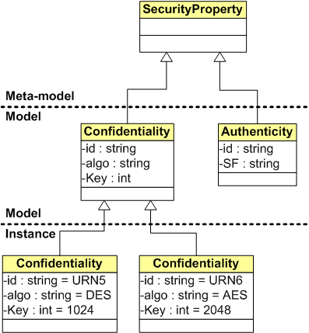
Security Property: Example
  Meta-Class: SecurityProperty
  Class
    Confidentiality
      Att1: id [String]
      Att2: algo [String]
      Att3: key [Int]
    Authenticity
      Att1: id [String]
      Att2: SF [String]
  Instance
    Confidentiality
      id=URN5
      algo=DES
      key=1024
    Confidentiality
      id=URN6
      algo=AES
      key=2048

Slide 60
Target of Certification (TOC): Model
  Target of certification
    Service-unit, resource-groups, resources in CSA document
    Assumptions on the TOC (e.g., HW in EU)
      Possibly part of the security property
    It can be the service under certification (SaaS), the platform deploying services (PaaS), the infrastructure hosting platforms and services (IaaS) or any combination of the above

Slide 61
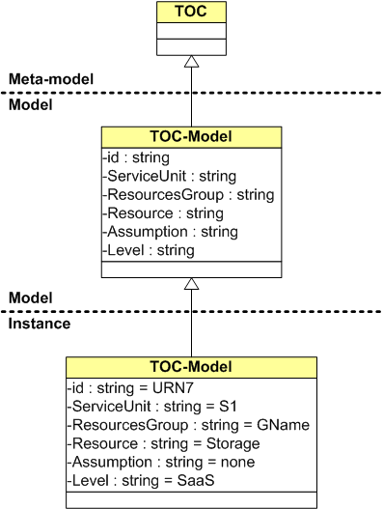
Target of Certification (TOC): Example
  Meta-Class: TOC
  Class
    TOC-Model
      Att1: id [String]
      Att2: ServiceUnit [string]
      Att3: ResourceGroup [string]
      Att4: Resource [string]
      Att5: Assumption [string]
      Att6: Level [string]
  Instance
    TOC-Model
      id=URN7
      ServiceUnit=S1
      ResourceGroup=GName
      Resource=Storage
      Assumption=None
      Level=SaaS

Slide 62
Actors: Model
  “Actor” models
    CUMULUS Clients (searching certified resources)
    Service Providers (providing services/platforms)
    Cloud Providers (providing the infrastructure)
    Certification Authority
    CUMULUS Certification Infrastructure
    Attacker
  Compliance with other cloud actors models (e.g., NIST)

Slide 63
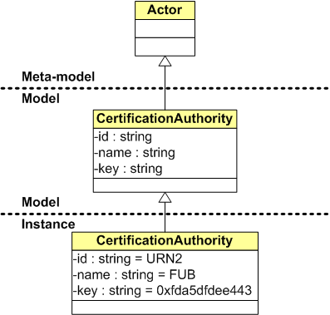
Actors: Example
  Meta-Class: Actor
  Class
    CertificationAuthority
      Att1: id [String]
      Att2: name [String]
      Att3: key [String]
  Instance
    CertificationAuthority
      id=URN2
      name=FUB
      key=0xfda5dfdee443

Slide 64
Evidence: Model
  A set of artifacts supporting a given property for the TOC
    Verification model: a model used to produce the evidence
    Verification mechanism: the mechanism used to produce the evidence
  Verification model and mechanism depend
  on the selected model of certification

Slide 65
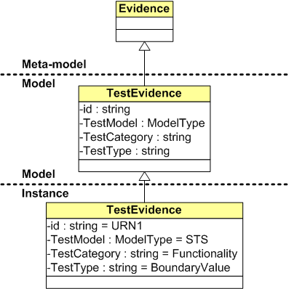
Evidence: Example
  Meta-Class: Evidence
  Class
    TestEvidence
      Att1: id [String]
      Att2: TestModel [ModelType]
      Att3: TestCategory [String]
      Att4: TestType [String]
      …
      Attn
  Instance
    TestEvidence
      id=URN1
      TestModel=STS
      TestCategory=Functionality
      TestType=BoundaryValue

Slide 66
Models of Certification: Model
  Each model of certification includes the elements needed for a given class of certification
    Service/Platform/Infrastructure (S/P/I) model
    Verification type
      Test, Monitoring, TPM, hybrid, incremental
      Offline (Static), Online (Dynamic)
    Evidence (instance of the evidence meta-class)
    Others

Slide 67
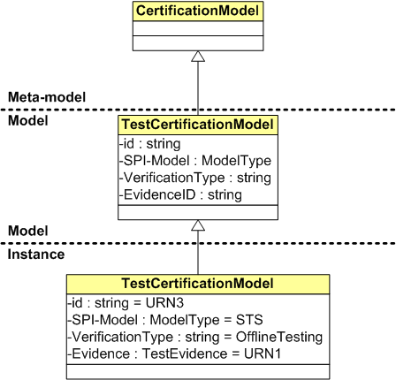
Model of Certification: Example
  Meta-Class: CertificationModel
  Class
    TestCertificationModel
      Att1: id [String]
      Att2: S/P/I-Model [ModelType]
      Att3: VerificationType [String]
      Att4: Evidence [TestEvidence]
      …
  Instance
    TestCertificationModel
      id=URN3
      S/P/I-Model=STS
      VerificationType= OfflineTesting
      Evidence=URN1

Slide 68
Authenticity Example
  Complete example from meta-model to instance
  Consider complex types including formulas

Slide 69
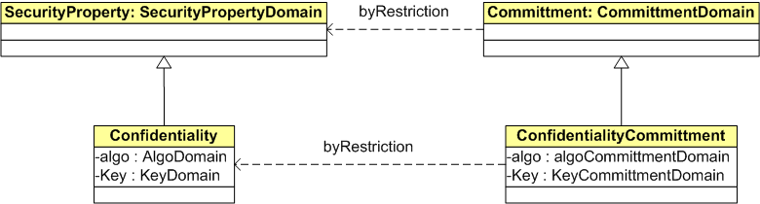
Security SLAs - Security Property
Food for Discussion
  SLA are based on commitments
  At the meta-model level, define commitments by restriction, that is, as a sub-class of security properties
    Security properties defined on security property domain
    Commitments defined on commitment domain
  Commitment domain is a restriction of security property domain

Slide 70
Security SLAs - Security Property
Food for Discussion
The MOST IMPORTANT attribute slot of a property is the one corresponding to the mechanism.
  This is the reason why this attribute is mandated (or at least suggested) by the meta-model to any modeler wishing to set up a model.
The main slots of any property are the name, a subject, a TOC and a mechanism

Slide 71
Value-related properties
The meta-model puts a (soft) constraint on the types that slots will be allowed to have in models
Whatever the modeler comes up with as the mechanism slot, it must take values in a domain which is a RESTRICTION of the generic domain mentioned in the meta model
The slot typing constraints also affect the relation between a property and a commitment on that property: all slots in the commitment must belong to types that are restrictions of the types of the corresponding property slots.
Notes:
The authentication property is interesting because the restriction is non-trivial; a trivial case would be an attribute that in the meta-model is mandated to belong to an ordered domain, and that the modeler specifies as an integer (rightly) or as a string (wrongly!, or at least debatable: is lexicographic order what the modeler wants?)

Slide 72
Performance-related properties
For "performance-related" properties, the "mechanism" slot will not point to a value (be it a simple type or a structured type), but to a typed monitor.
  Example: in the case of some dependability-related properties, say redundancy, asserting the number of replicas as an integer value is just not useful.
The meta-model will say that the slot must belong to a procedural type; thus the modeler will be advised to assign to that slot a specific procedural type, e.g. the endpoint of a monitor that returns an integer, plus an expected return value of that endpoint (say, 3).
In an availability SLA, a commitment on redundancy will be a restriction, e.g. an interval over the procedural type domain (say [2-3])

Slide 73
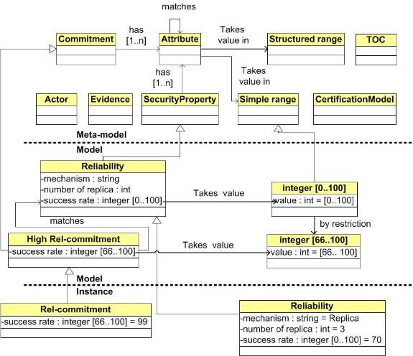
Reliability Example

Slide 74
Objective 2
Objective 1: Development of advanced cloud service certification models based on service testing data, service monitoring data, and trusted computing platforms proofs and supporting hybrid, incremental and multi-layer certification.
Objective 2: Development of an interoperable certification infrastructure for generating, maintaining and using certificates according to the different types of certification models.
Objective 3: Delivery of an interoperable certification solution and contribution to standards.

Slide 75
OBJ 2: CUMULUS Infrastructure
Cloud Trust Protocol
Cloud 1
Cloud
Monitor
Cloud N
External
Certificate
Registries
TCP
Cloud 2
Cloud
Monitor
Cloud
Monitor
TCP

Slide 76
OBJ 2: CUMULUS Assurance Infrastructure
CUMULUS Aware Service Engineering Tools
Cloud
Service
Provider
CUMULUS Certification Infrastructure
Certification
Models
Multi-layer, hybrid & incremental Certification
Security
Models
Cloud
Service
Customer
Test Based
Certification
Monitoring Based
Certification
Trusted Computing
Based Certification
Certification
Authority
CUMULUS Certification Protocol
Cloud Trust Protocol
Cloud 1
Cloud
Monitor
Cloud N
External
Certificate
Registries
Monitoring
Service
TCP
Cloud 2
Monitoring Service
TestService
Cloud
Monitor
Cloud
Monitor
Cloud
Monitor
TCP

Slide 77
Objectives
Objective 1: Development of advanced cloud service certification models based on service testing data, service monitoring data, and trusted computing platforms proofs and supporting hybrid, incremental and multi-layer certification.
Objective 2: Development of an interoperable certification infrastructure for generating, maintaining and using certificates according to the different types of the certification models developed in CUMULUS..
Objective 3: Delivery of an interoperable certification solution and contribution to standards.

Slide 78
OBJ 3: interoperability & standards
Interoperability with
  emerging standards (e.g., GRC stack, STAR Registry) for cloud audit
  reference cloud architectures (e.g., Nebula, CSA’s reference architecture)
Contribution to standards, e.g.:
  OCF (CSA; ongoing)
  ISO 27017 (Cloud controls; ongoing)
  ISO 27018 (Privacy in public clouds; ongoing)
Key challenge/opportunity
  Most of these standards are under development (e.g., OCF, ISO27017)
CUMULUS framework
contributes
underpin
underpin
Reference Cloud
Architectures
Cloud Standards

Slide 79
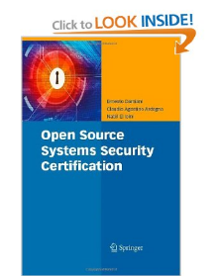
Five readings:
Ernesto Damiani, Claudio Ardagna, Nabil El-Ioini “Open Source Systems Security Certification”, Springer 2009
Jean Christophe Pazzaglia, et al., Advanced Security Service cERTificate for SOA: Certified Services go Digital!, Proc. of Information Security Solutions for Europe, 2011
Marco Anisetti, Claudio Ardagna, Ernesto Damiani: A Low-Cost Security Certification Scheme for Evolving Services. ICWS 2012: 122-129
Marco Anisetti, Claudio Ardagna, Ernesto Damiani, Fulvio Frati, Hausi A. Müller, Atousa Pahlevan: Web Service Assurance: The Notion and the Issues. Future Internet 4(1): 92-109 (2012)
Marco Anisetti, Claudio Ardagna, Ernesto Damiani, F. Saonara, A Test-based Security Certification Scheme for Web Services ACM Trans. On the Web 12-0040, to appear

Slide 80
Other References
[1] J. Heiser and M. Nicolett, Assessing the Security Risks of Cloud Computing, Gartner Report G00157782, June 2008
[2] D. Catteddu and G. Hogben, “Cloud Computing: Benefits, Risks and Recommendations for Information Security.”, European Network and Information Security Agency (ENISA), 2009
[3] L. Kaufman. Data Security in the World of Cloud Computing. IEEE Security and Privacy 7, 4: 61- 64, July 2009.
[4] R. Austin, et al., “Domain 5: Information Lifecycle Management.”, In Security Guidance for Critical Areas of Focus in Cloud Computing V2.1, CSA Cloud Security Alliance, December 2009.
[5] T. Forsheit, et al., “Domain 3: Legal and Electronic Discovery.”, In Security Guidance for Critical Areas of Focus in Cloud Computing V2.1, CSA Cloud Security Alliance, December 2009.
[6] A. Haeberlen. “A case for the accountable cloud.”, SIGOPS Oper. Syst. Rev. 44(2): 52-57, April 2010.
[7] M. Jensen, et al., On Technical Security Issues in Cloud Computing. In Proceedings of the 2009 IEEE International Conference on Cloud Computing (CLOUD '09). IEEE Computer Society, Washington, DC, USA, 109-116., 2009
[8] T. Ristenpart, et al., Hey, you, get off of my cloud: exploring information leakage in third-party compute clouds. In Proceedings of the 16th ACM conference on Computer and communications security. ACM, USA, 199-212. 2009
[9] Y. Chen, V. Paxson, R. Katz, What’s new about cloud security?, Technical Report No. UCB/EECS-2010-5, University of California at Berkeley, 2010
[10] Song, Z., Molina, J., Lee, S., Lee, H., Kotani, S., Masuoka, R. “Trustcube: An infrastructure that builds trust in client”. In: Future of Trust in Computing, Proceedings of the First International Conference, 2009
[11] Okuhara, M., Shiozaki, T., Suzuki, T., Security Architectures for Cloud Computing, Fujitsu scientific and technical journal, 46 (4): 397-402, 2010.
[12] Cloud Security Alliance, Security Guidance for Critical Areas of Focus in Cloud Computing v2.1, available from: http://www.cloudsecurityalliance.org/guidance/csaguide.v2.1.pdf
[13] NIST, Recommended Security Controls for Federal Information Systems and Organisations, NIST SP 800-53
[14] Cloud Security Alliance, Cloud Controls Matrix, Available from: https://cloudsecurityalliance.org/research/ccm/ (last accessed on 8/1/2012)

Slide 81
Other References
[15] Cloud Security Alliance, Consensus Assessments Initiative Questionnaire, https://cloudsecurityalliance.org/research/cai/)
[16] ISO/IEC 27001:2005
[17] Saripalli, P. and Walters, B., QUIRC: A Quantitative Impact and Risk Assessment Framework For Cloud Security, IEEE 3rd International Conference on Cloud Computing, IEEE, pp. 280 – 288, 2010.
[18] Kiran, M., Jiang, M., Armstrong, D. J., Djemame, K., Towards a Service Lifecycle based Methodology for Risk Assessment in Cloud Computing, In Proceedings of the 2011 IEEE Ninth International Conference on Dependable, Autonomic and Secure Computing (DASC '11), pp. 449-456, 2011
[19] Morali, A. and Wieringa, R. J., Risk-Based Confidentiality Requirements Specification for Outsourced IT Systems, Proceedings of the 18th IEEE International Requirements Engineering Conference, pp. 199-208, 2010.
[20] Visintine, V., An Introduction to Information Risk Assessment, GSEC Practical, Global Information Assurance Certification Paper, Version 1.4b, 2003, http://www.giac.org/paper/gsec/3156/introduction-information-risk-assessment/105258
[21] Lund, M.S., Solhaug, B., Stolen, K., Model-Driven Risk Analysis -The CORAS Approach. Springer,2011.
[22] J.C. Pazzaglia, et al., Advanced Security Service cERTificate for SOA: Certified Services go Digital!, Proc. of Information Security Solutions for Europe, 2011
[23] Pino L., Spanoudakis G.: Finding Secure Compositions of Software Services: Towards A Pattern Based Approach, 5th IFIP Int. Conf. on New Technologies, Mobility and Security (Track on Security), 2012
[24] Spanoudakis G., Damiani E., Mana A.: Certifying Services in Cloud: The Case for a Hybrid, Incremental and Multi-Layer Approach , 14th IEEE Inte. Symp. on High Assurance Systems Engineering, Oct2012

