Slide 1
REST API Security II

Slide 2
Misconfigurations
Security misconfigurations include all the mistakes developers could make within the supporting security configurations of an API.
Include misconfigured headers, misconfigured transit encryption, the use of default accounts, the acceptance of unnecessary HTTP methods, a lack of input sanitization, and verbose error messaging.
When a service uses a default account and credentials and the defaults are known, an attacker can use those credentials to assume the role of that account.

Slide 3
Detecting Misconfigurations
if an API provider allows unnecessary HTTP methods, there is an increased risk that the application won’t handle these methods properly or will result in sensitive information disclosure.
You can detect several of these security misconfigurations with web application vulnerability scanners such as Nessus, Qualys, OWASP ZAP, and Nikto.
These scanners will automatically check the web server version information, headers, cookies, transit encryption configuration, and parameters to see if expected security measures are missing.
You can also check for these security misconfigurations manually, if you know what you are looking for, by inspecting the headers, SSL certificate, cookies, and parameters.

Slide 4
Lack of sanitization
A lack of input sanitization can allow attackers to upload malicious payloads to the server. APIs often play a key role in automating processes
Imagine being able to upload payloads that the server automatically processes into a format that could be remotely executed
For example, if an upload endpoint is used to pass uploaded files to a web directory, it could allow the upload of a script. Navigating to the URL where the file is located could launch the script, resulting in direct shell access to the web server.
Need to fuzz API inputs to discover vulnerabilities such as security misconfigurations

Slide 5
Metrics collection
As we have seen, API providers use headers to provide the consumer with instructions for handling the response and security requirements. Misconfigured headers can result in sensitive information disclosure, downgrade attacks, and cross-site scripting attacks.
Many API providers will use additional services alongside their API to enhance API-related metrics or to improve security.

Slide 6
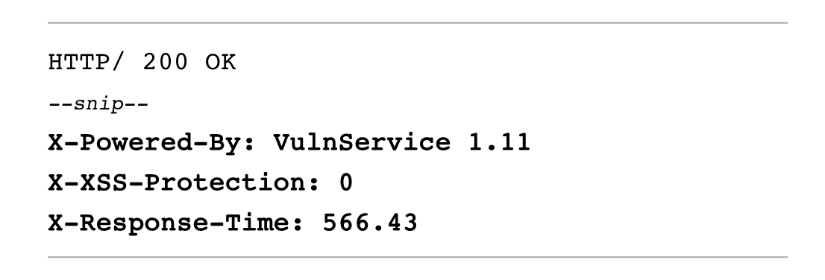
Protection Headers
X-XSS-Protection is exactly what it looks like: a header meant to prevent cross-site scripting (XSS) attacks.
XSS is a common type of injection vulnerability where an attacker can insert scripts into a web page and trick end users into clicking malicious links.
The X-Response-Time header is middleware that provides usage metrics. In the previous example, its value represents 566.43 milliseconds.

Slide 7
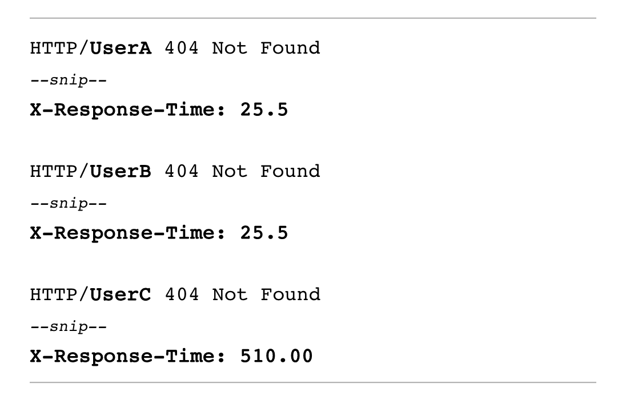
Response time analysis
If the X-Response-Time header has a consistent response time for nonexistent records, but increases its value for others, we can conclude that those records exist regardless of the service response

Slide 8
Injection flaws
Injection flaws exist when a request is passed to the API’s supporting infrastructure and the API provider doesn’t filter the input to remove unwanted characters (a process known as input sanitization).
As a result, the infrastructure might treat data from the request as code and run it. When this sort of flaw is present, the attacker can conduct injection attacks such as SQL injection, NoSQL injection, and system command injection.

Slide 9
Clues of injection flaws
In each of these injection attacks, the API delivers your unsanitized payload directly to the operating system running the application or its database.
As a result, if you send a payload containing SQL commands to a vulnerable API that uses a SQL database, the API will pass the commands to the database
Verbose error messaging, HTTP response codes, and unexpected API behavior can all be clues of an injection flaw.

Slide 10
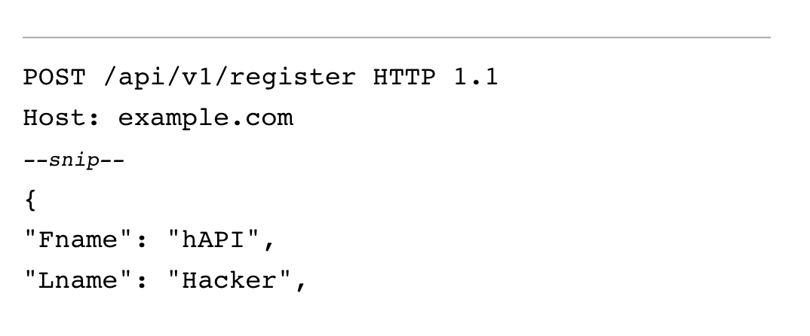
Example
Say, for example, you were to send OR 1=0-- as an address in an account registration process.
The API may pass that payload directly to the backend SQL database, where the OR 1=0 statement would fail (because 1 does not equal 0), causing some SQL error

Slide 11
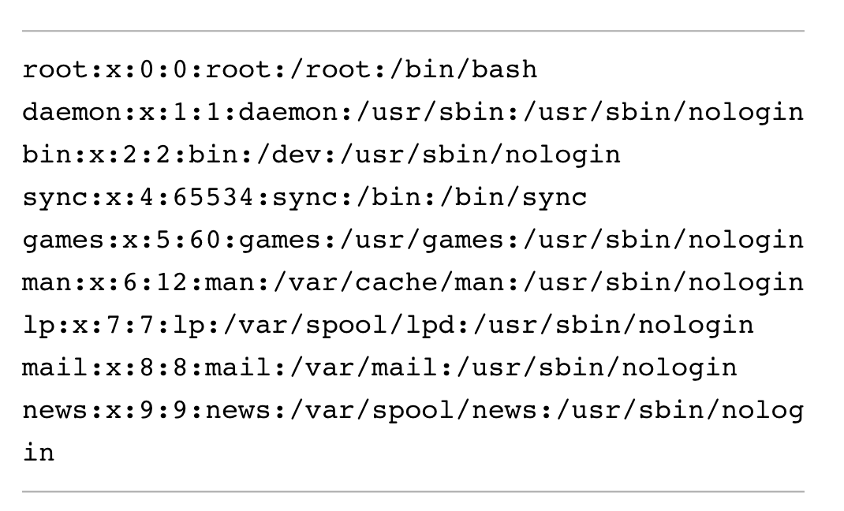
Example II
In this example, a code injection attack uses an API GET request to take advantage of a weak query parameter.
The weak query parameter passes any data in the query portion of the request directly to the underlying system, without sanitizing it first

Slide 12
Finding injection attacks
Finding injection flaws requires diligently testing API endpoints, paying attention to how the API responds, and then crafting requests that attempt to manipulate the backend systems.
Like directory traversal attacks, injection attacks have been around for decades, so there are many standard security controls to protect API providers from them.

Slide 13
Improper asset management
Improper assets management takes place when an organization exposes REST APIs that are either retired or still in development.
As with any software, old API versions are more likely to contain vulnerabilities because they are no longer being patched and upgraded.
Improper assets management can lead to other vulnerabilities, such as excessive data exposure, information disclosure, mass assignment, improper rate limiting, and API injection.
For attackers, discovering an improper assets management vulnerability is only the first step toward further exploitation of an API.

Slide 14
The hacker perspective
You can discover improper assets management by paying close attention to outdated API documentation, changelogs, and version history on repositories
For example, if an organization’s API documentation has not been updated along with the API’s endpoints, it could contain references to portions of the API that are no longer supported.
Organizations often include versioning information in their endpoint namessuch as /v1/, /v2/, /v3/, and so on.
APIs still in development often use paths such as /alpha/, /beta/, /test/, /uat/, and /demo/.
If you know that an API is now using apiv3.org/admin but part of the API documentation refers to apiv1.org/admin, you could try testing different endpoints to see if apiv1 or apiv2 is still active.

Slide 15
Business logic flaws
Business logic vulnerabilities (also known as business logic flaws, or BLFs) are intended features of an application that attackers can use maliciously.
For example, if an API has an upload feature that doesn’t validate encoded payloads, a user could upload any file as long as it was encoded.
This would allow end users to upload and execute arbitrary code, including malicious payloads.

Slide 16
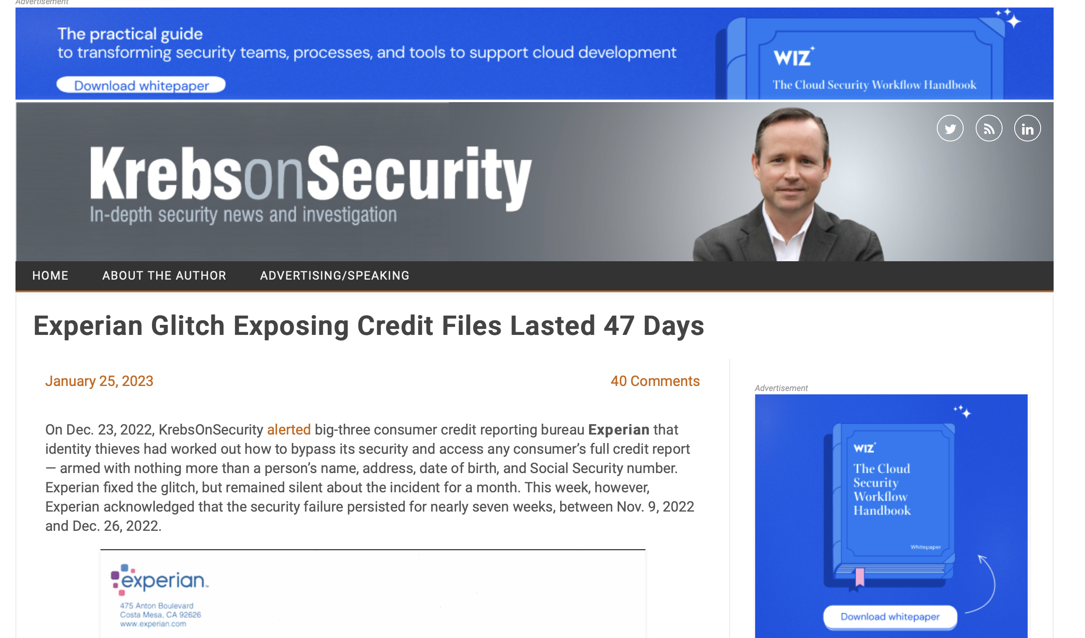
Example: the Experian leak
The Experian partner API leak is a great example of an API trust failure.
A certain Experian partner was authorized to use Experian’s API to perform credit checks, but the partner added the API’s credit check functionality to their web application and inadvertently exposed all partner-level requests to users.
A request could be intercepted when using the partner’s web application, and if it included a name and address, the Experian API would respond with the individual’s credit score and credit risk factors.
One of the leading causes of this business logic vulnerability was that Experian trusted the partner not to expose the API.

Slide 17
The hacker perspective
Hackers can search API documentation for telltale signs of business logic vulnerabilities.
Statements like the following should illuminate the lightbulb above their head: “Only use feature X to perform function Y.” “Do not do X with endpoint Y.” “Only admins should perform request X.”
These statements may indicate that the API provider is trusting that you won’t do any of the discouraged actions, as instructed.

Slide 18
Extra browser request editing
Another business logic vulnerability comes about when developers assume that consumers will exclusively use a browser to interact with the web application and won’t capture API requests that take place behind the scenes.
All it takes to exploit this sort of weakness is to intercept requests with a tool like Burp Suite Proxy or Postman and then alter the API request before it is sent to the provider. This could allow you to capture shared API keys or use parameters that could negatively impact the security of the application.
https://app.getpostman.com/join-team?invite_code=dd56d637f87d5502500e2323fdfdc17d

Slide 19
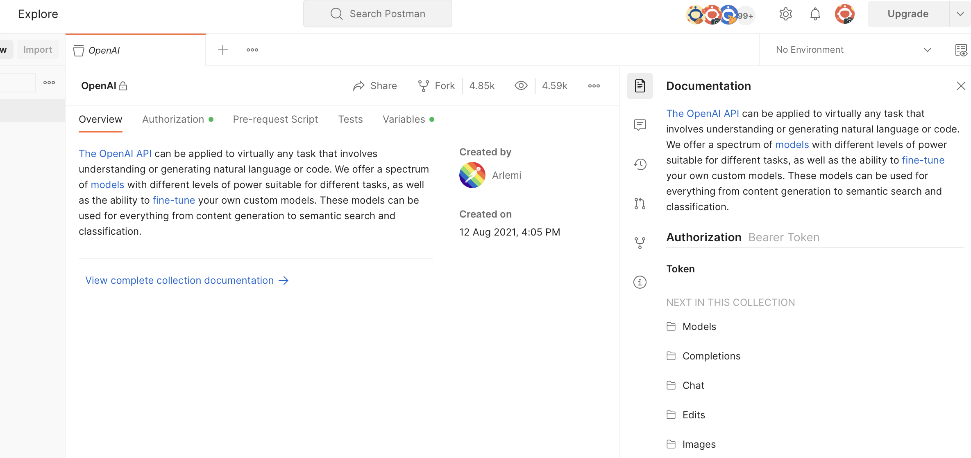
AI-related Example: the OpenAI REST API

Slide 20
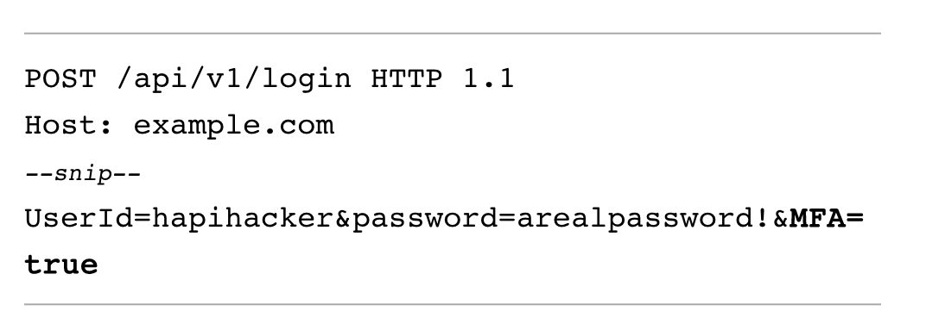
Request editing again
As an example, consider a web application authentication portal that a user would normally employ to authenticate to their account.
Say the web application issued the API request on the side
There is a chance that we could bypass multifactor authentication by simply altering the parameter MFA to false.
Hackers study the application’s business logic with an adversarial mindset, and try breaking any assumptions developers have made.

Slide 21
Summary
We covered some common REST API vulnerabilities.
It is important to become familiar with these vulnerabilities so that you can easily recognize them, take advantage of them during an engagement, and report them back to the organization to prevent the criminals from dragging your client into the headlines.

