Slide 1

ISO
ISO (International Organization for Standardization) is the world's largest developer and publisher of International Standards.
ISO is a network of the national standards institutes of 160 countries, one member per country, with a Central Secretariat in Geneva, Switzerland, that coordinates the system.
ISO is a non-governmental organization that forms a bridge between the public and private sectors. On the one hand, many of its member institutes are part of the governmental structure of their countries, or are mandated by their government. On the other hand, other members have their roots uniquely in the private sector, having been set up by national partnerships of industry associations.
Therefore, ISO enables a consensus to be reached on solutions that meet both the requirements of business and the broader needs of society

Slide 2

ISO 27x
ISO (the International Organization for Standardization) and IEC (the International Electrotechnical Commission) form the specialized system for worldwide standardization.
National bodies that are members of ISO or IEC participate in the development of International Standards through technical committees established by the respective organization to deal with particular fields of technical activity. ISO and IEC technical committees collaborate in fields of mutual interest.
Other international organizations, governmental and non-governmental, in liaison with ISO and IEC, also take part in the work. In the field of information technology, ISO and IEC have established a joint technical committee, ISO/IEC JTC 1.
International Standards are drafted in accordance with the rules given in the ISO/IEC Directives, Part 2.
The main task of the joint technical committee is to prepare International Standards. Draft International Standards adopted by the joint technical committee are circulated to national bodies for voting. Publication as an International Standard requires approval by at least 75 % of the national bodies casting a vote.

Slide 3
JTC-1
ISO 27000 Series is developed by JTC1-SC27
Certification is given for ISO 27001 Only
There are a number of supporting standards and best practices….

Slide 4
ISO 27001
ISO/IEC 27000, Information security management systems — Overview and vocabulary
ISO/IEC 27001:2005, Information security management systems Requirements
ISO/IEC 27002:2005, Code of practice for information security management
ISO/IEC 27003, Information security management system implementation guidance
ISO/IEC 27004, Information security management — Measurement
ISO/IEC 27005:2008, Information security risk management
ISO/IEC 27006:2007, Requirements for bodies providing audit and certification of information security management systems
ISO/IEC 27007, Guidelines for information security management systems auditing
ISO/IEC 27011, Information security management guidelines for telecommunications organizations basedon ISO/IEC 27002

Slide 5
What is ISO 27001 about ?
“….This International Standard has been prepared to provide a model for establishing, implementing, operating, monitoring, reviewing, maintaining and improving an Information Security Management System (ISMS)…..”
“…The design and implementation of an organization’s ISMS is influenced by their needs and objectives, security requirements, the processes employed and the size and structure of the organization.
These and their supporting systems are expected to change over time.
It is expected that an ISMS implementation will be scaled in accordance with the needs of the organization…”
Source: ISO/IEC FDIS 27001:2005(E)

Slide 6
ISO/IEC 27001 family of standards
as of 10.2013
Overview and vocabulary
27000
Organizational economics
27016
Guide 73
Code of practice
27002
27014
Governance
Vocabulary
27005
27001
27003
Implementation guidance
31000
Principles and
guidelines
Risk Management
Requirements
27004
Measurements
31010
27x Extended Range
27009
Applicability
Risk assessment techniques
27001
+
industry vertical
27010
Inter-sector and
Inter organizational
Certification
Conformity Assessment –
Vocabulary and general principals
27011
Telecommunications
17000
27013
27001+20000-1
Requirements for bodies
audit and certification
27015
Financial services
17021
27006
Conformity assessment
- ISMS
27017
Cloud Computing service
19011
27007
Guidelines for ISMS
auditing
27018
Data protection control of
public cloud computing service
Guidelines for
auditing management system
27019
Process control system - TR
27008
Guidance for auditors
on controls - TR
27799
Health

Slide 7
ISO Standard Lifecycle
5 Stages
WD Working draft ( 1-5 )
CD (Committee draft)
DIS (Draft international standard)
FDIS (Final draft International standard)
IS (International standard)

Slide 8
Difference to other Security Standards
PCI DSS Payment Card Industry Data Security Standard
The Payment Card Industry (PCI) Data Security Standard (DSS) was developed to encourage and enhance cardholder data security and facilitate the broad adoption of consistent data security measures globally. PCI DSS provides a baseline of technical and operational requirements designed to protect cardholder data. …
11.4 Use intrusion-detection systems, and/or intrusion-prevention systems to monitor all traffic at the perimeter of the cardholder data environment as well as at critical points inside of the cardholder data environment, and alert personnel to suspected compromises.
Keep all intrusion-detection and prevention engines, baselines, and signatures up-to-date.

Slide 9
ISO 27001
This International Standard specifies the requirements for establishing, implementing, maintaining and continually improving an information security management system within the context of the organization. This International Standard also includes requirements for the assessment and treatment of information security risks tailored to the needs of the organization. The requirements set out in this International Standard are generic and are intended to be applicable to all organizations, regardless of type, size or nature. ….
A.13.1.1
Network controls
Control
Networks shall be managed and controlled to protect information in systems and applications.
Source ISO/IEC 27001: 2013

Slide 10
ISO 27002
13.1.1 Network controls
Control
Networks should be managed and controlled to protect information in systems and applications.
Implementation guidance
Controls should be implemented to ensure the security of information in networks and the protection of connected services from unauthorized access. In particular, the following items should be considered:
a) responsibilities and procedures for the management of networking equipment should be established;
b) operational responsibility for networks should be separated from computer operations where appropriate (see 6.1.5);
c) special controls should be established to safeguard the confidentiality and integrity of data passing over public networks or over wireless networks and to protect the connected systems and applications (see 10 and 13.2 ); special controls may also be required to maintain the availability of the network services and computers connected;
d) appropriate logging and monitoring should be applied to enable recording and detection of actions that may affect, or are relevant to, information security;
e) management activities should be closely co-ordinated both to optimise the service to the organization and to ensure that controls are consistently applied across the information processing infrastructure;
f) systems on the network should be authenticated;
g) systems connection to the network should be restricted.
Other information
Additional information on network security can be found in ISO/IEC 27033 Network Security.

Slide 11
Supporting ISO 27x Standards
ISO 27030 - ISO 27050
27033 Part 1- 6, Network Security
27035 Part 1 – 2 Incident Response
27044 Guide to SIEM

Slide 12
Typical ISO 27001 certification process
Definition of Scope (ISMS)
Gap analysis
Risk assessment
Implementation design
Implementation ( to include awareness training )
Simulation Audit
Audit

Slide 13
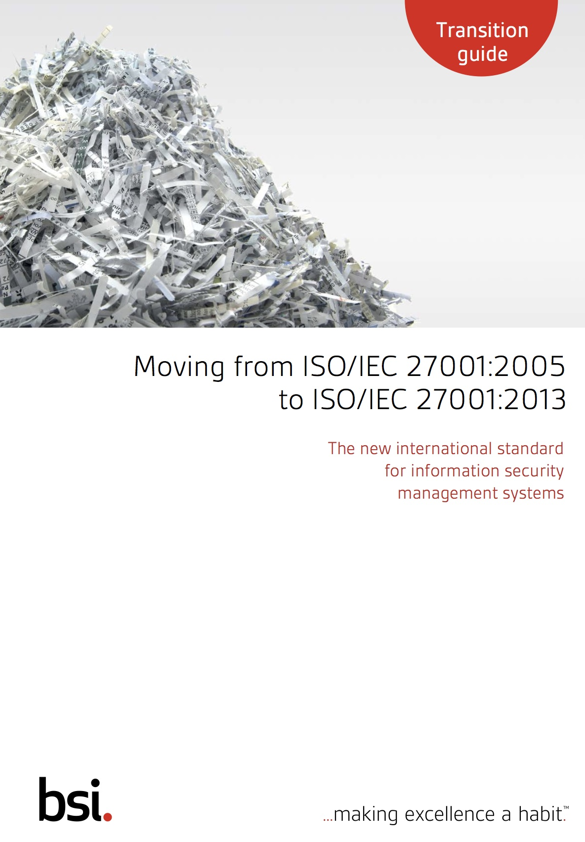
ISO 27001 2005 vs 2013
BSI Transition Guide

Slide 14
ISO 27001 2005 vs 2013
Alignment to other Management Standards
Closer alignment to ISO 31000, Risk Management
+ no duplicate requirements
+ greater freedom of choice for implementation

Slide 15
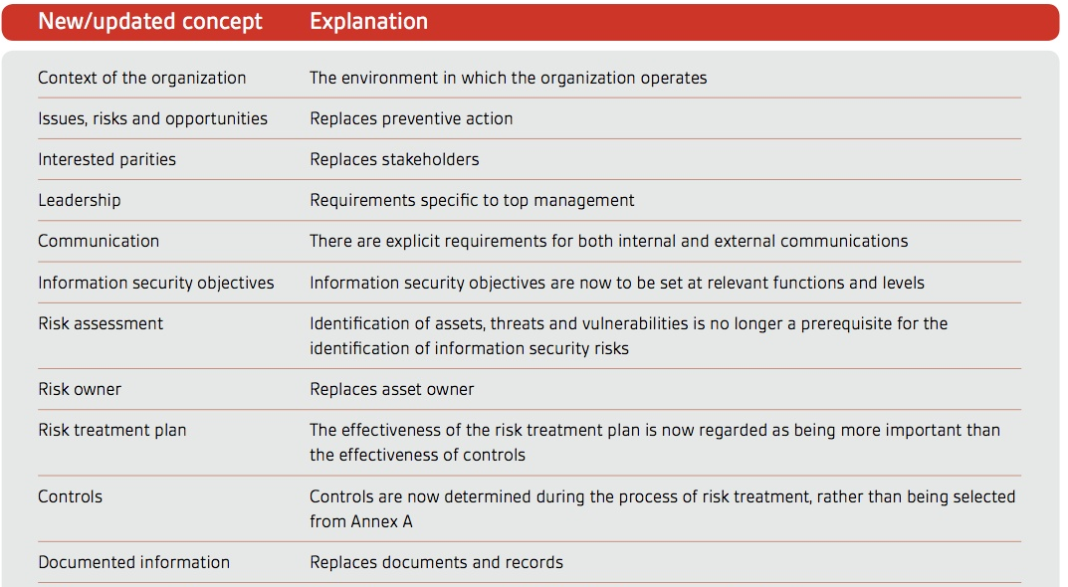
ISO27001 2005 vs. 2013

