Slide 2


Topics
Market update
LTE fundamentals
User experience & Use cases
LTE Advanced

Slide 3
Topics
LTE Market
LTE fundamentals
User experience & Use cases
LTE Advanced

Slide 4
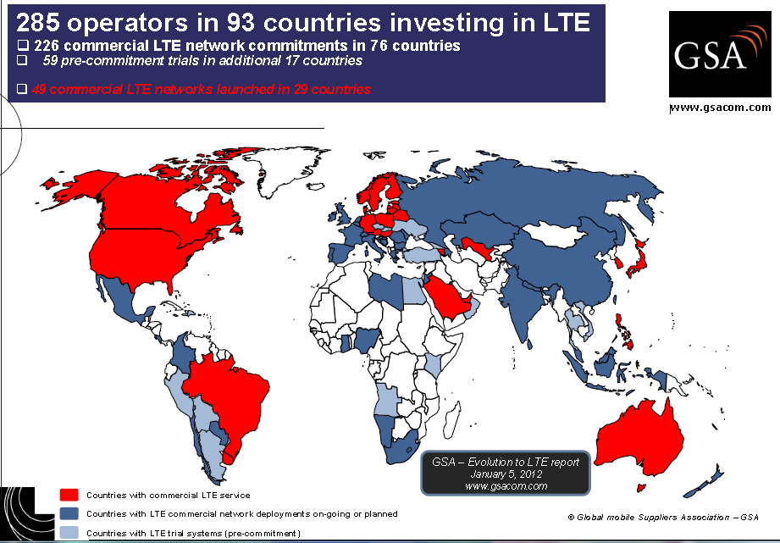
GLOBAL LTE MOMENTUM

Slide 5


THE Mobile broadband Reality
Everything connected
Part of daily life
Mobility
Broadband becoming a necessity
Internet connection

Slide 6
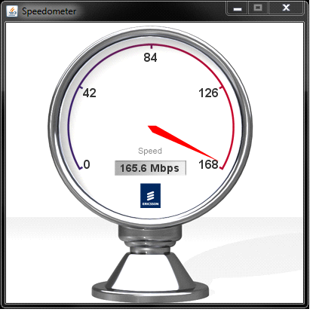
Market trends Global Mobile technology coverage
Current capability in Israel
% Population coverage
World population
100%
336
336
…
~92%
…
~85%
168
~80%
168
Rural
84
HSPA Evolution
84
42
42
28
28
21
Sub-
urban
21
7
7
World record: 168 Mbps
~35%
~35%
Urban
>200 million people covered today
Metro
~3%
lte
0%
World population distribution
2010
2016
2010
2016
2010
2016
GSM/EDGE
3G/HSPA
LTE
Need for speed & low latency = hspa evolved + lte

Slide 7









GLOBAL MBB HSPA SUBSCRIBER GROWTH
L
PC Connected Subs
Smartphone Subs
Tablet Subs
Subs [M]
Subs [M]
Subs [M]
2 x
3 x
4 x
2 x
2 x
3 x
6 x
SMARTPHONE SURPASSING PC IN 2010
STRONG CONTINUED GROWTH EXPECTED
Notes:
Sweat your Assets - Long version (with financials)
Ericsson AB 2010
7

Slide 8
Topics
Market update
LTE fundamentals
User experience & Use cases
LTE Advanced

Slide 9

Lte benefits in a nutshell
Higher Speeds
Low latency
Faster downloads
Simpler networks
More capacity
New services
Differentiation
Greater End-User Experience

Slide 10

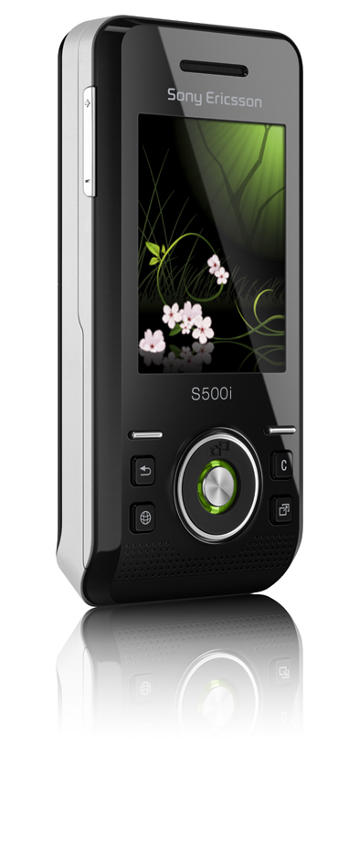

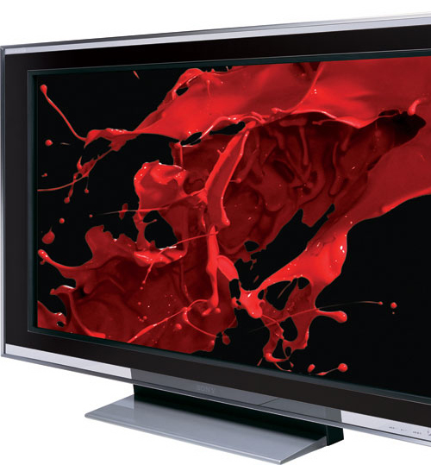
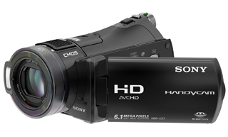

3GPP LTE Performance Targets
High data rates
Downlink: >100 Mbps
Uplink: >50 Mbps
Low delay/latency
User plane RTT: <10 ms
Channel set-up: <100 ms
Cost-effective migration

Slide 11
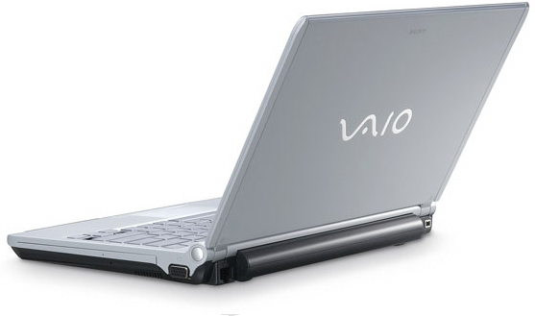

Key LTE radio access features
LTE radio access
Downlink: OFDM
Uplink: SC-FDMA
OFDMA
SC-FDMA
Advanced antenna solutions
Diversity
Beam-forming
Multi-layer transmission (MIMO)
TX
TX
Spectrum flexibility
Flexible bandwidth
New and existing bands
Duplex flexibility: FDD and TDD
1.4 MHz
20 MHz

Slide 12
LTE ”cost efficiency”
Wider pipe advantage
Self Organizing
Networks
All-IP architecture
Economies of Scale
Low total cost of ownership
Notes:
The cost efficiency is also a driving factor for LTE.
You have seen this earlier we have the wider pipe advantage or higher capacity which means that there will be lower cost per delivered bit.
We have the High degree of Self-Configuration, Self-Healing and Self-Optimization SON functionality driving down the OPEX by advanced features such as Auto Integration of RBS and Automated Neighbor Relations.
We have the All IP-based flat network architecture which brings down the number of NW elements and reduces the cost of the NW interface, the architecture is as you know also integrated with 2G/3G networks which brings down the cost of implementing LTE since much of the already existing infrastructure can be reused.
What is maybe new in this picture is the Economies of Scale which is also an important factor.
A strong industry support secures the availability and price preasure on system equipment as well as user equipment.
The Eco-system will be built upon the success and volumes established for HSPA.
A clear example of this are the terminals that Verizon are offering, just a few moths after launch.
The Global harmonization also means that some regions and operators can leverage on the global ecosystem in a way that hasn’t been possible with earlier systems, terminal availability for China for example which for 3G were using TD-SCDMA.
The global harmonization of (spectrum and) standard will ease cross-border coordination and operation (between countries) and increase and ease the Global roaming capabilities

Slide 13
LTE interfaces: Logical view
MME/GW
Evolved
Packet
Core
S1
S1
S1
LTE, or Evolved
UTRAN
X2
X2
eNode B
eNode B
eNode B
Notes:
3GSM RAN PPM in Kista 20083GSM RAN PPM in Kista 2008
168/221 09 - FGB 101 220 Uen Rev B168/221 09 - FGB 101 220 Uen Rev A
13
3GSM RAN PPM in Kista 2008
2008-05-19
168/221 09 - FGB 101 220 Uen Rev A
13
MME: Mobility Management Entity
GW: GateWay
The logical interface from the eNode B to the core network is called S1 and the logical interface between eNode Bs is called X2. The RNC that is used in WCDMA does not exist in LTE. Some of the functionality is moved to the eNode B and other functionality is moved to the core network.

Slide 14

LTE deployment
LTE will initially be deployed in coverage islands
3G HSPA
LTE
LTE
LTE
LTE
LTE
Why LTE?
Add more capacity to a site
Spectrum availability
Greater end user experience
LTE performance in itself will add a differentiator (in the short term)

Slide 15
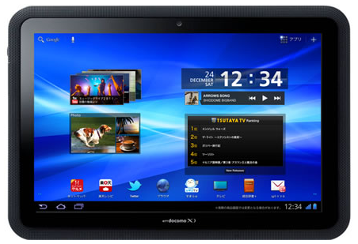
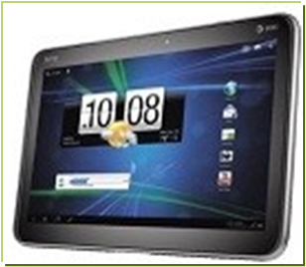


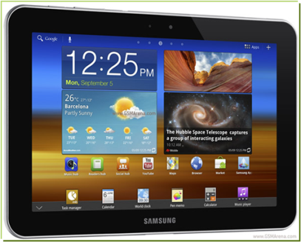
LTE Smartphones / Tablets with WCDMA fallback
 | LTE Capabilities | WCDMA Capabilities | Phones/ Tablets
 | 100 mbps | 14Mbps | 3
 | 100 mbps | 21Mbps | 2
 | 100 mbps | 28Mbps | 0
 | 100 mbps | 42Mbps | 1
 | 50 mbps | 2Mbps | 0
 | 50 mbps | 5.76Mbps | 4
Fujitsu Arrows
Downlink
HTC Jetstream
HTC
Samsung Galaxy II LTE
Uplink
Many markets
Samsung Galaxy Tab
HSDPA fallback for LTE Smartphones and Tablets 14.4 to 42 mbps
Notes:
2011-09-06
15
2011-03-09
15

Slide 16
Commercial LTE Speed evolution
LTE Advanced Radio Systems
Peak rate |  | ~50 Mbps |  | ~150 Mbps |  | ~1000 Mbps
Typical user rate downlink |  | 5-30 Mbps |  | 10-100 Mbps |  | Operator dependent
Typical user rate uplink Bandwidths |  | 1-10 Mbps |  | 5-50 Mbps |  | Operator dependent
LTE brings excellent user and network experience

Slide 17
Topics
Market update
LTE fundamentals
User experience & Use cases
LTE Advanced

Slide 18
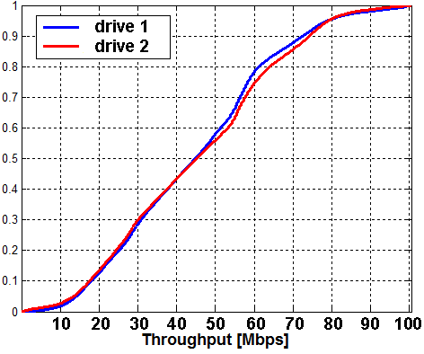
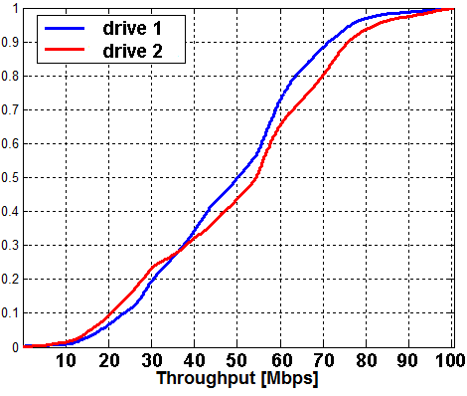
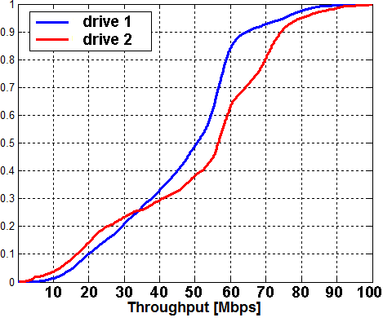
LTE dL throughput Drive test
Example of Cluster drive tests, Stockholm March 2011
Downlink Throughput CDFs
Gärdet
Norrmalm
Östermalm
Peak: 96Mbps
90 percentile: 73 Mbps
Median: 50 Mbps
10 percentile: 19Mbps
Overall average (over the 3 clusters before and after):
Notes:
Ncells
PCI

Slide 19
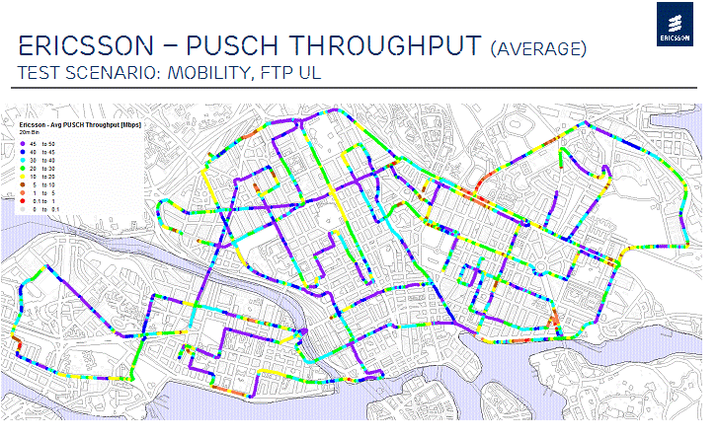
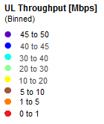
LTE Ul throughput Drive test

Slide 20
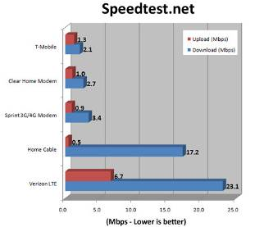

LTE replacing home internet
Verizon LTE good enough to replace your home internet?
http://blog.laptopmag.com/is-4g-good-enough-to-replace-your-home-internet#axzz17VFMTuW1
….download the file nearly twice as fast
What amazed us most here was that, not only did Verizon’s 4G LTE download the file nearly twice as fast as our home internet connection, but it also uploaded at over 10 times the speed.

Slide 21
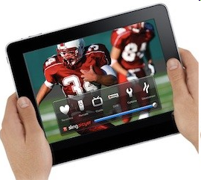



video on demand (streaming)

Slide 22
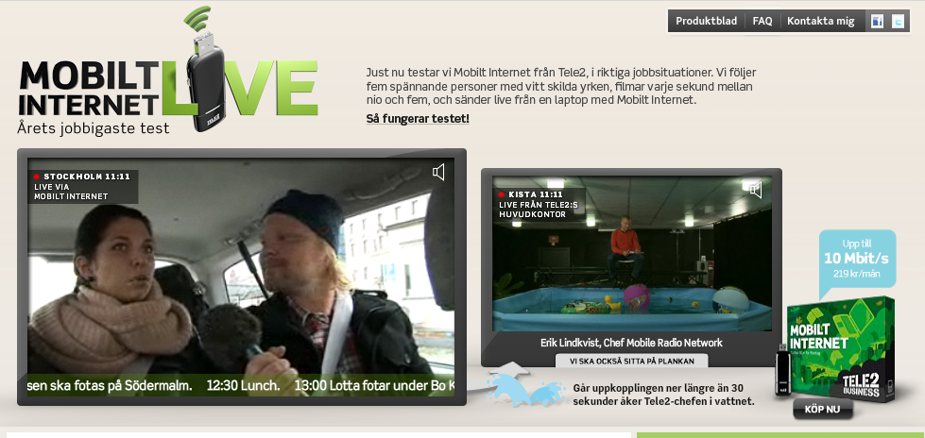

live video reporting
Tele 2 demo the performance of their network with live video reporting
HD Satellite link replaced by an LTE link
LTE

Slide 23

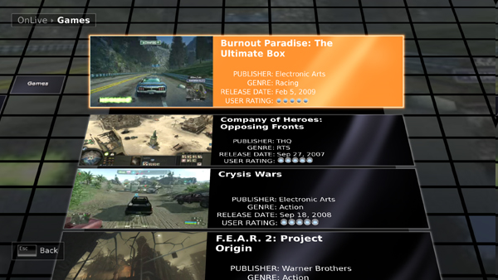
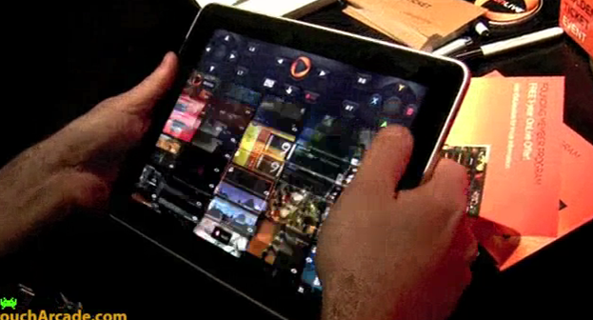
Network hosted gaming
Games are hosted in the network
Visual impacting games with cheap consumer HW
Pure service, no game purchase required
No download required, instant gaming
Source: http://www.onlive.com/service/index

Slide 24
Topics
Market update
LTE fundamentals
User experience & Use cases
LTE Advanced

Slide 25
LTE in the Future – Evolution!
Carrier aggregation
Spectrum aggregation
DL/UL Multi-Antenna transmission
20 MHz
100 MHz total bandwidth
20 MHz
20 MHz
40 MHz total bandwidth
8
4
Peak rates: 3Gbps/1.5Gbps !

Slide 26
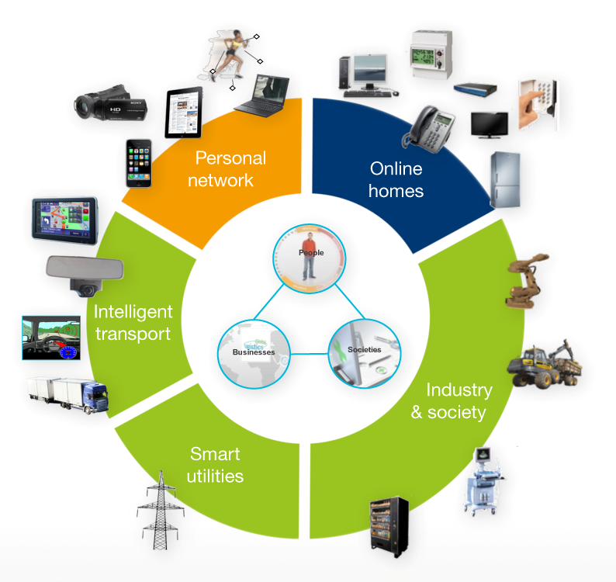
50 billion connected devices vision
Everything that benefits from being connected will be connected
Notes:
RAN PPM 2010 RAN PPM 2010 RAN PPM 2010 CONTINUED LEADERSHIP IN RADIO
Ericsson AB 2010 Ericsson AB 2010 Ericsson AB 2010 Ericsson AB 2010
26
Key messages: Ericsson has vision of 50 billion connected devices by the year 2020
************************************************
Slide owner: 50 billion marketing program
Latest update: December 2009
Best before: December 2010
************************************************
World population will grow to ~7.7 billion by 2020 (according to UN). Growth markets will contribute to the rise of the middle class (growing by 1 billion in 10 years). There is a high variation in the estimated size of the middle class, but it will be brought to the range of 2.2-4.0 billion people worldwide by 2020. The middle class will be surrounded by digital devices. Already in 2014, in the US, it will be around 2.2 billion digital consumer electronic devices, computers, and mobile phones. This is about 7 devices per person, of which 5 will be connected by 2014. And this do not include intelligent cars, home alarms and home appliances, connected terminals in point of sale, automated industrial infrastructures, and not even office equipment.
Important to note are drastic declines in poverty rates, with only about 10% living in poverty 2020, which means that a majority will have mobile phones and possibly other digital devices.
At an incredible pace, connectivity now becomes an essential element of any digital device. It will eventually grow to 10-12 connected devices per person (for middle class), thus bringing the total number of connected devices to 22-50 billion.
Furthermore, we should look at the number of embedded processors to be used in different types of devices. The number of shipped embedded processors have grown from below 2 billion in 2005 (excluding PCs) to 4 billion in 2009, and will continue to grow to 6 billion in 2012. With this pace it will be a cumulative 90 billion processors shipped between 2009 and 2020 (NB: rough estimate). Using the analogy with one of the first personal devices with a processor – the PC – eventually all these devices will be connected.
In 2008, there were 1,698 million electricity meters, 767 million utility or billing water meters, and 395 million gas consumers in the world, according to ABS Energy Research's latest world meter reports on the three sectors (METERING.COM, June 12, 2009). In total, 2.9 billion utility meters.
Today there are approximately 800 million private and 90 million commercial vehicles in use world wide (Bergh Insight, 2009), with most vehicle growth in emerging markets. Some say we will see 2 billion cars in 20 years time (http://e360.yale.edu/content/feature.msp?id=2128). It is projected 150 million vehicles to have on-board telematics systems by 2014.

