Slide 2
Introduction
Wireless devices offering IP connectivity
  PDA, handhelds, digital cellular phones, etc.
Mobile networking
  Computing activities are not disrupted when the user changes the computer’s point of attachment to the Internet
  All the needed reconnection occurs automatically and non-interactively
Technical obstacles
  Internet Protocol (IP) routing scheme
  Security concerns

Slide 3
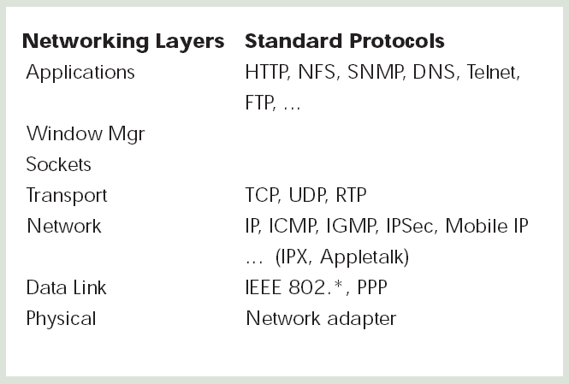
Nomadicity
How mobility will affect the protocol stack

Slide 4
Nomadicity (cont)
Layer 2 (data link layer)
  Collision detection → collision avoidance
  Dynamic range of the signals is very large, so that a transmitting station cannot effectively distinguish incoming weak signals from noise and the effects of its own transmissions
  Cell size (frequency reuse)
Layer 3 (network layer)
  Changing the routing of datagrams destined for the mobile nodes

Slide 5
Nomadicity (cont)
Layer 4 (transport layer)
  Congestion control is based on packet loss
  However, packet loss → congestion?
  Other reasons for packet loss
    Noisy wireless channel, During handoff process
Top layer (application layer)
  Automatic configuration
  Service discovery
  Link awareness → adaptability
  Environment awareness

Slide 6
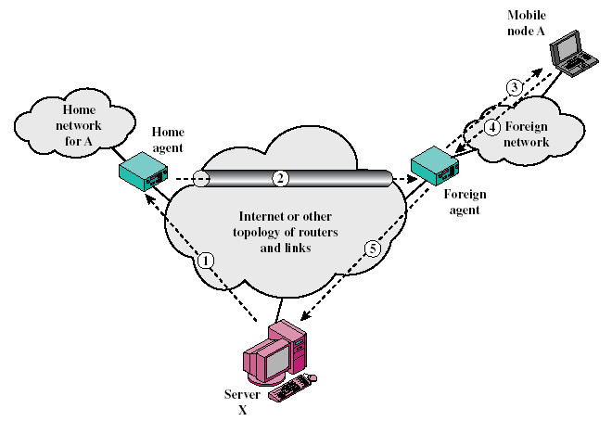
Mobile IP
Tunneling

Slide 7
Mobile IP (cont)
Idea
  New IP address associated with the new point of attachment is required
Two IP addresses for mobile node
  Home address: static
  Care-of address: topologically significant address
Home network, home agent
Foreign network, foreign agent

Slide 8
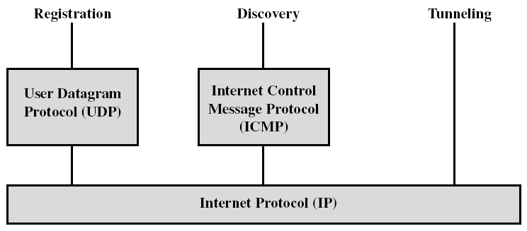
Mobile IP (cont)
Three Mobile IP mechanisms
  1. Discovering the care-of address
  2. Registering the care-of address
  3. Tunneling to the care-of address

Slide 9
Mobile IP (cont)
1. Discovery
  Extension of ICMP Router Advertisement
  Home agents and foreign agents broadcast agent advertisements at regular intervals
  Agent advertisement
    Allows for the detection of mobility agents
    Lists one or more available care-of addresses
    Informs the mobile node about special features
    Mobile node selects its care-of address
    Mobile node checks whether the agent is a home agent or foreign agent
  Mobile node issues an ICMP router solicitation message

Slide 10
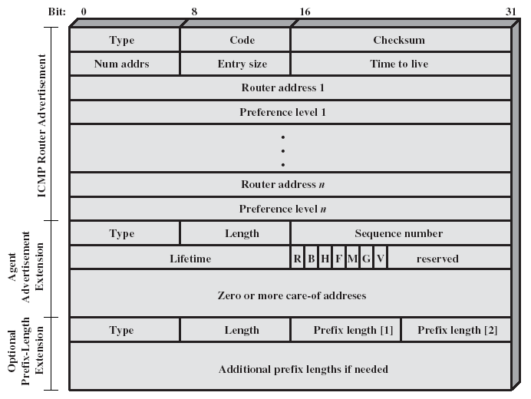
Mobile IP Agent Advertisement Message

Slide 11
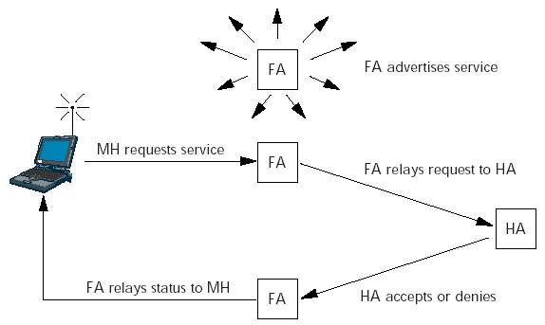
Mobile IP (cont)
2. Registration
  Once a mobile node has a care-of address, its home agent must find out about it

Slide 12
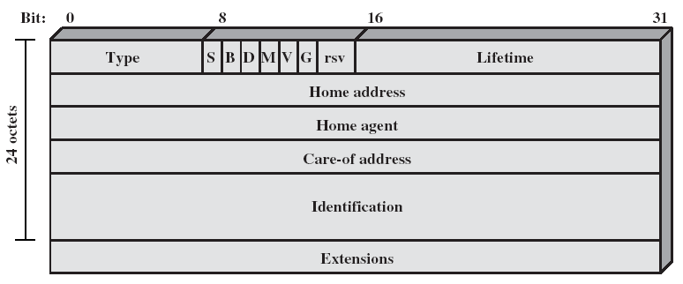
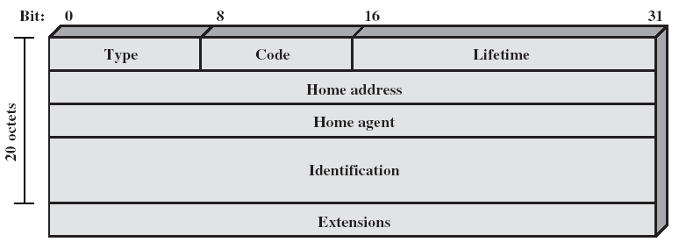
Registration request Message
Registration reply Message

Slide 13
Mobile IP (cont)
Secure the Registration Procedure
  The home agent must be certain registration was originated by the mobile node and not by some malicious node
  Security association: Message Digest 5 (MD5)
  Replay attacks
    A malicious node could record valid registrations for later replay, effectively disrupting the ability of the home agent to tunnel to the current care-of address of the mobile node at that later time
    Identification field that changes with every new registration
    Use of timestamp or random numbers

Slide 14
Mobile IP (cont)
  Foreign agents do not have to authenticate themselves to the mobile node or home agent
  What about a bogus foreign agent?
    Impersonates a real foreign agent by following protocol and offering agent advertisements to the mobile node
    The bogus agent could refuse to forward de-capsulated packets to the mobile node when they were received.
    The result is no worse than if any node were tricked into using the wrong default router, which is possible using unauthenticated router advertisements

Slide 15
Message Digest 5 (MD5)
One-Way Hash Function
  With some good properties, …
  Produces a 128-bit message digest
Example
  Two communicating parties A and B
  A and B share a common secret value S_{AB}
  When A has a message (M) to send to B, it calculate MD_{M} = H(S_{AB} || M)
  It then sends [ M || MD_{M} ] to B
  Because B possesses S_{AB}, it can re-compute H(S_{AB} || M) and verify MD_{M}.

Slide 16
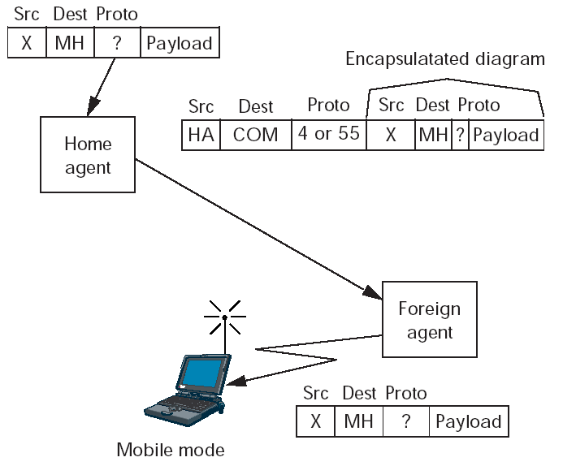
Mobile IP (cont)
3. Tunneling to the care-of address

Slide 17
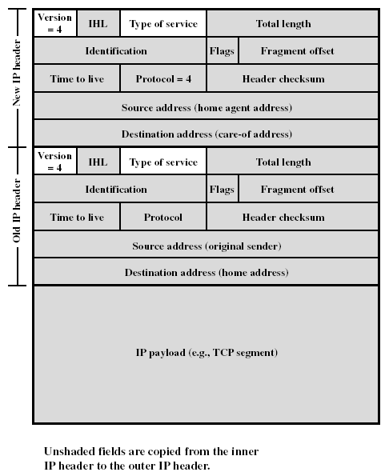
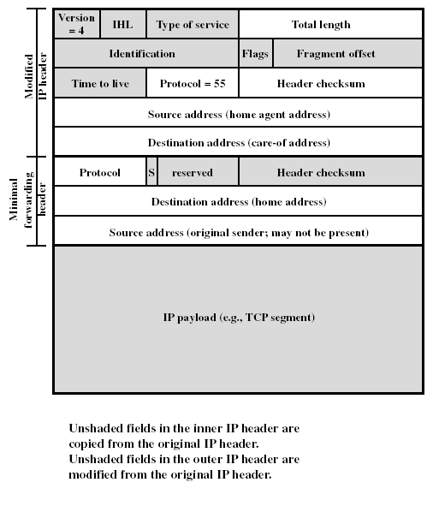
Two Tunneling Methods
IP-within-IP Encapsulation
Minimal Encapsulation

Slide 18
Mobile IPv6
Mobility support in IPv6
  Follows the design for Mobile IPv4, using encapsulation to deliver packets from the home network to the mobile point of attachment
Route Optimization
  Similar to IPv4
  Delivering binding updates directly to correspondent nodes
    (home address, care-of address, registration lifetime)
Security
  IPv6 nodes are expected to implement strong authentication and encryption features

Slide 19
Problems facing Mobile IP
Routing inefficiencies
  Asymmetry in routing: Triangle routing
  Route optimization requires changes in the correspondent nodes that will take a long time to deploy
Security issues
  Firewalls
    Blocks all classes of incoming packets that do not meet specified criteria
    It presents difficulties for mobile nodes wishing to communicate with other nodes within their home enterprise networks

Slide 20
Problems facing Mobile IP (cont)
Security issues
  Ingress filtering
    Many border router discard packets coming from within the enterprise if the packets do not contain a source IP address configured for one of the enterprise’s internal network
    Mobile node would otherwise use their home address as the source IP address of the packets they transmit
    Possible solution: tunneling outgoing packets from the care-of address (Q: where is the target for the tunneled packets from the mobile node? Home agent?)

